Slide 1
Module 5 - Business Data Analytics
Notes:
Title - The learning outcome
Subtitle - Duration

Slide 2
Understand business analytics and develop business intelligence.
(17 hours)
Notes:
Title - The learning outcome
Subtitle - Duration

Slide 3
In this section, we will discuss:
Introduction to business analytics and concepts of business analytics.
Trends in business analytics.
Introduction to Big Data Analytics
Notes:
Mention the parent topics one by one. This particular learning outcome has 4 parent topics.

Slide 4
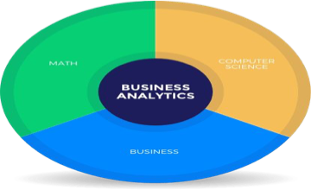
Introduction to business analytics and Concepts of business analytics
What is Business Analytics?
Business analytics (BA) is the iterative, methodical exploration of an organization's data, with an emphasis on statistical analysis.
Business analytics is used by companies that are committed to making data-driven decisions.
Image Source: https://www.businessanalytics.com/
Notes:
Left (White Color space):
Title - Parent Topic
Subtitle - Subtopic 1
Body Text - Description in bullets
Right (Grey Color Space):
Body Text - Relevant image (with source)/code snippet
Put reference links in Speaker Notes
Reference:
https://www.tutorialspoint.com/internet_technologies/internet_overview.htm/

Slide 5
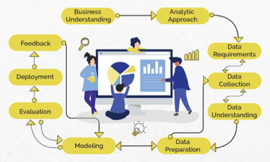
Introduction to business analytics and Concepts of business analytics
What is Business Analytics?(Contd)
Business Analytics is "the study of data through statistical and operations analysis, the formation of predictive models, application of optimization techniques, and the communication of these results to customers, business partners, and college executives”.
Image Source: https://www.proschoolonline.com/certification-business-analytics-course/what-is-b
Notes:
Left (White Color space):
Title - Parent Topic
Subtitle - Subtopic 1
Body Text - Description in bullets
Right (Grey Color Space):
Body Text - Relevant image (with source)/code snippet
Put reference links in Speaker Notes
Reference:
https://www.tutorialspoint.com/internet_technologies/internet_overview.htm/

Slide 6
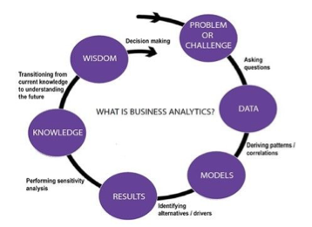
Introduction to business analytics and Concepts of business analytics
What is Business Analytics?(Contd)
It adopts quantitative methods and evidence is required for data to build certain models for businesses and make profitable decisions. Thus, Business Analytics majorly depends on and uses Big Data( large volume of data) .
Image Source: https://www.altudo.co/resources/blogs/business-analytics-vs-marketing-analytics-
Notes:
Left (White Color space):
Title - Parent Topic
Subtitle - Subtopic 1
Body Text - Description in bullets
Right (Grey Color Space):
Body Text - Relevant image (with source)/code snippet
Put reference links in Speaker Notes
Reference:
https://www.tutorialspoint.com/internet_technologies/internet_overview.htm/

Slide 7

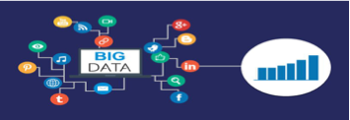
Introduction to business analytics and Concepts of business analytics
Understanding Business Analytics
Business Analytics is the procedure through which information is dissected after studying past performances and issues, to devise a successful plan for the future.
Big Data or large amounts of data is used to derive solutions.
Image Source: https://www.indiaeducation.net/management/streams/business-analytics.html
Notes:
Left (White Color space):
Title - Parent Topic
Subtitle - Subtopic 1
Body Text - Description in bullets
Right (Grey Color Space):
Body Text - Relevant image (with source)/code snippet
Put reference links in Speaker Notes
Reference:
https://www.tutorialspoint.com/internet_technologies/internet_overview.htm/

Slide 8
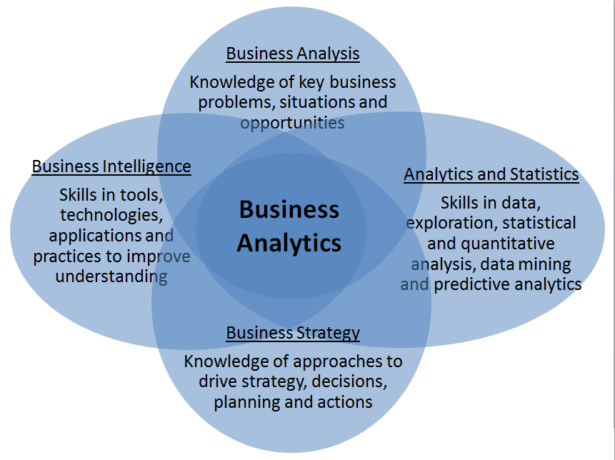
Introduction to business analytics and Concepts of business analytics
Understanding Business Analytics
This method of going about a business or this outlook towards building and sustaining a business is vital to the economy and industries that thrive in the economy.
Image Source: https://www.martinsights.com/?p=1049
Notes:
Left (White Color space):
Title - Parent Topic
Subtitle - Subtopic 1
Body Text - Description in bullets
Right (Grey Color Space):
Body Text - Relevant image (with source)/code snippet
Put reference links in Speaker Notes
Reference:
https://www.tutorialspoint.com/internet_technologies/internet_overview.htm/

Slide 9
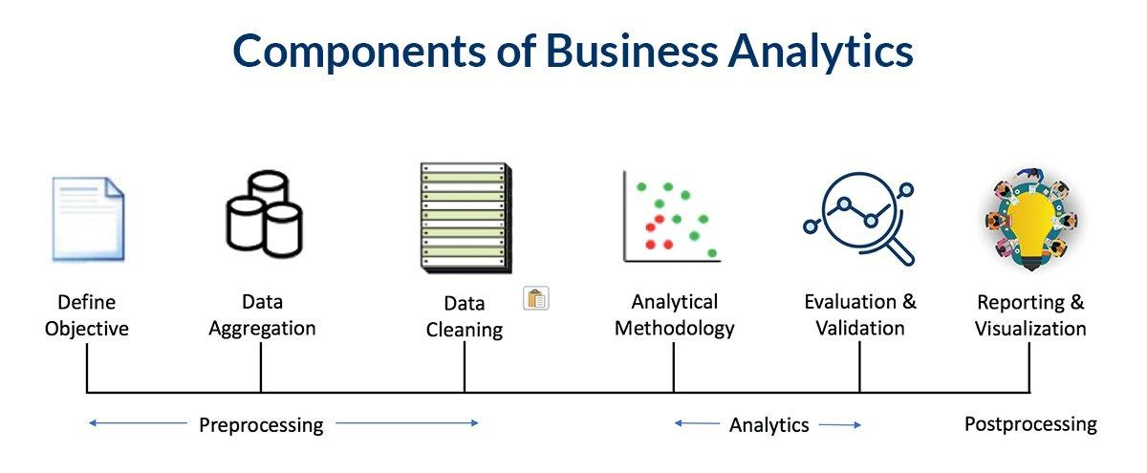
Introduction to business analytics and Concepts of business analytics
Components of Business Analytics
Define Objective
Data Aggregation
Data Cleaning
Analytical Methodology
Evaluation and Validation
Reporting and Data Visualisation
Image Source: https://www.analytixlabs.co.in/blog/what-is-business-analytics
Notes:
Left (White Color space):
Title - Parent Topic
Subtitle - Subtopic 1
Body Text - Description in bullets
Right (Grey Color Space):
Body Text - Relevant image (with source)/code snippet
Put reference links in Speaker Notes
Reference:
https://www.tutorialspoint.com/internet_technologies/internet_overview.htm/

Slide 10
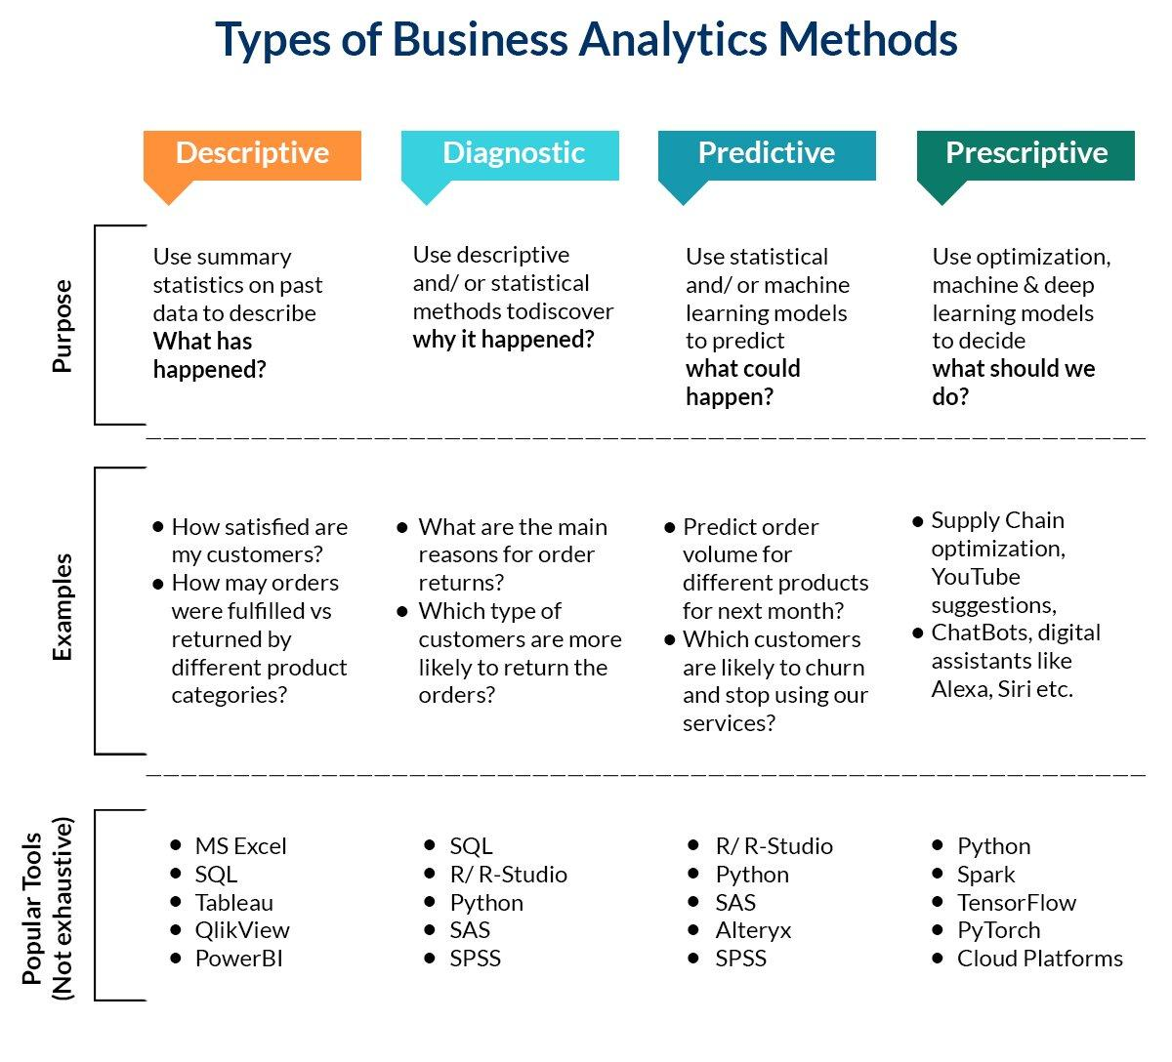
Introduction to business analytics and Concepts of business analytics
Types of Business Analytics Methods
Descriptive Analytics
Diagnostic Analytics
Predictive Analytics
Prescriptive Analytics
Image Source: https://www.analytixlabs.co.in/blog/what-is-business-analytics/
Notes:
Left (White Color space):
Title - Parent Topic
Subtitle - Subtopic 1
Body Text - Description in bullets
Right (Grey Color Space):
Body Text - Relevant image (with source)/code snippet
Put reference links in Speaker Notes
Reference:
https://www.tutorialspoint.com/internet_technologies/internet_overview.htm/

Slide 11
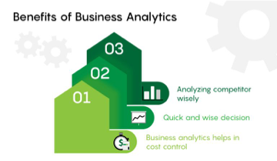
Introduction to business analytics and Concepts of business analytics
Uses and Benefits of Business Analytics
To carry out data mining and exploring new data to find new patterns and relationships.
To carry out statistical and quantitative analysis to provide explanations for certain occurrences.
Image Source: https://www.analytixlabs.co.in/blog/business-analytics-career/
Notes:
Left (White Color space):
Title - Parent Topic
Subtitle - Subtopic 1
Body Text - Description in bullets
Right (Grey Color Space):
Body Text - Relevant image (with source)/code snippet
Put reference links in Speaker Notes
Reference:
https://www.tutorialspoint.com/internet_technologies/internet_overview.htm/

Slide 12
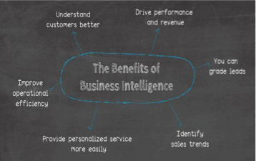
Introduction to business analytics and Concepts of business analytics
Uses and Benefits of Business Analytics
Test previous decisions are taken with the help of A/B testing and multivariate testing.
Deploy predictive modeling to predict future outcomes
Image Source: https://www.datapine.com/blog/benefits-of-business-intelligence-and-business-an
Notes:
Left (White Color space):
Title - Parent Topic
Subtitle - Subtopic 1
Body Text - Description in bullets
Right (Grey Color Space):
Body Text - Relevant image (with source)/code snippet
Put reference links in Speaker Notes
Reference:
https://www.tutorialspoint.com/internet_technologies/internet_overview.htm/

Slide 13
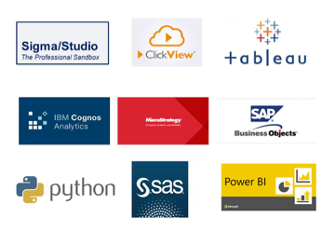
Introduction to business analytics and Concepts of business analytics
Business Analytics Tools
SQL
Tableau/ QlikView/ Power BI
Birt
Python ●R
MS Excel
Sisense
Clear Analytics
Pentaho BI
MicroStrategy
Image Source: https://sigma4sap.com/?page_id=466
Notes:
Left (White Color space):
Title - Parent Topic
Subtitle - Subtopic 1
Body Text - Description in bullets
Right (Grey Color Space):
Body Text - Relevant image (with source)/code snippet
Put reference links in Speaker Notes
Reference:
https://www.tutorialspoint.com/internet_technologies/internet_overview.htm/

Slide 14
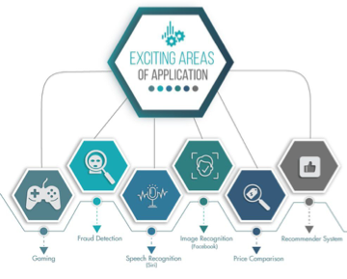
Introduction to business analytics and Concepts of business analytics
Applications of Business Analytics
Marketing
Finance
Human Resources
Manufacturing
Image Source: https://www.proschoolonline.com/certification-business-analytics-course/what-is-b
Notes:
Left (White Color space):
Title - Parent Topic
Subtitle - Subtopic 1
Body Text - Description in bullets
Right (Grey Color Space):
Body Text - Relevant image (with source)/code snippet
Put reference links in Speaker Notes
Reference:
https://www.tutorialspoint.com/internet_technologies/internet_overview.htm/

Slide 15
Trends in Business Analytics
Business Analytics Trends For 2021
Data Quality Management
Data Discovery/Visualization
Artificial Intelligence
Predictive and Prescriptive Analytics
Tools
Collaborative Business Intelligence
Data-driven Culture
Image Source: https://www.datapine.com/blog/benefits-of-business-intelligence-and-business-an
Notes:
Left (White Color space):
Title - Parent Topic
Subtitle - Subtopic 1
Body Text - Description in bullets
Right (Grey Color Space):
Body Text - Relevant image (with source)/code snippet
Put reference links in Speaker Notes
Reference:
https://www.tutorialspoint.com/internet_technologies/internet_overview.htm/

Slide 16
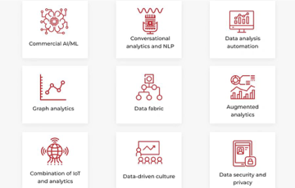
Trends in Business Analytics
Business Analytics Trends For 2021
Augmented Analytics
Mobile BI
Data Automation
Embedded Analytics
Natural language processing
Image Source: https://codeit.us/blog/top-data-and-analytics-trends
Notes:
Left (White Color space):
Title - Parent Topic
Subtitle - Subtopic 1
Body Text - Description in bullets
Right (Grey Color Space):
Body Text - Relevant image (with source)/code snippet
Put reference links in Speaker Notes
Reference:
https://www.tutorialspoint.com/internet_technologies/internet_overview.htm/

Slide 17
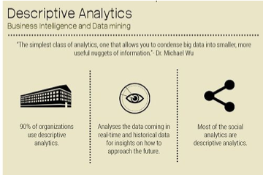
Descriptive analytics
What is Descriptive Analytics?
Descriptive analytics is a statistical method that is used to search and summarize historical data in order to identify patterns or meaning.
Descriptive analytics are based on standard aggregate functions in databases
Image Source: https://www.dezyre.com/article/types-of-analytics-descriptive-predictive-prescriptiv
Notes:
Left (White Color space):
Title - Parent Topic
Subtitle - Subtopic 1
Body Text - Description in bullets
Right (Grey Color Space):
Body Text - Relevant image (with source)/code snippet
Put reference links in Speaker Notes
Reference:
https://www.tutorialspoint.com/internet_technologies/internet_overview.htm/

Slide 18

Descriptive analytics
What is Descriptive Analytics?
(Contd..)
For example, in an online learning course with a discussion board, descriptive analytics could determine how many students participated in the discussion, or how many times a particular student posted in the discussion forum.
Image Source: https://www.valamis.com/hub/descriptive-analytics
Notes:
Left (White Color space):
Title - Parent Topic
Subtitle - Subtopic 1
Body Text - Description in bullets
Right (Grey Color Space):
Body Text - Relevant image (with source)/code snippet
Put reference links in Speaker Notes
Reference:
https://www.tutorialspoint.com/internet_technologies/internet_overview.htm/

Slide 19

Descriptive analytics
How does descriptive analytics work?
Data aggregation and data mining are two techniques used in descriptive analytics to discover historical data.
Data is first gathered and sorted by data aggregation in order to make the datasets more manageable by analysts.
Image Source: https://www.dataversity.net/fundamentals-descriptive-analytics/
Notes:
Left (White Color space):
Title - Parent Topic
Subtitle - Subtopic 1
Body Text - Description in bullets
Right (Grey Color Space):
Body Text - Relevant image (with source)/code snippet
Put reference links in Speaker Notes
Reference:
https://www.tutorialspoint.com/internet_technologies/internet_overview.htm/

Slide 20
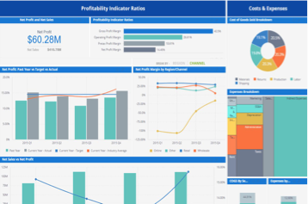
Descriptive analytics
How does descriptive analytics work?
(Contd..)
Data mining describes the next step of the analysis and involves a search of the data to identify patterns and meaning.
Identified patterns are analyzed to discover the specific ways that learners interacted with the learning content and within the learning environment.
Image Source: hhttps://www.sisense.com/glossary/descriptive-analytics/
Notes:
Left (White Color space):
Title - Parent Topic
Subtitle - Subtopic 1
Body Text - Description in bullets
Right (Grey Color Space):
Body Text - Relevant image (with source)/code snippet
Put reference links in Speaker Notes
Reference:
https://www.tutorialspoint.com/internet_technologies/internet_overview.htm/

Slide 21
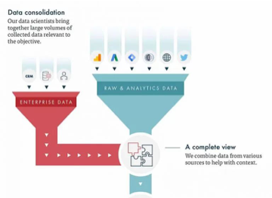
Descriptive analytics
Examples of descriptive analytics
Tracking course enrolment's, course compliance rates,
Recording which learning resources are accessed and how often
Summarizing the number of times a learner posts in a discussion board
Tracking assignment and assessment grades
Image Source: https://www.vertical-leap.uk/blog/data-science-for-marketers-part-2-descriptive-v-
Notes:
Left (White Color space):
Title - Parent Topic
Subtitle - Subtopic 1
Body Text - Description in bullets
Right (Grey Color Space):
Body Text - Relevant image (with source)/code snippet
Put reference links in Speaker Notes
Reference:
https://www.tutorialspoint.com/internet_technologies/internet_overview.htm/

Slide 22
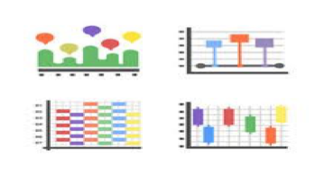
Descriptive analytics
Examples of descriptive analytics
(Contd..)
Comparing pre-test and post-test assessments
Analyzing course completion rates by learner or by course
Collating course survey results
Identifying length of time that learners took to complete a course
Image Source: https://www.vectorstock.com/royalty-free-vector/data-analytics-icons-flat-pack-vec
Notes:
Left (White Color space):
Title - Parent Topic
Subtitle - Subtopic 1
Body Text - Description in bullets
Right (Grey Color Space):
Body Text - Relevant image (with source)/code snippet
Put reference links in Speaker Notes
Reference:
https://www.tutorialspoint.com/internet_technologies/internet_overview.htm/

Slide 23
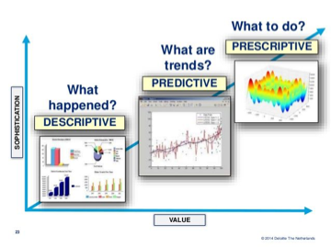
Descriptive analytics
Advantages of descriptive analytics
Quickly and easily report on the Return on Investment (ROI) by showing how performance achieved business or target goals.
Identify gaps and performance issues early - before they become problems.
Image Source: https://forums.bsdinsight.com/threads/descriptive-predictive-and-prescriptive-anal
Notes:
Left (White Color space):
Title - Parent Topic
Subtitle - Subtopic 1
Body Text - Description in bullets
Right (Grey Color Space):
Body Text - Relevant image (with source)/code snippet
Put reference links in Speaker Notes
Reference:
https://www.tutorialspoint.com/internet_technologies/internet_overview.htm/

Slide 24
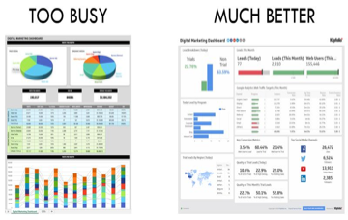
Descriptive analytics
Advantages of descriptive analytics
(Contd..)
Identify specific learners who require additional support, regardless of how many students or employees there are
Identify successful learners in order to offer positive feedback or additional resources.
Analyze the value and impact of course design and learning resources.
Image Source: https://econsultancy.com/analytics-approaches-every-marketer-should-know-1-de
Notes:
Left (White Color space):
Title - Parent Topic
Subtitle - Subtopic 1
Body Text - Description in bullets
Right (Grey Color Space):
Body Text - Relevant image (with source)/code snippet
Put reference links in Speaker Notes
Reference:
https://www.tutorialspoint.com/internet_technologies/internet_overview.htm/

Slide 25
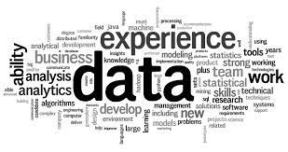
Introduction to Big Data Analytics
What is Data?
The quantities, characters, or symbols on which operations are performed by a computer, which may be stored and transmitted in the form of electrical signals and recorded on magnetic, optical, or mechanical recording media.
Image Source: https://encrypted-tbn0.gstatic.com/images?q=tbn:ANd9GcSCqNFP8VjcmqJX2EyEd-2mOaHcwSqTiXQVjCP1ISvmcIxoMYvCms5tQ_9imGeKaTmuBaA&usqp=CAU
Notes:
Left (White Color space):
Title - Parent Topic
Subtitle - Subtopic 1
Body Text - Description in bullets
Right (Grey Color Space):
Body Text - Relevant image (with source)/code snippet
Put reference links in Speaker Notes
Reference:
https://www.tutorialspoint.com/internet_technologies/internet_overview.htm/

Slide 26
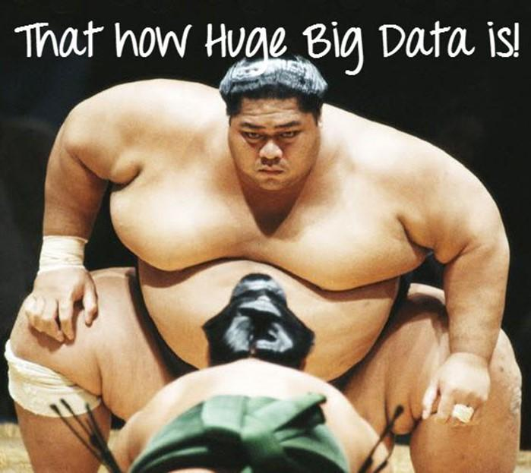
Introduction to Big Data Analytics
What is Big Data?
Big Data is a collection of data that is huge in volume, yet growing exponentially with time. It is a data with so large size and complexity that none of traditional data management tools can store it or process it efficiently. Big data is also a data but with huge size
Image Source: https://www.guru99.com/images/Big_Data/061114_0759_WhatIsBigDa1.jpg
Notes:
Left (White Color space):
Title - Parent Topic
Subtitle - Subtopic 1
Body Text - Description in bullets
Right (Grey Color Space):
Body Text - Relevant image (with source)/code snippet
Put reference links in Speaker Notes
Reference:
https://www.tutorialspoint.com/internet_technologies/internet_overview.htm/

Slide 27
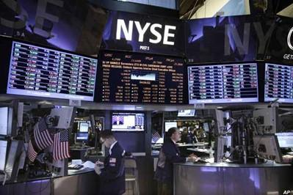
Introduction to Big Data Analytics
Example of Big Data
The New York Stock Exchange is an example of Big Data that generates about one terabyte of new trade data per day.
Image Source: https://www.guru99.com/images/Big_Data/061114_0759_WhatIsBigDa2.jpg
Notes:
Left (White Color space):
Title - Parent Topic
Subtitle - Subtopic 1
Body Text - Description in bullets
Right (Grey Color Space):
Body Text - Relevant image (with source)/code snippet
Put reference links in Speaker Notes
Reference:
https://www.tutorialspoint.com/internet_technologies/internet_overview.htm/

Slide 28

Introduction to Big Data Analytics
Example of Big Data
Social Media
The statistic shows that 500+terabytes of new data get ingested into the databases of social media site Facebook, every day. This data is mainly generated in terms of photo and video uploads, message exchanges, putting comments etc.
Image Source: https://www.guru99.com/images/Big_Data/061114_0759_WhatIsBigDa3.jpg
Notes:
Left (White Color space):
Title - Parent Topic
Subtitle - Subtopic 1
Body Text - Description in bullets
Right (Grey Color Space):
Body Text - Relevant image (with source)/code snippet
Put reference links in Speaker Notes
Reference:
https://www.tutorialspoint.com/internet_technologies/internet_overview.htm/

Slide 29

Introduction to Big Data Analytics
Example of Big Data
A single Jet engine can generate 10+terabytes of data in 30 minutes of flight time. With many thousand flights per day, generation of data reaches up to many Petabytes.
Image Source: https://www.guru99.com/images/Big_Data/061114_0759_WhatIsBigDa4.jpg
Notes:
Left (White Color space):
Title - Parent Topic
Subtitle - Subtopic 1
Body Text - Description in bullets
Right (Grey Color Space):
Body Text - Relevant image (with source)/code snippet
Put reference links in Speaker Notes
Reference:
https://www.tutorialspoint.com/internet_technologies/internet_overview.htm/

Slide 30
Introduction to Big Data Analytics
Types Of Big Data
Following are the types of Big Data:
Structured
Unstructured
Semi-structured
Image Source: https://www.guru99.com/images/Big_Data/061114_0759_WhatIsBigDa4.jpg
Notes:
Left (White Color space):
Title - Parent Topic
Subtitle - Subtopic 1
Body Text - Description in bullets
Right (Grey Color Space):
Body Text - Relevant image (with source)/code snippet
Put reference links in Speaker Notes
Reference:
https://www.tutorialspoint.com/internet_technologies/internet_overview.htm/

Slide 31
Introduction to Big Data Analytics
Structured Big Data
Any data that can be stored, accessed and processed in the form of fixed format is termed as a ‘structured’ data.
Image Source: https://www.guru99.com/images/Big_Data/061114_0759_WhatIsBigDa4.jpg
Notes:
Left (White Color space):
Title - Parent Topic
Subtitle - Subtopic 1
Body Text - Description in bullets
Right (Grey Color Space):
Body Text - Relevant image (with source)/code snippet
Put reference links in Speaker Notes
Reference:
https://www.tutorialspoint.com/internet_technologies/internet_overview.htm/

Slide 32
Introduction to Big Data Analytics
Unstructured Big Data
Any data with unknown form or the structure is classified as unstructured data. In addition to the size being huge, un-structured data poses multiple challenges in terms of its processing for deriving value out of it.
Image Source: https://www.guru99.com/images/Big_Data/061114_0759_WhatIsBigDa4.jpg
Notes:
Left (White Color space):
Title - Parent Topic
Subtitle - Subtopic 1
Body Text - Description in bullets
Right (Grey Color Space):
Body Text - Relevant image (with source)/code snippet
Put reference links in Speaker Notes
Reference:
https://www.tutorialspoint.com/internet_technologies/internet_overview.htm/

Slide 33
Introduction to Big Data Analytics
Semi-structured Big Data
Semi-structured data can contain both the forms of data. We can see semi-structured data as a structured in form but it is actually not defined with e.g. a table definition in relational DBMS.
Image Source: https://www.guru99.com/images/Big_Data/061114_0759_WhatIsBigDa4.jpg
Notes:
Left (White Color space):
Title - Parent Topic
Subtitle - Subtopic 1
Body Text - Description in bullets
Right (Grey Color Space):
Body Text - Relevant image (with source)/code snippet
Put reference links in Speaker Notes
Reference:
https://www.tutorialspoint.com/internet_technologies/internet_overview.htm/

Slide 34
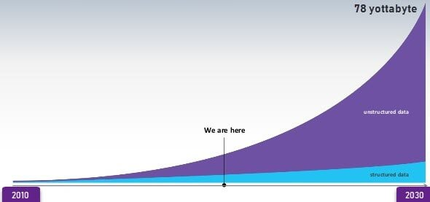
Introduction to Big Data Analytics
Data Growth over the years
Notes:
Left (White Color space):
Title - Parent Topic
Subtitle - Subtopic 1
Body Text - Description in bullets
Right (Grey Color Space):
Body Text - Relevant image (with source)/code snippet
Put reference links in Speaker Notes
Reference:
https://www.tutorialspoint.com/internet_technologies/internet_overview.htm/

Slide 35
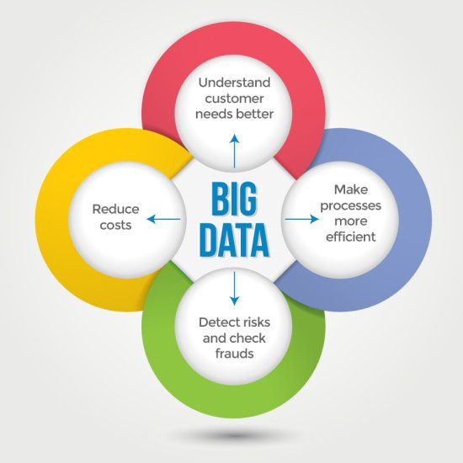
Introduction to Big Data Analytics
Characteristics Of Big Data
Big data can be described by the following characteristics:
Volume
Variety
Velocity
Variability
Image Source: https://qph.cf2.quoracdn.net/main-qimg-b093fe2a8f3d7ed42897bd85c33a4075-lq
Notes:
Left (White Color space):
Title - Parent Topic
Subtitle - Subtopic 1
Body Text - Description in bullets
Right (Grey Color Space):
Body Text - Relevant image (with source)/code snippet
Put reference links in Speaker Notes
Reference:
https://www.tutorialspoint.com/internet_technologies/internet_overview.htm/

Slide 36
Statistics
(16 hours)
Notes:
Title - The learning outcome
Subtitle - Duration

Slide 37
In this section, we will discuss:
Views in Laravel with complete conditional and looping construct.
Controllers and its usage.
Complete database connectivity with DB
Complete Database connectivity with Eloquent Model and its working.
Notes:
Mention the parent topics one by one. This particular learning outcome has 4 parent topics.

Slide 38
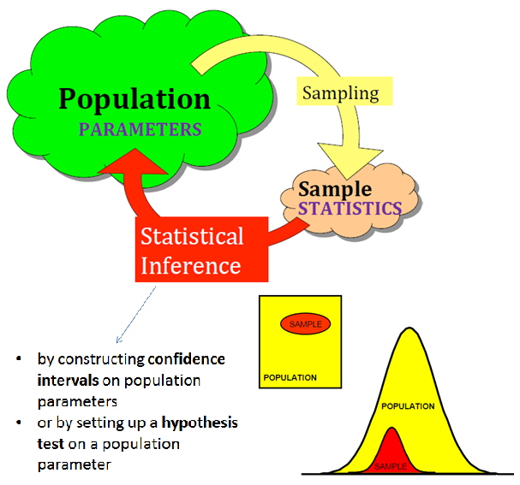
Inferential Statistics
Introduction to Inferential statistics
Inferential statistics is a scientific discipline that uses mathematical tools to make forecasts and projections by analyzing the given data.
This is of use to people employed in such fields as engineering, economics, biology, the social sciences, business, agriculture and communications.
Image Source: /
Notes:
Left (White Color space):
Title - Parent Topic
Subtitle - Subtopic 1
Body Text - Description in bullets
Right (Grey Color Space):
Body Text - Relevant image (with source)/code snippet
Put reference links in Speaker Notes
Reference:
https://www.tutorialspoint.com/internet_technologies/internet_overview.htm/

Slide 39
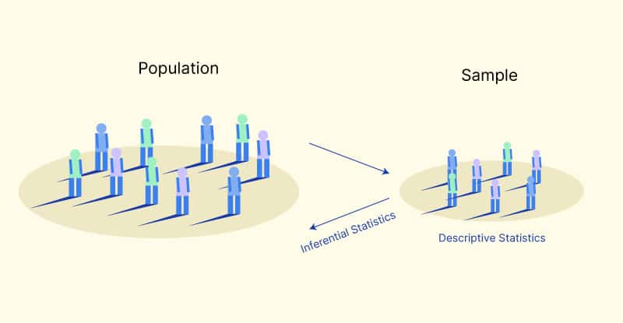
Inferential Statistics
Advantages of Inferential statistics
A precise tool for estimating population.
Highly structured analytical methods.
Image Source: /
Notes:
Left (White Color space):
Title - Parent Topic
Subtitle - Subtopic 1
Body Text - Description in bullets
Right (Grey Color Space):
Body Text - Relevant image (with source)/code snippet
Put reference links in Speaker Notes
Reference:
https://www.tutorialspoint.com/internet_technologies/internet_overview.htm/

Slide 40
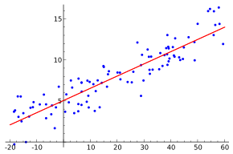
Inferential Statistics
Inferential Statistics Examples
Regression Analysis is one of the most popular analysis tools.
Regression analysis is used to predict the relationship between independent variables and the dependent variable.
Image Source: /
Notes:
Left (White Color space):
Title - Parent Topic
Subtitle - Subtopic 1
Body Text - Description in bullets
Right (Grey Color Space):
Body Text - Relevant image (with source)/code snippet
Put reference links in Speaker Notes
Reference:
https://www.tutorialspoint.com/internet_technologies/internet_overview.htm/

Slide 41
Inferential Statistics
Inferential Statistics Examples
Hypothesis testing is a statistical test where we want to know the truth of an assumption or opinion that is common in society.
Confidence interval or confidence level is a statistical test used to estimate the population by using samples.
Image Source: /
Notes:
Left (White Color space):
Title - Parent Topic
Subtitle - Subtopic 1
Body Text - Description in bullets
Right (Grey Color Space):
Body Text - Relevant image (with source)/code snippet
Put reference links in Speaker Notes
Reference:
https://www.tutorialspoint.com/internet_technologies/internet_overview.htm/

Slide 42
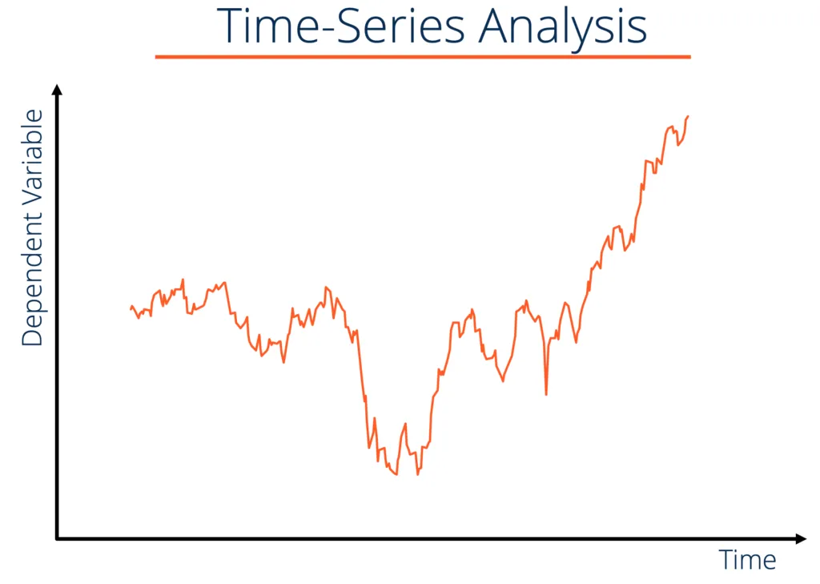
Inferential Statistics
Inferential Statistics Examples
Time series analysis is one type of statistical analysis that tries to predict an event in the future based on pre-existing data.
With this method, we can estimate how predictions a value or event that appears in the future.
Image Source: /
Notes:
Left (White Color space):
Title - Parent Topic
Subtitle - Subtopic 1
Body Text - Description in bullets
Right (Grey Color Space):
Body Text - Relevant image (with source)/code snippet
Put reference links in Speaker Notes
Reference:
https://www.tutorialspoint.com/internet_technologies/internet_overview.htm/

Slide 43
Descriptive Statistics
Introduction to descriptive statistics
It is used to describe the basic features of data in a study.
Descriptive statistics deals with the processing of data without attempting to draw any inferences from it.
The data are presented in the form of tables and graphs.
Image Source: /
Notes:
Left (White Color space):
Title - Parent Topic
Subtitle - Subtopic 1
Body Text - Description in bullets
Right (Grey Color Space):
Body Text - Relevant image (with source)/code snippet
Put reference links in Speaker Notes
Reference:
https://www.tutorialspoint.com/internet_technologies/internet_overview.htm/

Slide 44
Descriptive Statistics
Introduction to descriptive statistics
The characteristics of the data are described in simple terms.
Events that are dealt with include everyday happenings such as accidents, prices of goods, business, incomes, epidemics, sports data, population data.
Image Source: /
Notes:
Left (White Color space):
Title - Parent Topic
Subtitle - Subtopic 1
Body Text - Description in bullets
Right (Grey Color Space):
Body Text - Relevant image (with source)/code snippet
Put reference links in Speaker Notes
Reference:
https://www.tutorialspoint.com/internet_technologies/internet_overview.htm/

Slide 45
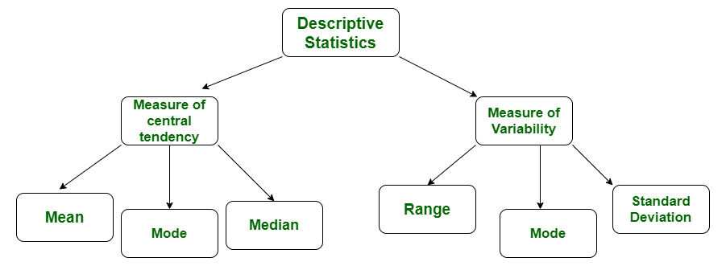
Descriptive Statistics
Types of descriptive statistics
All descriptive statistics are either measures of central tendency or measures of variability, also known as measures of dispersion.
Image Source: https://www.geeksforgeeks.org/difference-between-descriptive-and-inferential-statistics/
Notes:
Left (White Color space):
Title - Parent Topic
Subtitle - Subtopic 1
Body Text - Description in bullets
Right (Grey Color Space):
Body Text - Relevant image (with source)/code snippet
Put reference links in Speaker Notes
Reference:
https://www.tutorialspoint.com/internet_technologies/internet_overview.htm/

Slide 46
Descriptive Statistics
Measure of Central Tendency
Measures of central tendency focus on the average or middle values of data sets.
These measures indicate where most values in a distribution fall and are also referred to as the central location of a distribution.
Image Source: https://www.geeksforgeeks.org/difference-between-descriptive-and-inferential-statistics/
Notes:
Left (White Color space):
Title - Parent Topic
Subtitle - Subtopic 1
Body Text - Description in bullets
Right (Grey Color Space):
Body Text - Relevant image (with source)/code snippet
Put reference links in Speaker Notes
Reference:
https://www.tutorialspoint.com/internet_technologies/internet_overview.htm/

Slide 47
Descriptive Statistics
Measure of Central Tendency continued…
We can think of it as the tendency of data to cluster around a middle value.
In statistics the three most common measures of central tendency are the mean, median and mode.
Image Source: https://www.geeksforgeeks.org/difference-between-descriptive-and-inferential-statistics/
Notes:
Left (White Color space):
Title - Parent Topic
Subtitle - Subtopic 1
Body Text - Description in bullets
Right (Grey Color Space):
Body Text - Relevant image (with source)/code snippet
Put reference links in Speaker Notes
Reference:
https://www.tutorialspoint.com/internet_technologies/internet_overview.htm/

Slide 48
Descriptive Statistics
Measure of Central Tendency continued…
Each of these measures calculates the location of the central point using a different method.
Choosing the best measure of central tendency depends on the type of data we have.
Image Source: https://www.geeksforgeeks.org/difference-between-descriptive-and-inferential-statistics/
Notes:
Left (White Color space):
Title - Parent Topic
Subtitle - Subtopic 1
Body Text - Description in bullets
Right (Grey Color Space):
Body Text - Relevant image (with source)/code snippet
Put reference links in Speaker Notes
Reference:
https://www.tutorialspoint.com/internet_technologies/internet_overview.htm/

Slide 49
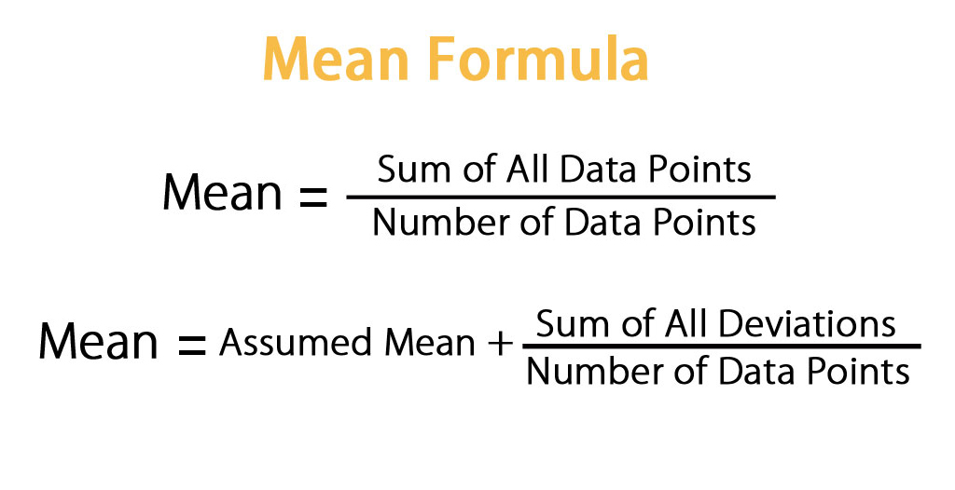
Measure of Central Tendency
Mean
The mean is the arithmetic average, and it is probably the measure of central tendency that you are most familiar.
Calculating the mean is very simple.
Image Source: https://www.geeksforgeeks.org/difference-between-descriptive-and-inferential-statistics/
Notes:
Left (White Color space):
Title - Parent Topic
Subtitle - Subtopic 1
Body Text - Description in bullets
Right (Grey Color Space):
Body Text - Relevant image (with source)/code snippet
Put reference links in Speaker Notes
Reference:
https://www.tutorialspoint.com/internet_technologies/internet_overview.htm/

Slide 50
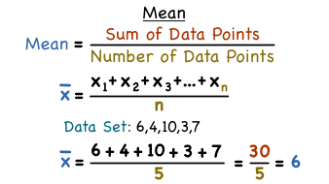
Measure of Central Tendency
Mean continued…
We just add up all of the values and divide by the number of observations in your dataset.
x1+x2+x3+.....+xn
_______________
n
Image Source: https://www.geeksforgeeks.org/difference-between-descriptive-and-inferential-statistics/
Notes:
Left (White Color space):
Title - Parent Topic
Subtitle - Subtopic 1
Body Text - Description in bullets
Right (Grey Color Space):
Body Text - Relevant image (with source)/code snippet
Put reference links in Speaker Notes
Reference:
https://www.tutorialspoint.com/internet_technologies/internet_overview.htm/

Slide 51
Measure of Central Tendency
Mean continued…
The calculation of the mean incorporates all values in the data.
If you change any value, the mean changes.
However, the mean doesn’t always locate the center of the data accurately.
Image Source: https://www.geeksforgeeks.org/difference-between-descriptive-and-inferential-statistics/
Notes:
Left (White Color space):
Title - Parent Topic
Subtitle - Subtopic 1
Body Text - Description in bullets
Right (Grey Color Space):
Body Text - Relevant image (with source)/code snippet
Put reference links in Speaker Notes
Reference:
https://www.tutorialspoint.com/internet_technologies/internet_overview.htm/

Slide 52
Measure of Central Tendency
Mean continued…
In a symmetric distribution, the mean locates the center accurately.
Image Source: https://www.geeksforgeeks.org/difference-between-descriptive-and-inferential-statistics/
Notes:
Left (White Color space):
Title - Parent Topic
Subtitle - Subtopic 1
Body Text - Description in bullets
Right (Grey Color Space):
Body Text - Relevant image (with source)/code snippet
Put reference links in Speaker Notes
Reference:
https://www.tutorialspoint.com/internet_technologies/internet_overview.htm/

Slide 53
Measure of Central Tendency
Mean continued…
However, in a skewed distribution, the mean can miss the mark.
This problem occurs because outliers have a substantial impact on the mean.
Extreme values in an extended tail pull the mean away from the center.
As the distribution becomes more skewed, the mean is drawn further away from the center.
Image Source: https://www.geeksforgeeks.org/difference-between-descriptive-and-inferential-statistics/
Notes:
Left (White Color space):
Title - Parent Topic
Subtitle - Subtopic 1
Body Text - Description in bullets
Right (Grey Color Space):
Body Text - Relevant image (with source)/code snippet
Put reference links in Speaker Notes
Reference:
https://www.tutorialspoint.com/internet_technologies/internet_overview.htm/

Slide 54
Measure of Central Tendency
Median
The median is the middle value.
It is the value that splits the dataset in half.
To find the median, order your data from smallest to largest, and then find the data point that has an equal amount of values above it and below it.
Image Source: https://www.geeksforgeeks.org/difference-between-descriptive-and-inferential-statistics/
Notes:
Left (White Color space):
Title - Parent Topic
Subtitle - Subtopic 1
Body Text - Description in bullets
Right (Grey Color Space):
Body Text - Relevant image (with source)/code snippet
Put reference links in Speaker Notes
Reference:
https://www.tutorialspoint.com/internet_technologies/internet_overview.htm/

Slide 55
Measure of Central Tendency
Median continued…
The method for locating the median varies slightly depending on whether your dataset has an even or odd number of values.
Image Source: https://www.geeksforgeeks.org/difference-between-descriptive-and-inferential-statistics/
Notes:
Left (White Color space):
Title - Parent Topic
Subtitle - Subtopic 1
Body Text - Description in bullets
Right (Grey Color Space):
Body Text - Relevant image (with source)/code snippet
Put reference links in Speaker Notes
Reference:
https://www.tutorialspoint.com/internet_technologies/internet_overview.htm/

Slide 56
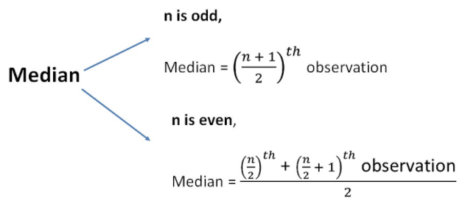
Measure of Central Tendency
Median continued…
In the dataset with the odd number of observations, notice how the number 12 has six values above it and six below it.
Therefore, 12 is the median of this dataset.
Image Source: https://www.geeksforgeeks.org/difference-between-descriptive-and-inferential-statistics/
Notes:
Left (White Color space):
Title - Parent Topic
Subtitle - Subtopic 1
Body Text - Description in bullets
Right (Grey Color Space):
Body Text - Relevant image (with source)/code snippet
Put reference links in Speaker Notes
Reference:
https://www.tutorialspoint.com/internet_technologies/internet_overview.htm/

Slide 57
Measure of Central Tendency
Median continued…
When there is an even number of values, you count in to the two innermost values and then take the average.
The average of 27 and 29 is 28.
Consequently, 28 is the median of this dataset.
Image Source: https://www.geeksforgeeks.org/difference-between-descriptive-and-inferential-statistics/
Notes:
Left (White Color space):
Title - Parent Topic
Subtitle - Subtopic 1
Body Text - Description in bullets
Right (Grey Color Space):
Body Text - Relevant image (with source)/code snippet
Put reference links in Speaker Notes
Reference:
https://www.tutorialspoint.com/internet_technologies/internet_overview.htm/

Slide 58
Measure of Central Tendency
Mode
The mode is the value that occurs the most frequently in your data set.
On a bar chart, the mode is the highest bar.
If the data have multiple values that are tied for occurring the most frequently, you have a multimodal distribution.
If no value repeats, the data do not have a mode.
Image Source: https://www.geeksforgeeks.org/difference-between-descriptive-and-inferential-statistics/
Notes:
Left (White Color space):
Title - Parent Topic
Subtitle - Subtopic 1
Body Text - Description in bullets
Right (Grey Color Space):
Body Text - Relevant image (with source)/code snippet
Put reference links in Speaker Notes
Reference:
https://www.tutorialspoint.com/internet_technologies/internet_overview.htm/

Slide 59
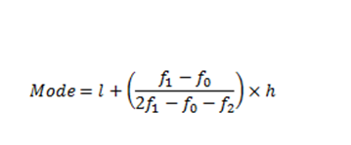
Measure of Central Tendency
Mode continued….
In the dataset, the value 5 occurs most frequently, which makes it the mode.
These data might represent a 5-point Likert scale.
Image Source: https://www.geeksforgeeks.org/difference-between-descriptive-and-inferential-statistics/
Notes:
Left (White Color space):
Title - Parent Topic
Subtitle - Subtopic 1
Body Text - Description in bullets
Right (Grey Color Space):
Body Text - Relevant image (with source)/code snippet
Put reference links in Speaker Notes
Reference:
https://www.tutorialspoint.com/internet_technologies/internet_overview.htm/

Slide 60
Measure of Central Tendency
Mode continued….
Typically, you use the mode with categorical, ordinal, and discrete data.
In fact, the mode is the only measure of central tendency that you can use with categorical data—such as the most preferred flavor of ice cream.
However, with categorical data, there isn’t a central value because you can’t order the groups.
Image Source: https://www.geeksforgeeks.org/difference-between-descriptive-and-inferential-statistics/
Notes:
Left (White Color space):
Title - Parent Topic
Subtitle - Subtopic 1
Body Text - Description in bullets
Right (Grey Color Space):
Body Text - Relevant image (with source)/code snippet
Put reference links in Speaker Notes
Reference:
https://www.tutorialspoint.com/internet_technologies/internet_overview.htm/

Slide 61
Measure of Central Tendency
Mode continued….
With ordinal and discrete data, the mode can be a value that is not in the center.
Again, the mode represents the most common value.
Image Source: https://www.geeksforgeeks.org/difference-between-descriptive-and-inferential-statistics/
Notes:
Left (White Color space):
Title - Parent Topic
Subtitle - Subtopic 1
Body Text - Description in bullets
Right (Grey Color Space):
Body Text - Relevant image (with source)/code snippet
Put reference links in Speaker Notes
Reference:
https://www.tutorialspoint.com/internet_technologies/internet_overview.htm/

Slide 62
Arithmetic mean
Definition
Arithmetic Mean in the most common and easily understood measure of central tendency.
We can define mean as the value obtained by dividing the sum of measurements with the number of measurements contained in the data set and is denoted by the symbol x bar
Image Source: https://www.geeksforgeeks.org/difference-between-descriptive-and-inferential-statistics/
Notes:
Left (White Color space):
Title - Parent Topic
Subtitle - Subtopic 1
Body Text - Description in bullets
Right (Grey Color Space):
Body Text - Relevant image (with source)/code snippet
Put reference links in Speaker Notes
Reference:
https://www.tutorialspoint.com/internet_technologies/internet_overview.htm/

Slide 63
Arithmetic mean
Arithmetic Mean for three types of
series
Individual Data Series
Discrete Data Series
Continuous Data Series
Image Source: https://www.geeksforgeeks.org/difference-between-descriptive-and-inferential-statistics/
Notes:
Left (White Color space):
Title - Parent Topic
Subtitle - Subtopic 1
Body Text - Description in bullets
Right (Grey Color Space):
Body Text - Relevant image (with source)/code snippet
Put reference links in Speaker Notes
Reference:
https://www.tutorialspoint.com/internet_technologies/internet_overview.htm/

Slide 64
Arithmetic mean
Individual Data Series
When data is given on individual basis.
Following is an example of individual series:
Items:
5 10 20 30 40 50 60 70
Image Source: https://www.geeksforgeeks.org/difference-between-descriptive-and-inferential-statistics/
Notes:
Left (White Color space):
Title - Parent Topic
Subtitle - Subtopic 1
Body Text - Description in bullets
Right (Grey Color Space):
Body Text - Relevant image (with source)/code snippet
Put reference links in Speaker Notes
Reference:
https://www.tutorialspoint.com/internet_technologies/internet_overview.htm/

Slide 65
Arithmetic mean
Individual Data Series continued…
Alternatively, we can write same formula as follows:
Image Source: https://www.geeksforgeeks.org/difference-between-descriptive-and-inferential-statistics/
Notes:
Left (White Color space):
Title - Parent Topic
Subtitle - Subtopic 1
Body Text - Description in bullets
Right (Grey Color Space):
Body Text - Relevant image (with source)/code snippet
Put reference links in Speaker Notes
Reference:
https://www.tutorialspoint.com/internet_technologies/internet_overview.htm/

Slide 66
Arithmetic mean
Individual Data Series continued…
Image Source: https://www.geeksforgeeks.org/difference-between-descriptive-and-inferential-statistics/
Notes:
Left (White Color space):
Title - Parent Topic
Subtitle - Subtopic 1
Body Text - Description in bullets
Right (Grey Color Space):
Body Text - Relevant image (with source)/code snippet
Put reference links in Speaker Notes
Reference:
https://www.tutorialspoint.com/internet_technologies/internet_overview.htm/

Slide 67
Arithmetic mean
Individual Data Series continued…
Example:
Problem Statement:
Calculate Arithmetic Mean for the following individual data:
Items:
14 36 45 70 105
Image Source: https://www.geeksforgeeks.org/difference-between-descriptive-and-inferential-statistics/
Notes:
Left (White Color space):
Title - Parent Topic
Subtitle - Subtopic 1
Body Text - Description in bullets
Right (Grey Color Space):
Body Text - Relevant image (with source)/code snippet
Put reference links in Speaker Notes
Reference:
https://www.tutorialspoint.com/internet_technologies/internet_overview.htm/

Slide 68
Arithmetic mean
Individual Data Series continued…
Solution:
Based on the above mentioned formula, Arithmetic Mean x¯ will be:
The Arithmetic Mean of the given
numbers is 54.
Image Source: https://www.geeksforgeeks.org/difference-between-descriptive-and-inferential-statistics/
Notes:
Left (White Color space):
Title - Parent Topic
Subtitle - Subtopic 1
Body Text - Description in bullets
Right (Grey Color Space):
Body Text - Relevant image (with source)/code snippet
Put reference links in Speaker Notes
Reference:
https://www.tutorialspoint.com/internet_technologies/internet_overview.htm/

Slide 69
Arithmetic mean
Discrete Data Series
When data is given along with their frequencies. Following is an example of discrete series:
Items : 5 10 20 30 40 50 60 70
Frequency: 2 5 1 3 12 0 5 7
Image Source: https://www.geeksforgeeks.org/difference-between-descriptive-and-inferential-statistics/
Notes:
Left (White Color space):
Title - Parent Topic
Subtitle - Subtopic 1
Body Text - Description in bullets
Right (Grey Color Space):
Body Text - Relevant image (with source)/code snippet
Put reference links in Speaker Notes
Reference:
https://www.tutorialspoint.com/internet_technologies/internet_overview.htm/

Slide 70
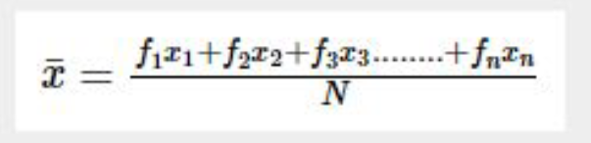
Arithmetic mean
Discrete Data Series continued…
For discrete series, the Arithmetic Mean can be calculated using the following formula.
Formula
Image Source: https://www.geeksforgeeks.org/difference-between-descriptive-and-inferential-statistics/
Notes:
Left (White Color space):
Title - Parent Topic
Subtitle - Subtopic 1
Body Text - Description in bullets
Right (Grey Color Space):
Body Text - Relevant image (with source)/code snippet
Put reference links in Speaker Notes
Reference:
https://www.tutorialspoint.com/internet_technologies/internet_overview.htm/

Slide 71
Arithmetic mean
Discrete Data Series continued…
Alternatively, we can write same formula as follows:
Formula
Image Source: https://www.geeksforgeeks.org/difference-between-descriptive-and-inferential-statistics/
Notes:
Left (White Color space):
Title - Parent Topic
Subtitle - Subtopic 1
Body Text - Description in bullets
Right (Grey Color Space):
Body Text - Relevant image (with source)/code snippet
Put reference links in Speaker Notes
Reference:
https://www.tutorialspoint.com/internet_technologies/internet_overview.htm/

Slide 72
Arithmetic mean
Continuous Data Series
When data is given based on ranges along with their frequencies. Following is an example of continuous series:
Items: 0-5 5-10 10-20 20-30 30-40
Frequency: 2 5 1 3 12
Image Source: https://www.geeksforgeeks.org/difference-between-descriptive-and-inferential-statistics/
Notes:
Left (White Color space):
Title - Parent Topic
Subtitle - Subtopic 1
Body Text - Description in bullets
Right (Grey Color Space):
Body Text - Relevant image (with source)/code snippet
Put reference links in Speaker Notes
Reference:
https://www.tutorialspoint.com/internet_technologies/internet_overview.htm/

Slide 73
Arithmetic mean
Continuous Data Series continued…
Image Source: https://www.geeksforgeeks.org/difference-between-descriptive-and-inferential-statistics/
Notes:
Left (White Color space):
Title - Parent Topic
Subtitle - Subtopic 1
Body Text - Description in bullets
Right (Grey Color Space):
Body Text - Relevant image (with source)/code snippet
Put reference links in Speaker Notes
Reference:
https://www.tutorialspoint.com/internet_technologies/internet_overview.htm/

Slide 74
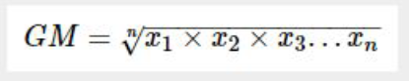
Arithmetic mean
Geometric mean
Geometric mean of n numbers is defined as the nth root of the product of n numbers.
Formula :
Image Source: https://www.geeksforgeeks.org/difference-between-descriptive-and-inferential-statistics/
Notes:
Left (White Color space):
Title - Parent Topic
Subtitle - Subtopic 1
Body Text - Description in bullets
Right (Grey Color Space):
Body Text - Relevant image (with source)/code snippet
Put reference links in Speaker Notes
Reference:
https://www.tutorialspoint.com/internet_technologies/internet_overview.htm/

Slide 75
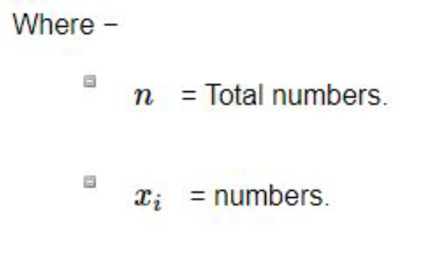
Arithmetic mean
Geometric mean continued…
Image Source: https://www.geeksforgeeks.org/difference-between-descriptive-and-inferential-statistics/
Notes:
Left (White Color space):
Title - Parent Topic
Subtitle - Subtopic 1
Body Text - Description in bullets
Right (Grey Color Space):
Body Text - Relevant image (with source)/code snippet
Put reference links in Speaker Notes
Reference:
https://www.tutorialspoint.com/internet_technologies/internet_overview.htm/

Slide 76
Harmonic mean
What is Harmonic Mean ?
Harmonic mean is a type of average that is calculated by dividing the number of values in a data series by the sum of the reciprocals (1/x_i) of each value in the data series.
A harmonic mean is one of the three Pythagorean means (the other two are arithmetic mean and geometric mean).
The harmonic mean always shows the lowest value among the Pythagorean means.
Image Source: https://www.geeksforgeeks.org/difference-between-descriptive-and-inferential-statistics/
Notes:
Left (White Color space):
Title - Parent Topic
Subtitle - Subtopic 1
Body Text - Description in bullets
Right (Grey Color Space):
Body Text - Relevant image (with source)/code snippet
Put reference links in Speaker Notes
Reference:
https://www.tutorialspoint.com/internet_technologies/internet_overview.htm/

Slide 77
Harmonic mean
Formula of Harmonic Mean
The general formula for calculating a harmonic mean is:
Harmonic mean = n / (Σ1/x_i)
Where: n – the number of the values in a dataset
x_i – the point in a dataset
The weighted harmonic mean can be calculated using the following formula:
Weighted Harmonic Mean = (Σw_i ) /(Σw_i/x_i) Where:
w_i – the weight of the data point
x_i – the point in a dataset.
Image Source: https://www.geeksforgeeks.org/difference-between-descriptive-and-inferential-statistics/
Notes:
Left (White Color space):
Title - Parent Topic
Subtitle - Subtopic 1
Body Text - Description in bullets
Right (Grey Color Space):
Body Text - Relevant image (with source)/code snippet
Put reference links in Speaker Notes
Reference:
https://www.tutorialspoint.com/internet_technologies/internet_overview.htm/

Slide 78
Harmonic mean
Formula of Harmonic Mean
The general formula for calculating a harmonic mean is:
Harmonic mean = n / (Σ1/x_i)
Where: n – the number of the values in a dataset
x_i – the point in a dataset
The weighted harmonic mean can be calculated using the following formula:
Weighted Harmonic Mean = (Σw_i ) /(Σw_i/x_i) Where:
w_i – the weight of the data point
x_i – the point in a dataset.
Image Source: https://www.geeksforgeeks.org/difference-between-descriptive-and-inferential-statistics/
Notes:
Left (White Color space):
Title - Parent Topic
Subtitle - Subtopic 1
Body Text - Description in bullets
Right (Grey Color Space):
Body Text - Relevant image (with source)/code snippet
Put reference links in Speaker Notes
Reference:
https://www.tutorialspoint.com/internet_technologies/internet_overview.htm/

Slide 79
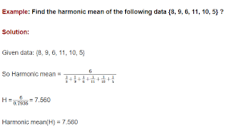
Harmonic mean
Example of Harmonic Mean
Firstly, we need to find the P/E ratios of each company. Remember that the P/E ratio is essentially the market capitalization divided by the earnings.
P/E (Company A) = ($1 billion) / ($20 million) = 50
P/E (Company B) = ($20 billion) / ($5 billion) = 4
Image Source: https://www.geeksforgeeks.org/difference-between-descriptive-and-inferential-statistics/
Notes:
Left (White Color space):
Title - Parent Topic
Subtitle - Subtopic 1
Body Text - Description in bullets
Right (Grey Color Space):
Body Text - Relevant image (with source)/code snippet
Put reference links in Speaker Notes
Reference:
https://www.tutorialspoint.com/internet_technologies/internet_overview.htm/

Slide 80
Harmonic mean
Example of Harmonic Mean
We must use the weighted harmonic mean to calculate the P/E ratio of the index. Using the formula for the weighted harmonic mean, the P/E ratio of the index can be found in the following way:
P/E (Index) = (0.4+0.6) / (0.4/50 + 0.6/4)= 6.33
Note that if we calculate the P/E ratio of the index using the weighted arithmetic mean, it would be significantly overstated:
P/E (Index) = 0.4×50 + 0.6×4 = 22.4
Image Source: https://www.geeksforgeeks.org/difference-between-descriptive-and-inferential-statistics/
Notes:
Left (White Color space):
Title - Parent Topic
Subtitle - Subtopic 1
Body Text - Description in bullets
Right (Grey Color Space):
Body Text - Relevant image (with source)/code snippet
Put reference links in Speaker Notes
Reference:
https://www.tutorialspoint.com/internet_technologies/internet_overview.htm/

Slide 81
Median in Raw and Grouped Data
Median in Raw Data
The median of raw data is the number which divides the observations when arranged in an order (ascending or descending) in two equal parts.
Image Source: https://www.geeksforgeeks.org/difference-between-descriptive-and-inferential-statistics/
Notes:
Left (White Color space):
Title - Parent Topic
Subtitle - Subtopic 1
Body Text - Description in bullets
Right (Grey Color Space):
Body Text - Relevant image (with source)/code snippet
Put reference links in Speaker Notes
Reference:
https://www.tutorialspoint.com/internet_technologies/internet_overview.htm/

Slide 82
Median in Raw and Grouped Data
Method of finding median
Take the following steps to find the median of raw data.
Step I: Arrange the raw data in ascending or descending order.
Step II: Observe the number of variates in the data. Let the number of variates in the data be n. Then find the median as following.
(i) If n is odd then [Math Processing Error]th variate is the median
Image Source: https://www.geeksforgeeks.org/difference-between-descriptive-and-inferential-statistics/
Notes:
Left (White Color space):
Title - Parent Topic
Subtitle - Subtopic 1
Body Text - Description in bullets
Right (Grey Color Space):
Body Text - Relevant image (with source)/code snippet
Put reference links in Speaker Notes
Reference:
https://www.tutorialspoint.com/internet_technologies/internet_overview.htm/

Slide 83
Median in Raw and Grouped Data
Method of finding median
(ii) If n is even then the mean of [Math Processing Error]th and ([Math Processing Error] + 1)th variates is the median, i.e.,
median = [Math Processing Error].
Image Source: https://www.geeksforgeeks.org/difference-between-descriptive-and-inferential-statistics/
Notes:
Left (White Color space):
Title - Parent Topic
Subtitle - Subtopic 1
Body Text - Description in bullets
Right (Grey Color Space):
Body Text - Relevant image (with source)/code snippet
Put reference links in Speaker Notes
Reference:
https://www.tutorialspoint.com/internet_technologies/internet_overview.htm/

Slide 84
Median in Raw and Grouped Data
Solved Examples on Median of Raw
Data
Find the median of the ungrouped data.
15, 18, 10, 6, 14
Solution:
Arranging variates in ascending order,
we get 6, 10, 14, 15, 18.
The number of variates = 5, which is odd.
Therefore, median = [Math Processing Error]th variate = 3rd variate
Image Source: https://www.geeksforgeeks.org/difference-between-descriptive-and-inferential-statistics/
Notes:
Left (White Color space):
Title - Parent Topic
Subtitle - Subtopic 1
Body Text - Description in bullets
Right (Grey Color Space):
Body Text - Relevant image (with source)/code snippet
Put reference links in Speaker Notes
Reference:
https://www.tutorialspoint.com/internet_technologies/internet_overview.htm/

Slide 85
Median in Raw and Grouped Data
Finding Median for Grouped Data
Median is the value which occupies the middle position when all the observations are arranged in an ascending or descending order. It is a positional average.
(i) Construct the cumulative frequency distribution.
(ii) Find (N/2)th term
(iii) The class that contains the cumulative frequency N/2 is called the median class.
Image Source: https://www.geeksforgeeks.org/difference-between-descriptive-and-inferential-statistics/
Notes:
Left (White Color space):
Title - Parent Topic
Subtitle - Subtopic 1
Body Text - Description in bullets
Right (Grey Color Space):
Body Text - Relevant image (with source)/code snippet
Put reference links in Speaker Notes
Reference:
https://www.tutorialspoint.com/internet_technologies/internet_overview.htm/

Slide 86
Median in Raw and Grouped Data
Finding Median for Grouped Data
(iv) Find the median by using the formula:
Where l = Lower limit of the median class,
f = Frequency of the median class
c = Width of the median class,
N = The total frequency (Σf)
m = cumulative frequency of the class preceding the median class
Image Source: https://www.geeksforgeeks.org/difference-between-descriptive-and-inferential-statistics/
Notes:
Left (White Color space):
Title - Parent Topic
Subtitle - Subtopic 1
Body Text - Description in bullets
Right (Grey Color Space):
Body Text - Relevant image (with source)/code snippet
Put reference links in Speaker Notes
Reference:
https://www.tutorialspoint.com/internet_technologies/internet_overview.htm/

Slide 87
Median in Raw and Grouped Data
Solved Examples on Median of
Grouped Data
A researcher studying the behavior of mice has recorded the time (in seconds) taken by each mouse to locate its food by considering 13 different mice as 31,33, 63, 33, 28, 29, 33, 27, 27, 34, 35,28, 32. Find the median time that mice spent in searching its food.
31, 33, 63, 33, 28, 29, 33, 27, 27, 34,35, 28, 32
Ascending order of given data is 27, 27, 28, 28, 29, 31, 32, 33, 33, 33,34, 35, 63
Middle value is 7th observation
Image Source: https://www.geeksforgeeks.org/difference-between-descriptive-and-inferential-statistics/
Notes:
Left (White Color space):
Title - Parent Topic
Subtitle - Subtopic 1
Body Text - Description in bullets
Right (Grey Color Space):
Body Text - Relevant image (with source)/code snippet
Put reference links in Speaker Notes
Reference:
https://www.tutorialspoint.com/internet_technologies/internet_overview.htm/

Slide 88
Mode in Raw and Grouped Data
Finding the Mode in Raw Data
To find the mode, or modal value, it is best to put the numbers in order. Then count how many of each number. A number that appears most often is the mode.
3, 7, 5, 13, 20, 23, 39, 23, 40, 23, 14, 12, 56, 23, 29
In order these numbers are:
Image Source: https://www.geeksforgeeks.org/difference-between-descriptive-and-inferential-statistics/
Notes:
Left (White Color space):
Title - Parent Topic
Subtitle - Subtopic 1
Body Text - Description in bullets
Right (Grey Color Space):
Body Text - Relevant image (with source)/code snippet
Put reference links in Speaker Notes
Reference:
https://www.tutorialspoint.com/internet_technologies/internet_overview.htm/

Slide 89
Mode in Raw and Grouped Data
Finding the Mode in Raw Data
3, 5, 7, 12, 13, 14, 20, 23, 23, 23, 23, 29, 39, 40, 56
This makes it easy to see which numbers appear most often.
This makes it easy to see which numbers appear most often.
In this case the mode is 23.
Image Source: https://www.geeksforgeeks.org/difference-between-descriptive-and-inferential-statistics/
Notes:
Left (White Color space):
Title - Parent Topic
Subtitle - Subtopic 1
Body Text - Description in bullets
Right (Grey Color Space):
Body Text - Relevant image (with source)/code snippet
Put reference links in Speaker Notes
Reference:
https://www.tutorialspoint.com/internet_technologies/internet_overview.htm/

Slide 90
Mode in Raw and Grouped Data
Finding the Mode in Grouped Data
In some cases (such as when all values appear the same number of times) the mode is not useful. But we can group the values to see if one group has more than the others.
Example: {4, 7, 11, 16, 20, 22, 25, 26, 33}
Each value occurs once, so let us try to group them.
Image Source: https://www.geeksforgeeks.org/difference-between-descriptive-and-inferential-statistics/
Notes:
Left (White Color space):
Title - Parent Topic
Subtitle - Subtopic 1
Body Text - Description in bullets
Right (Grey Color Space):
Body Text - Relevant image (with source)/code snippet
Put reference links in Speaker Notes
Reference:
https://www.tutorialspoint.com/internet_technologies/internet_overview.htm/

Slide 91
Mode in Raw and Grouped Data
Finding the Mode in Grouped Data
We can try groups of 10:
0-9: 2 values (4 and 7)
10-19: 2 values (11 and 16)
20-29: 4 values (20, 22, 25 and 26)
30-39: 1 value (33)
In groups of 10, the "20s" appear most often, so we could choose 25 (the middle of the 20s group) as the mode.
Image Source: https://www.geeksforgeeks.org/difference-between-descriptive-and-inferential-statistics/
Notes:
Left (White Color space):
Title - Parent Topic
Subtitle - Subtopic 1
Body Text - Description in bullets
Right (Grey Color Space):
Body Text - Relevant image (with source)/code snippet
Put reference links in Speaker Notes
Reference:
https://www.tutorialspoint.com/internet_technologies/internet_overview.htm/

Slide 92
Standard Deviation
Standard Deviation Formulas
The Standard Deviation is a measure of how spread out numbers are.
You might like to read this simpler page on Standard Deviation first.
But here we explain the formulas.
The symbol for Standard Deviation is σ (the Greek letter sigma).
This is the formula for Standard Deviation:
Image Source: https://www.geeksforgeeks.org/difference-between-descriptive-and-inferential-statistics/
Notes:
Left (White Color space):
Title - Parent Topic
Subtitle - Subtopic 1
Body Text - Description in bullets
Right (Grey Color Space):
Body Text - Relevant image (with source)/code snippet
Put reference links in Speaker Notes
Reference:
https://www.tutorialspoint.com/internet_technologies/internet_overview.htm/

Slide 93
Standard Deviation
Steps for Standard Deviation
Say we have a bunch of numbers like 9, 2, 5, 4, 12, 7, 8, 11.
To calculate the standard deviation of those numbers:
1. Work out the Mean (the simple average of the numbers)
2. Then for each number: subtract then Mean and square the result
3. Then work out the mean of those squared differences.
4. Take the square root of that and we are done!
Image Source: https://www.geeksforgeeks.org/difference-between-descriptive-and-inferential-statistics/
Notes:
Left (White Color space):
Title - Parent Topic
Subtitle - Subtopic 1
Body Text - Description in bullets
Right (Grey Color Space):
Body Text - Relevant image (with source)/code snippet
Put reference links in Speaker Notes
Reference:
https://www.tutorialspoint.com/internet_technologies/internet_overview.htm/

Slide 94
Variance
What is Variance?
Variance is the expected value of the squared deviation of a random variable from its mean.
In short, it is the measurement of the distance of a set of random numbers from their collective average value.
Variance is used in statistics as a way of better understanding a data set's distribution.
Image Source: https://www.geeksforgeeks.org/difference-between-descriptive-and-inferential-statistics/
Notes:
Left (White Color space):
Title - Parent Topic
Subtitle - Subtopic 1
Body Text - Description in bullets
Right (Grey Color Space):
Body Text - Relevant image (with source)/code snippet
Put reference links in Speaker Notes
Reference:
https://www.tutorialspoint.com/internet_technologies/internet_overview.htm/

Slide 95
Variance
How does Variance work?
Variance is calculated by finding the square of the standard deviation of a variable, and the covariance of the variable with itself.
In the formula above, u represents the mean of the data points, x is the value of an individual data point, and N is the total number of data points.
Image Source: https://www.geeksforgeeks.org/difference-between-descriptive-and-inferential-statistics/
Notes:
Left (White Color space):
Title - Parent Topic
Subtitle - Subtopic 1
Body Text - Description in bullets
Right (Grey Color Space):
Body Text - Relevant image (with source)/code snippet
Put reference links in Speaker Notes
Reference:
https://www.tutorialspoint.com/internet_technologies/internet_overview.htm/

Slide 96
Variance
How to Calculate Variance?
(Continued)
Steps to Calculate Variance:
List elements of data set. The following are ages of students pursuing a Master’s degree:
Data set 1: 28,25,26,27,31,32,24
Calculate the mean.
(28 + 25 +26 +27 +31 +32 + 24) / 7 = 27.57
Image Source: https://www.geeksforgeeks.org/difference-between-descriptive-and-inferential-statistics/
Notes:
Left (White Color space):
Title - Parent Topic
Subtitle - Subtopic 1
Body Text - Description in bullets
Right (Grey Color Space):
Body Text - Relevant image (with source)/code snippet
Put reference links in Speaker Notes
Reference:
https://www.tutorialspoint.com/internet_technologies/internet_overview.htm/

Slide 97
Variance
How to Calculate Variance?
(Continued)
Find the deviation from the mean for each data point.
Image Source: https://www.geeksforgeeks.org/difference-between-descriptive-and-inferential-statistics/
Notes:
Left (White Color space):
Title - Parent Topic
Subtitle - Subtopic 1
Body Text - Description in bullets
Right (Grey Color Space):
Body Text - Relevant image (with source)/code snippet
Put reference links in Speaker Notes
Reference:
https://www.tutorialspoint.com/internet_technologies/internet_overview.htm/

Slide 98
Variance
How to Calculate Variance?
(Continued)
Square it
Image Source: https://www.geeksforgeeks.org/difference-between-descriptive-and-inferential-statistics/
Notes:
Left (White Color space):
Title - Parent Topic
Subtitle - Subtopic 1
Body Text - Description in bullets
Right (Grey Color Space):
Body Text - Relevant image (with source)/code snippet
Put reference links in Speaker Notes
Reference:
https://www.tutorialspoint.com/internet_technologies/internet_overview.htm/

Slide 99
Variance
=> (0.1849 + 6.6049 + 2.4649 + .3249 + 11.76 +
19.6249 + 12. 4609) / 7
⇒ 53.4303 /7 = 7.6329
⇒ Variance=7.6329
⇒ Standard Deviation=sqrt of Variance
How to Calculate Variance?
(Continued)
The average of all squared differences is the variance. To find it, add all squared variances and divide the sum by a number of elements in data set (n).
To find the standard deviation in ages of students pursuing Master’s, we calculate the square root of the variance
Image Source: https://www.geeksforgeeks.org/difference-between-descriptive-and-inferential-statistics/
Notes:
Left (White Color space):
Title - Parent Topic
Subtitle - Subtopic 1
Body Text - Description in bullets
Right (Grey Color Space):
Body Text - Relevant image (with source)/code snippet
Put reference links in Speaker Notes
Reference:
https://www.tutorialspoint.com/internet_technologies/internet_overview.htm/

Slide 100
Variance
Applications of Variance
Variance plays a major role in interpreting data in statistics.
The most common application of variance is in polls.
For opinion polls, the data gathering agencies cannot invest in collecting data from the entire population.
They set criteria for sampling the population based on ethnicity, income group, regions, education level, salary and religion, so that the population is completely represented by the samples.
Image Source: https://www.geeksforgeeks.org/difference-between-descriptive-and-inferential-statistics/
Notes:
Left (White Color space):
Title - Parent Topic
Subtitle - Subtopic 1
Body Text - Description in bullets
Right (Grey Color Space):
Body Text - Relevant image (with source)/code snippet
Put reference links in Speaker Notes
Reference:
https://www.tutorialspoint.com/internet_technologies/internet_overview.htm/

Slide 101
Properties of Variance and standard deviation
Properties of Variance
Variance is a numerical value that describes the variability of observations from its arithmetic mean.
Variance is nothing but an average of squared deviations.
Variance is denoted by sigma-squared (σ2)
Variance is expressed in square units which are usually larger than the values in the given dataset.
Variance measures how far individuals.
Image Source: https://www.educba.com/variance-vs-standard-deviation/
Notes:
Left (White Color space):
Title - Parent Topic
Subtitle - Subtopic 1
Body Text - Description in bullets
Right (Grey Color Space):
Body Text - Relevant image (with source)/code snippet
Put reference links in Speaker Notes
Reference:
https://www.tutorialspoint.com/internet_technologies/internet_overview.htm/

Slide 102
Properties of Variance and standard deviation
Properties of Variance
In statistics variance is defined as the measure of variability that represents how far members of a group are spread out.
It finds out the average degree to which each observation varies from the mean.
When the variance of a data set is small, it shows the closeness of the data points to the mean whereas a greater value of variance represents that the observations are very dispersed around
Image Source: https://www.educba.com/variance-vs-standard-deviation/
Notes:
Left (White Color space):
Title - Parent Topic
Subtitle - Subtopic 1
Body Text - Description in bullets
Right (Grey Color Space):
Body Text - Relevant image (with source)/code snippet
Put reference links in Speaker Notes
Reference:
https://www.tutorialspoint.com/internet_technologies/internet_overview.htm/

Slide 103
Median in Raw and Grouped Data
Finding Median for Grouped Data
Median is the value which occupies the middle position when all the observations are arranged in an ascending or descending order. It is a positional average.
(i) Construct the cumulative frequency distribution.
(ii) Find (N/2)th term
(iii) The class that contains the cumulative frequency N/2 is called the median class.
Image Source: https://www.geeksforgeeks.org/difference-between-descriptive-and-inferential-statistics/
Notes:
Left (White Color space):
Title - Parent Topic
Subtitle - Subtopic 1
Body Text - Description in bullets
Right (Grey Color Space):
Body Text - Relevant image (with source)/code snippet
Put reference links in Speaker Notes
Reference:
https://www.tutorialspoint.com/internet_technologies/internet_overview.htm/

Slide 104
Properties of Variance and standard deviation
Properties of Standard Deviation
Standard deviation is a measure that quantifies the amount of dispersion of the observations in a dataset.
The low standard deviation is an indicator of the closeness of the scores to the arithmetic mean and a high standard deviation represents.
The scores are dispersed over a higher range of values.
Image Source: https://www.educba.com/variance-vs-standard-deviation/
Notes:
Left (White Color space):
Title - Parent Topic
Subtitle - Subtopic 1
Body Text - Description in bullets
Right (Grey Color Space):
Body Text - Relevant image (with source)/code snippet
Put reference links in Speaker Notes
Reference:
https://www.tutorialspoint.com/internet_technologies/internet_overview.htm/

Slide 105
Properties of Variance and standard deviation
Properties of Standard Deviation
Standard deviation is a measure of the
dispersion of observations within a data set relative to their mean.
The standard deviation is the root mean square deviation.
standard deviation is labelled as sigma (σ).
standard deviation which is expressed in the same units as the values in the set of data.
Standard Deviation measures how much
Image Source: https://www.educba.com/variance-vs-standard-deviation/
Notes:
Left (White Color space):
Title - Parent Topic
Subtitle - Subtopic 1
Body Text - Description in bullets
Right (Grey Color Space):
Body Text - Relevant image (with source)/code snippet
Put reference links in Speaker Notes
Reference:
https://www.tutorialspoint.com/internet_technologies/internet_overview.htm/

Slide 106
Properties of Variance and standard deviation
Example : To find Standard Deviation
and Variance
Marks scored by a student in five subjects are 60, 75, 46, 58 and 80 respectively.
You have to find out the standard deviation and variance.
First of all, you have to find out the mean,
Image Source: https://www.educba.com/variance-vs-standard-deviation/
Notes:
Left (White Color space):
Title - Parent Topic
Subtitle - Subtopic 1
Body Text - Description in bullets
Right (Grey Color Space):
Body Text - Relevant image (with source)/code snippet
Put reference links in Speaker Notes
Reference:
https://www.tutorialspoint.com/internet_technologies/internet_overview.htm/

Slide 107
Properties of Variance and standard deviation
Example : To find Standard Deviation
and Variance
Now calculate the variance
Where, X = Observations
A = Arithmetic Mean
Both variance and standard deviation are always positive.
If all the observations in a data set are identical, then the standard deviation and variance will be zero.
Image Source: https://www.educba.com/variance-vs-standard-deviation/
Notes:
Left (White Color space):
Title - Parent Topic
Subtitle - Subtopic 1
Body Text - Description in bullets
Right (Grey Color Space):
Body Text - Relevant image (with source)/code snippet
Put reference links in Speaker Notes
Reference:
https://www.tutorialspoint.com/internet_technologies/internet_overview.htm/

Slide 108
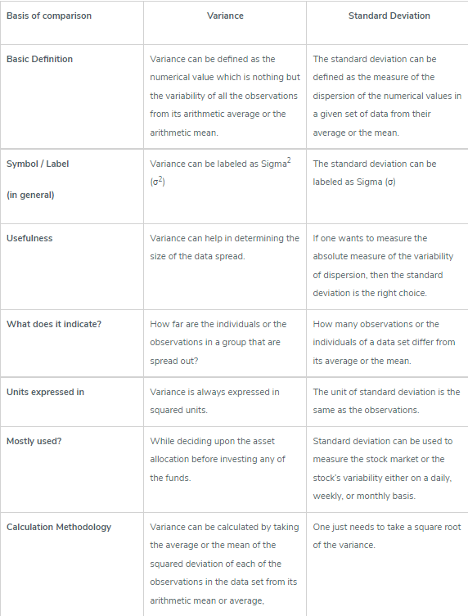
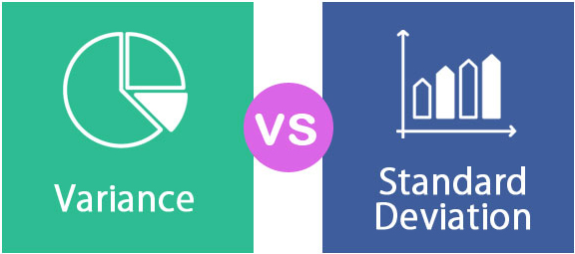
Properties of Variance and standard deviation
Image Source: https://www.educba.com/variance-vs-standard-deviation/
Notes:
Left (White Color space):
Title - Parent Topic
Subtitle - Subtopic 1
Body Text - Description in bullets
Right (Grey Color Space):
Body Text - Relevant image (with source)/code snippet
Put reference links in Speaker Notes
Reference:
https://www.tutorialspoint.com/internet_technologies/internet_overview.htm/

Slide 109
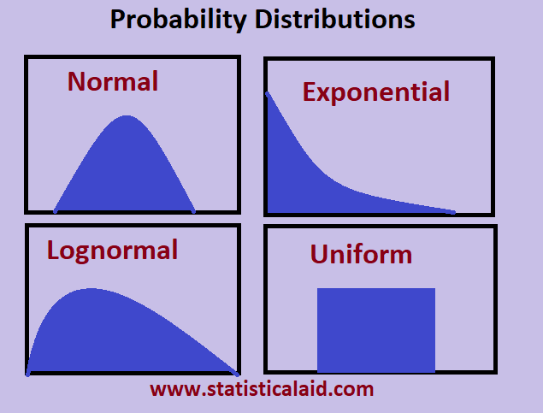
Types of Distributions
Data Distribution
Data distribution is a function that determines the values of a variable and quantifies relative frequency, it transforms raw data into graphical methods to give valuable information.
Image Source: https://www.educba.com/variance-vs-standard-deviation/
Notes:
Left (White Color space):
Title - Parent Topic
Subtitle - Subtopic 1
Body Text - Description in bullets
Right (Grey Color Space):
Body Text - Relevant image (with source)/code snippet
Put reference links in Speaker Notes
Reference:
https://www.tutorialspoint.com/internet_technologies/internet_overview.htm/

Slide 110
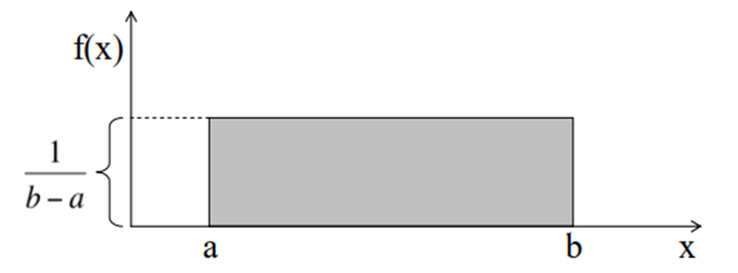
Types of Distributions
Uniform Distribution
The graph of a uniform distribution curve looks like
Uniform distribution can either be discrete or continuous where each event is equally likely to occur. It has a constant probability constructing a rectangular distribution.
A variable X is said to be uniformly distributed if the density function is:
Image Source: https://www.educba.com/variance-vs-standard-deviation/
Notes:
Left (White Color space):
Title - Parent Topic
Subtitle - Subtopic 1
Body Text - Description in bullets
Right (Grey Color Space):
Body Text - Relevant image (with source)/code snippet
Put reference links in Speaker Notes
Reference:
https://www.tutorialspoint.com/internet_technologies/internet_overview.htm/

Slide 111
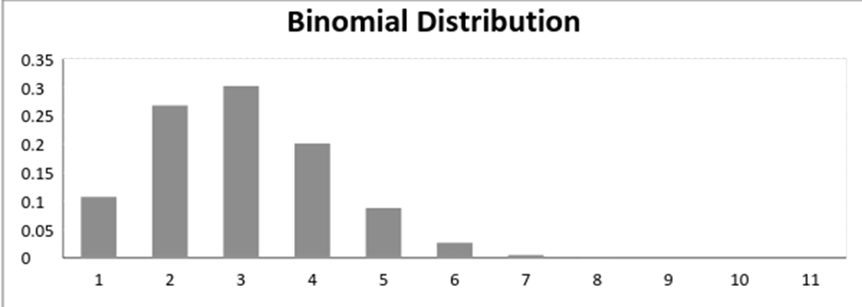
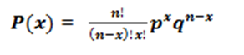
Types of Distributions
Binomial Distribution
A binomial distribution graph where the probability of success does not equal the probability of failure looks like
A distribution where only two outcomes are possible, such as success or failure, gain or loss, win or lose and where the probability of success and failure is same for all the trials is called a Binomial Distribution.
The mathematical representation of binomial distribution is given by:
Image Source: https://www.educba.com/variance-vs-standard-deviation/
Notes:
Left (White Color space):
Title - Parent Topic
Subtitle - Subtopic 1
Body Text - Description in bullets
Right (Grey Color Space):
Body Text - Relevant image (with source)/code snippet
Put reference links in Speaker Notes
Reference:
https://www.tutorialspoint.com/internet_technologies/internet_overview.htm/

Slide 112
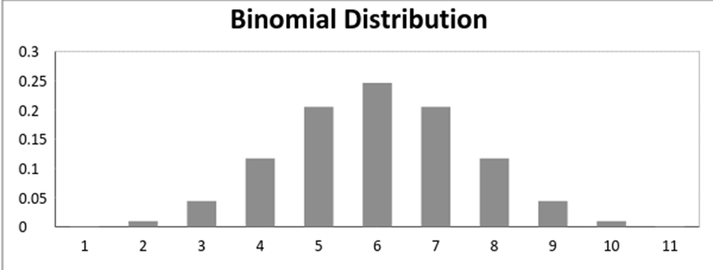
Types of Distributions
Binomial Distribution continued..
When probability of success = probability of failure, in such a situation the graph of binomial distribution looks like
Image Source: https://www.educba.com/variance-vs-standard-deviation/
Notes:
Left (White Color space):
Title - Parent Topic
Subtitle - Subtopic 1
Body Text - Description in bullets
Right (Grey Color Space):
Body Text - Relevant image (with source)/code snippet
Put reference links in Speaker Notes
Reference:
https://www.tutorialspoint.com/internet_technologies/internet_overview.htm/

Slide 113
Types of Distributions
Normal Distribution
Being a continuous distribution, the normal distribution is most commonly used in data science.
A very common process of our day to day life belongs to this distribution- income distribution, average employees report, average weight of a population, etc.
Image Source: https://www.educba.com/variance-vs-standard-deviation/
Notes:
Left (White Color space):
Title - Parent Topic
Subtitle - Subtopic 1
Body Text - Description in bullets
Right (Grey Color Space):
Body Text - Relevant image (with source)/code snippet
Put reference links in Speaker Notes
Reference:
https://www.tutorialspoint.com/internet_technologies/internet_overview.htm/

Slide 114
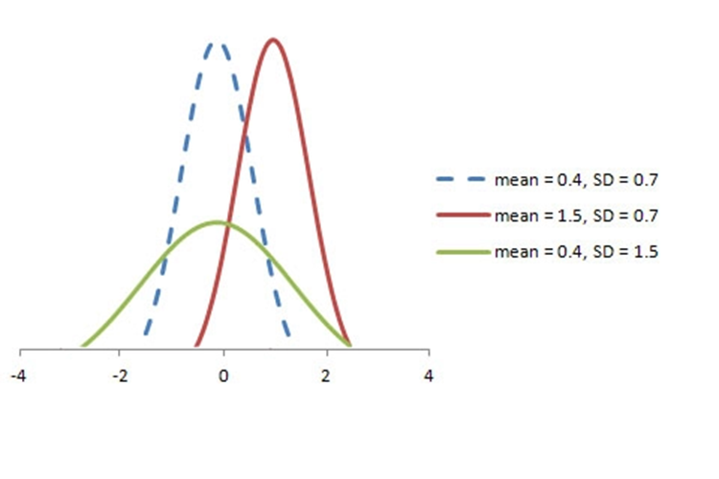
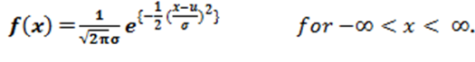
Types of Distributions
The graph of a random variable X ~ N (µ, σ) is shown below.
Normal Distribution
The PDF of a random variable X following a normal distribution is given by:
Image Source: https://www.educba.com/variance-vs-standard-deviation/
Notes:
Left (White Color space):
Title - Parent Topic
Subtitle - Subtopic 1
Body Text - Description in bullets
Right (Grey Color Space):
Body Text - Relevant image (with source)/code snippet
Put reference links in Speaker Notes
Reference:
https://www.tutorialspoint.com/internet_technologies/internet_overview.htm/

Slide 115
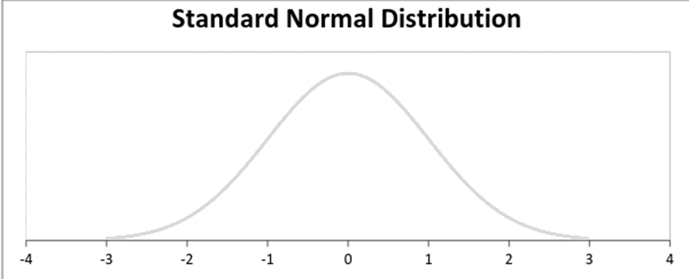
Types of Distributions
Normal Distribution
A standard normal distribution is defined as the distribution with mean 0 and standard deviation
Image Source: https://www.educba.com/variance-vs-standard-deviation/
Notes:
Left (White Color space):
Title - Parent Topic
Subtitle - Subtopic 1
Body Text - Description in bullets
Right (Grey Color Space):
Body Text - Relevant image (with source)/code snippet
Put reference links in Speaker Notes
Reference:
https://www.tutorialspoint.com/internet_technologies/internet_overview.htm/

Slide 116
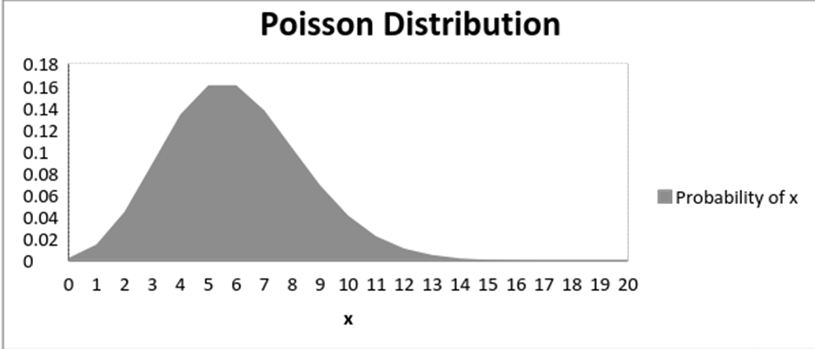
Types of Distributions
Poisson Distribution
The graph of a Poisson distribution is shown below:
A distribution is called Poisson distribution when the following assumptions are valid:
Any successful event should not influence the outcome of another successful event.
The probability of success over a short interval must equal the probability of success over a longer interval.
The probability of success in an interval approaches zero as the interval becomes smaller.
Image Source: https://www.educba.com/variance-vs-standard-deviation/
Notes:
Left (White Color space):
Title - Parent Topic
Subtitle - Subtopic 1
Body Text - Description in bullets
Right (Grey Color Space):
Body Text - Relevant image (with source)/code snippet
Put reference links in Speaker Notes
Reference:
https://www.tutorialspoint.com/internet_technologies/internet_overview.htm/

Slide 117
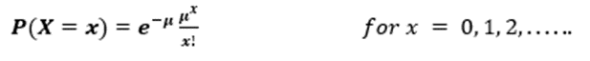
Types of Distributions
Poisson Distribution
Some notations used in Poisson distribution are:
λ is the rate at which an event occurs,
t is the length of a time interval,
And X is the number of events in that time interval.
Here, X is called a Poisson Random Variable and the probability distribution of X is called Poisson distribution.
Let µ denote the mean number of events in an interval of length t. Then, µ = λ*t.
The PMF of X following a Poisson distribution is given by:
Image Source: https://www.educba.com/variance-vs-standard-deviation/
Notes:
Left (White Color space):
Title - Parent Topic
Subtitle - Subtopic 1
Body Text - Description in bullets
Right (Grey Color Space):
Body Text - Relevant image (with source)/code snippet
Put reference links in Speaker Notes
Reference:
https://www.tutorialspoint.com/internet_technologies/internet_overview.htm/

Slide 118
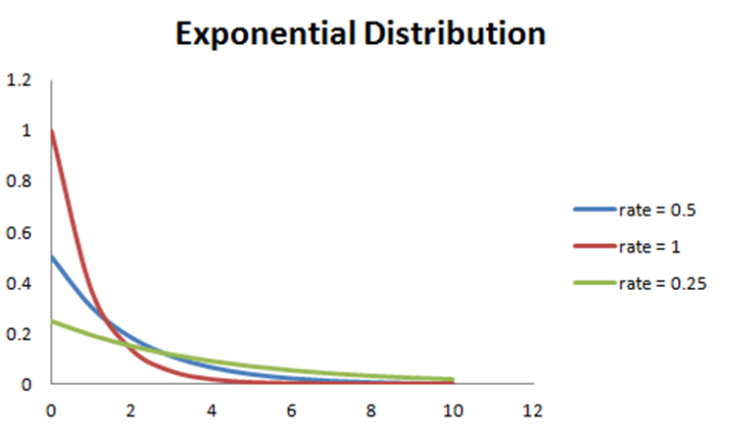
Types of Distributions
Exponential Distribution
Like the Poisson distribution, exponential distribution has the time element; it gives the probability of a time duration before an event takes place.
A random variable X is said to have an exponential distribution with PDF:
f(x) = { λe-λx, x ≥ 0
Image Source: https://www.educba.com/variance-vs-standard-deviation/
Notes:
Left (White Color space):
Title - Parent Topic
Subtitle - Subtopic 1
Body Text - Description in bullets
Right (Grey Color Space):
Body Text - Relevant image (with source)/code snippet
Put reference links in Speaker Notes
Reference:
https://www.tutorialspoint.com/internet_technologies/internet_overview.htm/

Slide 119
Sampling
What is sampling?
Sampling is a technique of selecting individual members or a subset of the population to make statistical inferences from them and estimate characteristics of the whole population.
Image Source:
Notes:
Left (White Color space):
Title - Parent Topic
Subtitle - Subtopic 1
Body Text - Description in bullets
Right (Grey Color Space):
Body Text - Relevant image (with source)/code snippet
Put reference links in Speaker Notes
Reference:
https://www.tutorialspoint.com/internet_technologies/internet_overview.htm/

Slide 120
Sampling
Sampling Example
If a drug manufacturer would like to research the adverse side effects of a drug on the country’s population, it is almost impossible to conduct a research study that involves everyone.
In this case, the researcher decides a sample of people from each demographic and then researches them, giving him/her indicative feedback on the drug’s behavior.
Image Source:
Notes:
Left (White Color space):
Title - Parent Topic
Subtitle - Subtopic 1
Body Text - Description in bullets
Right (Grey Color Space):
Body Text - Relevant image (with source)/code snippet
Put reference links in Speaker Notes
Reference:
https://www.tutorialspoint.com/internet_technologies/internet_overview.htm/

Slide 121
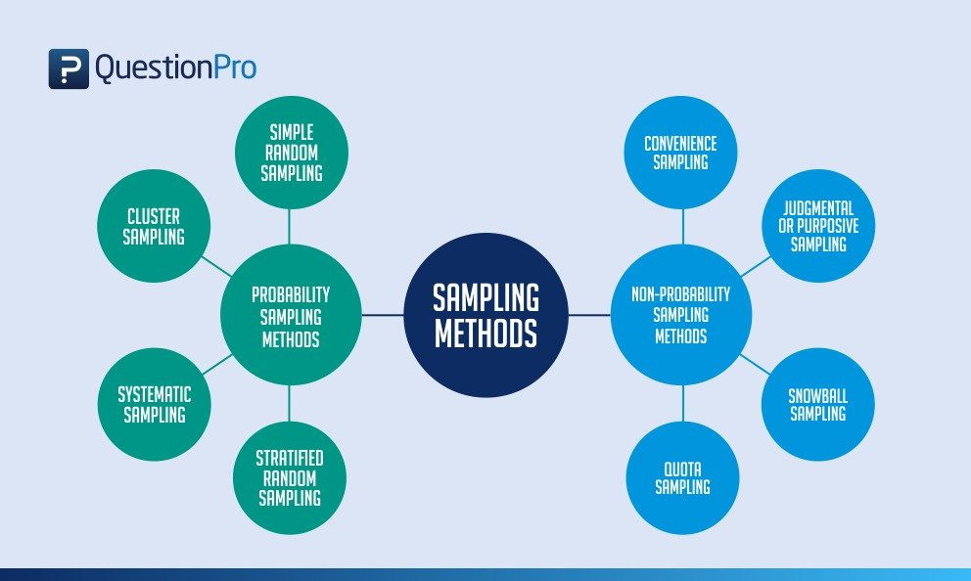
Sampling
Types of sampling: sampling methods
Probability sampling: Probability sampling is a sampling technique where a researcher sets a selection of a few criteria and chooses members of a population randomly.
All the members have an equal opportunity to be a part of the sample with this selection parameter.
Image Source:
Notes:
Left (White Color space):
Title - Parent Topic
Subtitle - Subtopic 1
Body Text - Description in bullets
Right (Grey Color Space):
Body Text - Relevant image (with source)/code snippet
Put reference links in Speaker Notes
Reference:
https://www.tutorialspoint.com/internet_technologies/internet_overview.htm/

Slide 122
Sampling
Types of sampling: sampling methods
Non-probability sampling: In non-probability sampling, the researcher chooses members for research at random.
This sampling method is not a fixed or predefined selection process. This makes it difficult for all elements of a population to have equal opportunities to be included in a sample.
Image Source:
Notes:
Left (White Color space):
Title - Parent Topic
Subtitle - Subtopic 1
Body Text - Description in bullets
Right (Grey Color Space):
Body Text - Relevant image (with source)/code snippet
Put reference links in Speaker Notes
Reference:
https://www.tutorialspoint.com/internet_technologies/internet_overview.htm/

Slide 123

Sampling
Types of probability sampling
Probability sampling is a sampling technique in which researchers choose samples from a larger population using a method based on the theory of probability.
This sampling method considers every member of the population and forms samples based on a fixed process.
Image Source:
Notes:
Left (White Color space):
Title - Parent Topic
Subtitle - Subtopic 1
Body Text - Description in bullets
Right (Grey Color Space):
Body Text - Relevant image (with source)/code snippet
Put reference links in Speaker Notes
Reference:
https://www.tutorialspoint.com/internet_technologies/internet_overview.htm/

Slide 124
Sampling
Types of probability sampling
Simple random sampling: It is a reliable method of obtaining information where every single member of a population is chosen randomly, merely by chance.
Cluster sampling: It sampling is a method where the researchers divide the entire population into sections or clusters that represent a population.
Image Source:
Notes:
Left (White Color space):
Title - Parent Topic
Subtitle - Subtopic 1
Body Text - Description in bullets
Right (Grey Color Space):
Body Text - Relevant image (with source)/code snippet
Put reference links in Speaker Notes
Reference:
https://www.tutorialspoint.com/internet_technologies/internet_overview.htm/

Slide 125
Sampling
Types of probability sampling
Systematic sampling: This method to choose the sample members of a population at regular intervals. It requires the selection of a starting point for the sample and sample size that can be repeated at regular intervals.
Stratified random sampling: It is a method in which the researcher divides the population into smaller groups that don’t overlap but represent the entire population.
Image Source:
Notes:
Left (White Color space):
Title - Parent Topic
Subtitle - Subtopic 1
Body Text - Description in bullets
Right (Grey Color Space):
Body Text - Relevant image (with source)/code snippet
Put reference links in Speaker Notes
Reference:
https://www.tutorialspoint.com/internet_technologies/internet_overview.htm/

Slide 126

Sampling
Types of non-probability sampling
Convenience sampling: This method is dependent on the ease of access to subjects such as surveying customers at a mall or passers-by on a busy street.
Judgmental or purposive sampling: Judgmental or purposive samples are formed by the discretion of the researcher. Researchers purely consider the purpose of the study, along with the understanding of the target audience.
Image Source:
Notes:
Left (White Color space):
Title - Parent Topic
Subtitle - Subtopic 1
Body Text - Description in bullets
Right (Grey Color Space):
Body Text - Relevant image (with source)/code snippet
Put reference links in Speaker Notes
Reference:
https://www.tutorialspoint.com/internet_technologies/internet_overview.htm/

Slide 127
Sampling
Types of non-probability sampling
Snowball sampling: It is a sampling method that researchers apply when the subjects are difficult to trace.
Quota sampling: In Quota sampling, the selection of members in this sampling technique happens based on a pre-set standard. .
Image Source:
Notes:
Left (White Color space):
Title - Parent Topic
Subtitle - Subtopic 1
Body Text - Description in bullets
Right (Grey Color Space):
Body Text - Relevant image (with source)/code snippet
Put reference links in Speaker Notes
Reference:
https://www.tutorialspoint.com/internet_technologies/internet_overview.htm/

Slide 128
Business Analytics
(17 hours)
Notes:
Title - The learning outcome
Subtitle - Duration

Slide 129
In this section, we will discuss:
Probability Theories
Bayes’ Theorem
Maximum Likelihood
Hypothesis Testing
Central limit theorem
Chi-square test
Notes:
Mention the parent topics one by one. This particular learning outcome has 4 parent topics.

Slide 130

Probability Theories
What Is Probability Theory?
Probability theory is a branch of mathematics focusing on the analysis of random phenomena. It is an important skill for data scientists using data affected by chance.
Image Source: https://i.pinimg.com/originals/c7/44/33/c74433effae9a094ff059a6d016d547b.jpg
Notes:
Left (White Color space):
Title - Parent Topic
Subtitle - Subtopic 1
Body Text - Description in bullets
Right (Grey Color Space):
Body Text - Relevant image (with source)/code snippet
Put reference links in Speaker Notes
Reference:
https://www.tutorialspoint.com/internet_technologies/internet_overview.htm/

Slide 131
Probability Theories
Practical Uses for Probability Theory
Data scientists to model situations
Business world
Business world
Clinical trials
Image Source: https://i.pinimg.com/originals/c7/44/33/c74433effae9a094ff059a6d016d547b.jpg
Notes:
Left (White Color space):
Title - Parent Topic
Subtitle - Subtopic 1
Body Text - Description in bullets
Right (Grey Color Space):
Body Text - Relevant image (with source)/code snippet
Put reference links in Speaker Notes
Reference:
https://www.tutorialspoint.com/internet_technologies/internet_overview.htm/

Slide 132

Probability Theories
Types of Probability?
Classical
Relative Frequency
Subjective Probability
Image Source: https://slideplayer.com/slide/6379961/22/images/3/Types+of+Probability.jpg
Notes:
Left (White Color space):
Title - Parent Topic
Subtitle - Subtopic 1
Body Text - Description in bullets
Right (Grey Color Space):
Body Text - Relevant image (with source)/code snippet
Put reference links in Speaker Notes
Reference:
https://www.tutorialspoint.com/internet_technologies/internet_overview.htm/

Slide 133
Probability Theories
Probability Theory Examples
Probability theory is a tool employed by researchers, businesses, investment analysts and countless others for risk management and scenario analysis.
Epidemiology
Insurance
Small Business
Meteorology
Image Source: https://i.pinimg.com/originals/c7/44/33/c74433effae9a094ff059a6d016d547b.jpg
Notes:
Left (White Color space):
Title - Parent Topic
Subtitle - Subtopic 1
Body Text - Description in bullets
Right (Grey Color Space):
Body Text - Relevant image (with source)/code snippet
Put reference links in Speaker Notes
Reference:
https://www.tutorialspoint.com/internet_technologies/internet_overview.htm/

Slide 134
Probability Theories
Advantages and Disadvantages of Probability Theory
Classical
Relative Frequency
Subjective
Image Source: https://slideplayer.com/slide/6379961/22/images/3/Types+of+Probability.jpg
Notes:
Left (White Color space):
Title - Parent Topic
Subtitle - Subtopic 1
Body Text - Description in bullets
Right (Grey Color Space):
Body Text - Relevant image (with source)/code snippet
Put reference links in Speaker Notes
Reference:
https://www.tutorialspoint.com/internet_technologies/internet_overview.htm/

Slide 135

Probability Theories
What is the probability formula?
P(A) = favorable outcomes/total outcomes
Image Source: https://d138zd1ktt9iqe.cloudfront.net/media/seo_landing_files/probability-formula-1-1634878086.png
Notes:
Left (White Color space):
Title - Parent Topic
Subtitle - Subtopic 1
Body Text - Description in bullets
Right (Grey Color Space):
Body Text - Relevant image (with source)/code snippet
Put reference links in Speaker Notes
Reference:
https://www.tutorialspoint.com/internet_technologies/internet_overview.htm/

Slide 136

Probability Theories
How Data Scientists Use Probability Theory
Probability allows data scientists to assess the certainty of outcomes of a particular study or experiment.
Today’s data scientists need to have an understanding of the foundational concepts of probability theory including key concepts involving probability distribution, statistical significance, hypothesis testing and regression.
Image Source: https://luminousmen.com/media/data-science-probability_2.jpg
Notes:
Left (White Color space):
Title - Parent Topic
Subtitle - Subtopic 1
Body Text - Description in bullets
Right (Grey Color Space):
Body Text - Relevant image (with source)/code snippet
Put reference links in Speaker Notes
Reference:
https://www.tutorialspoint.com/internet_technologies/internet_overview.htm/

Slide 137
Bayes’ Theorem
What is the Bayes’ Theorem?
The Bayes’ theorem is a mathematical formula used to determine the conditional probability of events. Essentially, the Bayes’ theorem describes the probability of an event based on prior knowledge of the conditions that might be relevant to the event.
Image Source: : https://cdn.corporatefinanceinstitute.com/assets/bayes-theorem.png
Notes:
Left (White Color space):
Title - Parent Topic
Subtitle - Subtopic 1
Body Text - Description in bullets
Right (Grey Color Space):
Body Text - Relevant image (with source)/code snippet
Put reference links in Speaker Notes
Reference:
https://www.tutorialspoint.com/internet_technologies/internet_overview.htm/

Slide 138
Bayes’ Theorem
Formula for Bayes’ Theorem
Where:
P(A|B) – the probability of event A occurring, given event B has occurred
P(B|A) – the probability of event B occurring, given event A has occurred
P(A) – the probability of event A
P(B) – the probability of event B
Image Source: : https://cdn.corporatefinanceinstitute.com/assets/bayes-theorem1.png
Notes:
Left (White Color space):
Title - Parent Topic
Subtitle - Subtopic 1
Body Text - Description in bullets
Right (Grey Color Space):
Body Text - Relevant image (with source)/code snippet
Put reference links in Speaker Notes
Reference:
https://www.tutorialspoint.com/internet_technologies/internet_overview.htm/

Slide 139
Bayes’ Theorem
Formula for Bayes’ Theorem
A special case of the Bayes’ theorem is when event A is a binary variable. In such a case, the theorem is expressed in the following way
Where:
•P(B|A–) – the probability of event B occurring given that event A– has occurred
•P(B|A+) – the probability of event B occurring given that event A+ has occurred
Image Source: https://cdn.corporatefinanceinstitute.com/assets/bayes-theorem2-600x97.png
Notes:
Left (White Color space):
Title - Parent Topic
Subtitle - Subtopic 1
Body Text - Description in bullets
Right (Grey Color Space):
Body Text - Relevant image (with source)/code snippet
Put reference links in Speaker Notes
Reference:
https://www.tutorialspoint.com/internet_technologies/internet_overview.htm/

Slide 140
Bayes’ Theorem
Example of Bayes’ Theorem
Using the Bayes’ theorem, we can find the required probability:
Image Source: https://cdn.corporatefinanceinstitute.com/assets/bayes-theorem3.png
Notes:
Left (White Color space):
Title - Parent Topic
Subtitle - Subtopic 1
Body Text - Description in bullets
Right (Grey Color Space):
Body Text - Relevant image (with source)/code snippet
Put reference links in Speaker Notes
Reference:
https://www.tutorialspoint.com/internet_technologies/internet_overview.htm/

Slide 141

Maximum likelihood
What is Maximum likelihood
Maximum likelihood is a widely used technique for estimation with applications in many areas including time series modeling, panel data, discrete data, and even machine learning.
Image Source: https://4.bp.blogspot.com/-FewCGHC23oU/WliHLS_APPI/AAAAAAAAAv8/gyvldpT8aG4VEPVu6DnqhIXoSaBg0F_YgCLcBGAs/s1600/Maximum-Likelihood-Estimation-in-Machine-Learning.jpg
Notes:
Left (White Color space):
Title - Parent Topic
Subtitle - Subtopic 1
Body Text - Description in bullets
Right (Grey Color Space):
Body Text - Relevant image (with source)/code snippet
Put reference links in Speaker Notes
Reference:
https://www.tutorialspoint.com/internet_technologies/internet_overview.htm/

Slide 142

Maximum likelihood
What is Maximum Likelihood Estimation?
Maximum likelihood estimation is a statistical method for estimating the parameters of a model. In maximum likelihood estimation, the parameters are chosen to maximize the likelihood that the assumed model results in the observed data.
Image Source: https://i.ytimg.com/vi/2vh98ful3_M/hqdefault.jpg
Notes:
Left (White Color space):
Title - Parent Topic
Subtitle - Subtopic 1
Body Text - Description in bullets
Right (Grey Color Space):
Body Text - Relevant image (with source)/code snippet
Put reference links in Speaker Notes
Reference:
https://www.tutorialspoint.com/internet_technologies/internet_overview.htm/

Slide 143
Maximum likelihood
What is Maximum Likelihood Estimation?
In order to implement maximum likelihood estimation we must:
Assume a model, also known as a data generating process, for our data.
Be able to derive the likelihood function for our data, given our assumed model (we will discuss this more later).
Image Source: https://i.ytimg.com/vi/2vh98ful3_M/hqdefault.jpg
Notes:
Left (White Color space):
Title - Parent Topic
Subtitle - Subtopic 1
Body Text - Description in bullets
Right (Grey Color Space):
Body Text - Relevant image (with source)/code snippet
Put reference links in Speaker Notes
Reference:
https://www.tutorialspoint.com/internet_technologies/internet_overview.htm/

Slide 144

Maximum likelihood
Advantages of Maximum Likelihood Estimation
If the model is correctly assumed, the maximum likelihood estimator is the most efficient estimator.
It provides a consistent but flexible approach which makes it suitable for a wide variety of applications, including cases where assumptions of other models are violated.
It results in unbiased estimates in larger samples.
Image Source: https://images.slideplayer.com/35/10494584/slides/slide_7.jpg
Notes:
Left (White Color space):
Title - Parent Topic
Subtitle - Subtopic 1
Body Text - Description in bullets
Right (Grey Color Space):
Body Text - Relevant image (with source)/code snippet
Put reference links in Speaker Notes
Reference:
https://www.tutorialspoint.com/internet_technologies/internet_overview.htm/

Slide 145
Maximum likelihood
Disadvantages of Maximum Likelihood Estimation
It relies on the assumption of a model and the derivation of the likelihood function which is not always easy.
Like other optimization problems, maximum likelihood estimation can be sensitive to the choice of starting values.
Image Source: https://images.slideplayer.com/35/10494584/slides/slide_7.jpg
Notes:
Left (White Color space):
Title - Parent Topic
Subtitle - Subtopic 1
Body Text - Description in bullets
Right (Grey Color Space):
Body Text - Relevant image (with source)/code snippet
Put reference links in Speaker Notes
Reference:
https://www.tutorialspoint.com/internet_technologies/internet_overview.htm/

Slide 146
Maximum likelihood
Disadvantages of Maximum Likelihood Estimation
Depending on the complexity of the likelihood function, the numerical estimation can be computationally expensive.
Estimates can be biased in small samples.
Image Source: https://images.slideplayer.com/35/10494584/slides/slide_7.jpg
Notes:
Left (White Color space):
Title - Parent Topic
Subtitle - Subtopic 1
Body Text - Description in bullets
Right (Grey Color Space):
Body Text - Relevant image (with source)/code snippet
Put reference links in Speaker Notes
Reference:
https://www.tutorialspoint.com/internet_technologies/internet_overview.htm/

Slide 147

Maximum likelihood
What is the Likelihood Function?
Maximum likelihood estimation hinges on the derivation of the likelihood function. For this reason, it is important to have a good understanding of what the likelihood function is and where it comes from.
Let's start with the very simple case where we have one series with 10 independent observations: 5, 0, 1, 1, 0, 3, 2, 3, 4, 1.
Image Source: http://ai.stanford.edu/~moises/tutorial/img032.GIF
Notes:
Left (White Color space):
Title - Parent Topic
Subtitle - Subtopic 1
Body Text - Description in bullets
Right (Grey Color Space):
Body Text - Relevant image (with source)/code snippet
Put reference links in Speaker Notes
Reference:
https://www.tutorialspoint.com/internet_technologies/internet_overview.htm/

Slide 148
What is the Likelihood Function?
The Probability Density
The first step in maximum likelihood estimation is to assume a probability distribution for the data. A probability density function measures the probability of observing the data given a set of underlying model parameters.
Image Source: http://ai.stanford.edu/~moises/tutorial/img032.GIF
Notes:
Left (White Color space):
Title - Parent Topic
Subtitle - Subtopic 1
Body Text - Description in bullets
Right (Grey Color Space):
Body Text - Relevant image (with source)/code snippet
Put reference links in Speaker Notes
Reference:
https://www.tutorialspoint.com/internet_technologies/internet_overview.htm/

Slide 149

What is the Likelihood Function?
The Probability Density
The Poisson probability density function for an individual observation, is given by
Because the observations in our sample are independent, the probability density of our observed sample can be found by taking the product of the probability of the individual observations:
Image Source: http://ai.stanford.edu/~moises/tutorial/img032.GIF
Notes:
Left (White Color space):
Title - Parent Topic
Subtitle - Subtopic 1
Body Text - Description in bullets
Right (Grey Color Space):
Body Text - Relevant image (with source)/code snippet
Put reference links in Speaker Notes
Reference:
https://www.tutorialspoint.com/internet_technologies/internet_overview.htm/

Slide 150
What is the Likelihood Function?
The Likelihood Function
The differences between the likelihood function and the probability density function are nuanced but important.
A probability density function expresses the probability of observing our data given the underlying distribution parameters. It assumes that the parameters are known.
Image Source: http://ai.stanford.edu/~moises/tutorial/img032.GIF
Notes:
Left (White Color space):
Title - Parent Topic
Subtitle - Subtopic 1
Body Text - Description in bullets
Right (Grey Color Space):
Body Text - Relevant image (with source)/code snippet
Put reference links in Speaker Notes
Reference:
https://www.tutorialspoint.com/internet_technologies/internet_overview.htm/

Slide 151
What is the Likelihood Function?
The Likelihood Function
The likelihood function expresses the likelihood of parameter values occurring given the observed data. It assumes that the parameters are unknown.
Image Source: http://ai.stanford.edu/~moises/tutorial/img032.GIF
Notes:
Left (White Color space):
Title - Parent Topic
Subtitle - Subtopic 1
Body Text - Description in bullets
Right (Grey Color Space):
Body Text - Relevant image (with source)/code snippet
Put reference links in Speaker Notes
Reference:
https://www.tutorialspoint.com/internet_technologies/internet_overview.htm/

Slide 152


What is the Likelihood Function?
The Likelihood Function
Mathematically the likelihood function looks similar to the probability density:
For our Poisson example, we can fairly easily derive the likelihood function
Image Source: http://ai.stanford.edu/~moises/tutorial/img032.GIF
Notes:
Left (White Color space):
Title - Parent Topic
Subtitle - Subtopic 1
Body Text - Description in bullets
Right (Grey Color Space):
Body Text - Relevant image (with source)/code snippet
Put reference links in Speaker Notes
Reference:
https://www.tutorialspoint.com/internet_technologies/internet_overview.htm/

Slide 153

What is the Likelihood Function?
The Log-Likelihood Function
In practice, the joint distribution function can be difficult to work with and the of the likelihood function is used instead. In the case of our Poisson dataset the log-likelihood function is:
Image Source: http://ai.stanford.edu/~moises/tutorial/img032.GIF
Notes:
Left (White Color space):
Title - Parent Topic
Subtitle - Subtopic 1
Body Text - Description in bullets
Right (Grey Color Space):
Body Text - Relevant image (with source)/code snippet
Put reference links in Speaker Notes
Reference:
https://www.tutorialspoint.com/internet_technologies/internet_overview.htm/

Slide 154


What is the Likelihood Function?
The Maximum Likelihood Estimator
A graph of the likelihood and log-likelihood for our dataset shows that the maximum likelihood occurs when θ= 2. This means that our maximum likelihood estimator,
Image Source: https://www.aptech.com/wp-content/uploads/2020/09/poisson-likelihood-function.jpeg
Notes:
Left (White Color space):
Title - Parent Topic
Subtitle - Subtopic 1
Body Text - Description in bullets
Right (Grey Color Space):
Body Text - Relevant image (with source)/code snippet
Put reference links in Speaker Notes
Reference:
https://www.tutorialspoint.com/internet_technologies/internet_overview.htm/

Slide 155
What is the Likelihood Function?
 | MLE | Bayesian Estimation
Predictions | We make predictions utilizing the latent variables in the density function to compute a probability. | We make predictions using the posterior distribution and the parameters which are considered as the random variables.
Situations to working with | Data with minimal values and the knowledge of prior is low. We can use MLE. | Data with sparse value and knowledge about the reliability of priors is high. We can use Bayesian estimation.
Complexity | MLE is less complex because we require to compute only the likelihood function | Bayesian estimation is more complex because the computation requires the likelihood function, evidence, and prior.
Maximum Likelihood Estimation (MLE) vs Bayesian Estimation.
Maximum Likelihood Estimation (MLE) vs Bayesian Estimation.
Notes:
Left (White Color space):
Title - Parent Topic
Subtitle - Subtopic 1
Body Text - Description in bullets
Right (Grey Color Space):
Body Text - Relevant image (with source)/code snippet
Put reference links in Speaker Notes
Reference:
https://www.tutorialspoint.com/internet_technologies/internet_overview.htm/

Slide 156

Hypothesis Testing
What Is Hypothesis Testing?
Hypothesis testing is an act in statistics whereby an analyst tests an assumption regarding a population parameter. The methodology employed by the analyst depends on the nature of the data used and the reason for the analysis.
https://miro.medium.com/max/862/1*VXxdieFiYCgR6v7nUaq01g.jpeg
Image Source: https://miro.medium.com/max/862/1*VXxdieFiYCgR6v7nUaq01g.jpeg
Notes:
Left (White Color space):
Title - Parent Topic
Subtitle - Subtopic 1
Body Text - Description in bullets
Right (Grey Color Space):
Body Text - Relevant image (with source)/code snippet
Put reference links in Speaker Notes
Reference:
https://www.tutorialspoint.com/internet_technologies/internet_overview.htm/

Slide 157
Hypothesis Testing
What Is Hypothesis Testing?
Hypothesis testing is used to assess the plausibility of a hypothesis by using sample data. Such data may come from a larger population, or from a data-generating process. The word "population" will be used for both of these cases in the following descriptions.
Image Source: https://miro.medium.com/max/862/1*VXxdieFiYCgR6v7nUaq01g.jpeg
Notes:
Left (White Color space):
Title - Parent Topic
Subtitle - Subtopic 1
Body Text - Description in bullets
Right (Grey Color Space):
Body Text - Relevant image (with source)/code snippet
Put reference links in Speaker Notes
Reference:
https://www.tutorialspoint.com/internet_technologies/internet_overview.htm/

Slide 158
Hypothesis Testing
What Is Hypothesis Testing?
Hypothesis testing is used to assess the plausibility of a hypothesis by using sample data.
The test provides evidence concerning the plausibility of the hypothesis, given the data.
Statistical analysts test a hypothesis by measuring and examining a random sample of the population being analyzed.
Image Source: https://miro.medium.com/max/862/1*VXxdieFiYCgR6v7nUaq01g.jpeg
Notes:
Left (White Color space):
Title - Parent Topic
Subtitle - Subtopic 1
Body Text - Description in bullets
Right (Grey Color Space):
Body Text - Relevant image (with source)/code snippet
Put reference links in Speaker Notes
Reference:
https://www.tutorialspoint.com/internet_technologies/internet_overview.htm/

Slide 159

Hypothesis Testing
How Hypothesis Testing Works
In hypothesis testing, an analyst tests a statistical sample, with the goal of providing evidence on the plausibility of the null hypothesis.
Statistical analysts test a hypothesis by measuring and examining a random sample of the population being analyzed.
Image Source: https://miro.medium.com/max/642/0*EsLPwer1RYCSczmw
Notes:
Left (White Color space):
Title - Parent Topic
Subtitle - Subtopic 1
Body Text - Description in bullets
Right (Grey Color Space):
Body Text - Relevant image (with source)/code snippet
Put reference links in Speaker Notes
Reference:
https://www.tutorialspoint.com/internet_technologies/internet_overview.htm/

Slide 160

Hypothesis Testing
Types of Hypothesis Testing
There are two types of Hypothesis Testing
Null hypothesis
Alternative hypothesis
Image Source: https://www.analyticssteps.com/backend/media/thumbnail/6735922/4237247_1626434645_HYPOTHESIS%20TESTINGArtboard%201.jpg
Notes:
Left (White Color space):
Title - Parent Topic
Subtitle - Subtopic 1
Body Text - Description in bullets
Right (Grey Color Space):
Body Text - Relevant image (with source)/code snippet
Put reference links in Speaker Notes
Reference:
https://www.tutorialspoint.com/internet_technologies/internet_overview.htm/

Slide 161
Hypothesis Testing
Types of Hypothesis Testing
Null Hypothesis: It is denoted by H0. A null hypothesis is the one in which sample observations result purely from chance. This means that the observations are not influenced by some non-random cause.
Image Source: https://www.analyticssteps.com/backend/media/thumbnail/6735922/4237247_1626434645_HYPOTHESIS%20TESTINGArtboard%201.jpg
Notes:
Left (White Color space):
Title - Parent Topic
Subtitle - Subtopic 1
Body Text - Description in bullets
Right (Grey Color Space):
Body Text - Relevant image (with source)/code snippet
Put reference links in Speaker Notes
Reference:
https://www.tutorialspoint.com/internet_technologies/internet_overview.htm/

Slide 162
Hypothesis Testing
Types of Hypothesis Testing
Alternative Hypothesis: It is denoted by Ha or H1. An alternative hypothesis is the one in which sample observations are influenced by some non-random cause. A hypothesis test concludes whether to reject the null hypothesis and accept the alternative hypothesis or to fail to reject the null hypothesis. The decision is based on the value of X and R.
Image Source: https://www.analyticssteps.com/backend/media/thumbnail/6735922/4237247_1626434645_HYPOTHESIS%20TESTINGArtboard%201.jpg
Notes:
Left (White Color space):
Title - Parent Topic
Subtitle - Subtopic 1
Body Text - Description in bullets
Right (Grey Color Space):
Body Text - Relevant image (with source)/code snippet
Put reference links in Speaker Notes
Reference:
https://www.tutorialspoint.com/internet_technologies/internet_overview.htm/

Slide 163
Hypothesis Testing
Steps in Hypothesis Testing
Stating the Hypotheses
Making Statistical Assumptions
Formulating an Analysis Plan
Investigating Sample Data
Interpreting Results
Image Source: https://miro.medium.com/max/642/0*EsLPwer1RYCSczmw
Notes:
Left (White Color space):
Title - Parent Topic
Subtitle - Subtopic 1
Body Text - Description in bullets
Right (Grey Color Space):
Body Text - Relevant image (with source)/code snippet
Put reference links in Speaker Notes
Reference:
https://www.tutorialspoint.com/internet_technologies/internet_overview.htm/

Slide 164

Hypothesis Testing
Accepting or Rejecting Null Hypothesis
This is an extension of the last step - interpreting results in the process of hypothesis testing. A null hypothesis is accepted or rejected basis P value and the region of acceptance.
P value – it is a function of the observed sample results.
Image Source: https://i0.wp.com/www.iedunote.com/img/25143/hypothesis-testing.png?resize=299%2C158&quality=100&ssl=1
Notes:
Left (White Color space):
Title - Parent Topic
Subtitle - Subtopic 1
Body Text - Description in bullets
Right (Grey Color Space):
Body Text - Relevant image (with source)/code snippet
Put reference links in Speaker Notes
Reference:
https://www.tutorialspoint.com/internet_technologies/internet_overview.htm/

Slide 165
Central limit theorem
What is the Central Limit Theorem (CLT)?
The Central Limit Theorem (CLT) is a statistical concept that states that the sample mean distribution of a random variable will assume a near-normal or normal distribution if the sample size is large enough.
Image Source: https://cdn.corporatefinanceinstitute.com/assets/Central-Limit-Theorem-CLT-Diagram-1200x734.png
Notes:
Left (White Color space):
Title - Parent Topic
Subtitle - Subtopic 1
Body Text - Description in bullets
Right (Grey Color Space):
Body Text - Relevant image (with source)/code snippet
Put reference links in Speaker Notes
Reference:
https://www.tutorialspoint.com/internet_technologies/internet_overview.htm/

Slide 166
Central limit theorem
How Does the Central Limit Theorem Work?
The central limit theorem forms the basis of the probability distribution. It makes it easy to understand how population estimates behave when subjected to repeated sampling. When plotted on a graph, the theorem shows the shape of the distribution formed by means of repeated population samples.
Image Source: https://cdn.corporatefinanceinstitute.com/assets/Central-Limit-Theorem-CLT-How-it-works-and-how-it-arises.png
Notes:
Left (White Color space):
Title - Parent Topic
Subtitle - Subtopic 1
Body Text - Description in bullets
Right (Grey Color Space):
Body Text - Relevant image (with source)/code snippet
Put reference links in Speaker Notes
Reference:
https://www.tutorialspoint.com/internet_technologies/internet_overview.htm/

Slide 167
Central limit theorem
How Does the Central Limit Theorem Work?
From the figure above, we can deduce that despite the fact that the original shape of the distribution was uniform, it tends towards a normal distribution as the value of n (sample size) increases.
Image Source: https://cdn.corporatefinanceinstitute.com/assets/Central-Limit-Theorem-CLT-How-it-works-and-how-it-arises.png
Notes:
Left (White Color space):
Title - Parent Topic
Subtitle - Subtopic 1
Body Text - Description in bullets
Right (Grey Color Space):
Body Text - Relevant image (with source)/code snippet
Put reference links in Speaker Notes
Reference:
https://www.tutorialspoint.com/internet_technologies/internet_overview.htm/

Slide 168
Central limit theorem
How Does the Central Limit Theorem Work?
Apart from showing the shape that the sample means will take, the central limit theorem also gives an overview of the mean and variance of the distribution. The sample mean of the distribution is the actual population mean from which the samples were taken.
Image Source: https://cdn.corporatefinanceinstitute.com/assets/Central-Limit-Theorem-CLT-How-it-works-and-how-it-arises.png
Notes:
Left (White Color space):
Title - Parent Topic
Subtitle - Subtopic 1
Body Text - Description in bullets
Right (Grey Color Space):
Body Text - Relevant image (with source)/code snippet
Put reference links in Speaker Notes
Reference:
https://www.tutorialspoint.com/internet_technologies/internet_overview.htm/

Slide 169
Central limit theorem
How Does the Central Limit Theorem Work?
The variance of the sample distribution, on the other hand, is the variance of the population divided by n. Therefore, the larger the sample size of the distribution, the smaller the variance of the sample mean.
Image Source: https://cdn.corporatefinanceinstitute.com/assets/Central-Limit-Theorem-CLT-How-it-works-and-how-it-arises.png
Notes:
Left (White Color space):
Title - Parent Topic
Subtitle - Subtopic 1
Body Text - Description in bullets
Right (Grey Color Space):
Body Text - Relevant image (with source)/code snippet
Put reference links in Speaker Notes
Reference:
https://www.tutorialspoint.com/internet_technologies/internet_overview.htm/

Slide 170

Chi-square test
What Is a Chi-Square Statistic?
A chi-square (χ2) statistic is a test that measures how a model compares to actual observed data. The data used in calculating a chi-square statistic must be random, raw, mutually exclusive, drawn from independent variables, and drawn from a large enough sample.
Image Source: https://i.ytimg.com/vi/HKDqlYSLt68/maxresdefault.jpg
Notes:
Left (White Color space):
Title - Parent Topic
Subtitle - Subtopic 1
Body Text - Description in bullets
Right (Grey Color Space):
Body Text - Relevant image (with source)/code snippet
Put reference links in Speaker Notes
Reference:
https://www.tutorialspoint.com/internet_technologies/internet_overview.htm/

Slide 171
Chi-square test
What Is a Chi-Square Statistic?
Chi-square tests are often used in hypothesis testing.
The chi-square statistic compares the size of any discrepancies between the expected results and the actual results, given the size of the sample and the number of variables in the relationship.
Image Source: https://i.ytimg.com/vi/HKDqlYSLt68/maxresdefault.jpg
Notes:
Left (White Color space):
Title - Parent Topic
Subtitle - Subtopic 1
Body Text - Description in bullets
Right (Grey Color Space):
Body Text - Relevant image (with source)/code snippet
Put reference links in Speaker Notes
Reference:
https://www.tutorialspoint.com/internet_technologies/internet_overview.htm/

Slide 172

Chi-square test
The Formula for Chi-Square Is
Image Source: https://i.ytimg.com/vi/HKDqlYSLt68/maxresdefault.jpg
Notes:
Left (White Color space):
Title - Parent Topic
Subtitle - Subtopic 1
Body Text - Description in bullets
Right (Grey Color Space):
Body Text - Relevant image (with source)/code snippet
Put reference links in Speaker Notes
Reference:
https://www.tutorialspoint.com/internet_technologies/internet_overview.htm/

Slide 173

Chi-square test
What Does a Chi-Square Statistic Tell You?
There are two main kinds of chi-square tests:
The test of independence, which asks a question of relationship, such as, "Is there a relationship between student sex and course choice?";
Image Source: https://www.statstest.com/wp-content/uploads/2020/10/Chi-Square-Test-of-Independence-1.jpg
Notes:
Left (White Color space):
Title - Parent Topic
Subtitle - Subtopic 1
Body Text - Description in bullets
Right (Grey Color Space):
Body Text - Relevant image (with source)/code snippet
Put reference links in Speaker Notes
Reference:
https://www.tutorialspoint.com/internet_technologies/internet_overview.htm/

Slide 174

Chi-square test
What Does a Chi-Square Statistic Tell You?
The goodness-of-fit test, which asks something like "How well does the coin in my hand match a theoretically fair coin?"
Chi-square analysis is applied to categorical variables and is especially useful when those variables are nominal (where order doesn't matter, like marital status or gender).
Image Source: https://www.statstest.com/wp-content/uploads/2020/09/Chi-Square-Goodness-of-Fit-Test-1024x622.jpg
Notes:
Left (White Color space):
Title - Parent Topic
Subtitle - Subtopic 1
Body Text - Description in bullets
Right (Grey Color Space):
Body Text - Relevant image (with source)/code snippet
Put reference links in Speaker Notes
Reference:
https://www.tutorialspoint.com/internet_technologies/internet_overview.htm/

Slide 175

Chi-square test
What is a chi-square test used for?
Chi-square is a statistical test used to examine the differences between categorical variables from a random sample in order to judge goodness of fit between expected and observed results.
Image Source: https://encrypted-tbn0.gstatic.com/images?q=tbn:ANd9GcR7Hd2uJDxTmKlfIWnu_U6Hqz4X8J5DRfRewA&usqp=CAU
Notes:
Left (White Color space):
Title - Parent Topic
Subtitle - Subtopic 1
Body Text - Description in bullets
Right (Grey Color Space):
Body Text - Relevant image (with source)/code snippet
Put reference links in Speaker Notes
Reference:
https://www.tutorialspoint.com/internet_technologies/internet_overview.htm/

Slide 176

Chi-square test
Who uses chi-square analysis?
Researchers
Nominal or Ordinal variable
Image Source: https://statswork.com/blog/wp-content/uploads/2019/10/chi-square-infographics.png
Notes:
Left (White Color space):
Title - Parent Topic
Subtitle - Subtopic 1
Body Text - Description in bullets
Right (Grey Color Space):
Body Text - Relevant image (with source)/code snippet
Put reference links in Speaker Notes
Reference:
https://www.tutorialspoint.com/internet_technologies/internet_overview.htm/

Slide 177
Data Analytics using Python
(30 Hours)
Notes:
Title - The learning outcome
Subtitle - Duration

Slide 178
In this section, we will discuss:
Data mining, wrangling, data manipulation techniques
Data cleaning and pre-processing techniques
Data analytics project lifecycle
Numerical Computing using NumPy Library
Multidimensional data handling using Pandas Library
Data Visualization using Matplotlib
Advanced data visualization using seaborn
Pandas profiling for report generation
Need for data visualization
Notes:
Mention the parent topics one by one. This particular learning outcome has 4 parent topics.

Slide 179

Data mining, wrangling,data manipulation techniques
Data Mining
Data Mining is defined as extracting information from huge sets of data.
Data mining is a process of extracting and discovering patterns in large data sets involving methods at the intersection of machine learning, statistics, and database systems.
Image Source: https://www.shutterstock.com/search/data+mining
Notes:
Left (White Color space):
Title - Parent Topic
Subtitle - Subtopic 1
Body Text - Description in bullets
Right (Grey Color Space):
Body Text - Relevant image (with source)/code snippet
Data mining is the process of sorting through large data sets to identify patterns and relationships that can help solve business problems through data analysis. Data mining techniques and tools enable enterprises to predict future trends and make more-informed business decisions.
Reference:
https://www.shutterstock.com/search/data+mining

Slide 180

Data mining, wrangling,data manipulation techniques
Why is data mining important?
Data mining tools predict behaviors and future trends, allowing businesses to make proactive, knowledge-driven decisions. Data mining tools can answer business questions that traditionally were too time consuming to resolve.
Image Source: https://slideplayer.com/slide/3900027/13/images/14/Why+is+data+mining+important.jpg
/
Notes:
This slide talks about the case if we have to divide a subtopic further.
Left (White Color space):
Title - Parent Topic
Subtitle - Subtopics of subtopics
Body Text - Description in bullets
Right (Grey Color Space):
Body Text - Relevant image (with source)/code snippet
Data mining is a crucial component of successful analytics initiatives in organizations. The information it generates can be used in business intelligence (BI) and advanced analytics applications that involve analysis of historical data, as well as real-time analytics applications that examine streaming data as it's created or collected.
Reference:
https://slideplayer.com/slide/3900027/13/images/14/Why+is+data+mining+important.jpg

Slide 181

Data mining, wrangling,data manipulation techniques
Data mining Steps
Understand Business
Understand the Data
Prepare the Data
Model the Data
Evaluate the Data
Deploy the Solution
Image Source: https://www.researchgate.net/figure/The-steps-for-data-mining-process_fig3_344166043
Notes:
Left (White Color space):
Title - Parent Topic
Subtitle - Subtopics of subtopics
Body Text - Description in bullets
Right (Grey Color Space):
Body Text - Relevant image (with source)/code snippet
Understand Business
What is the company’s current situation, the project’s objectives, and what defines success?
Understand the Data
Figure out what kind of data is needed to solve the issue, and then collect it from the proper sources.
Prepare the Data
Resolve data quality problems like duplicate, missing, or corrupted data, then prepare the data in a format suitable to resolve the business problem.
Model the Data
Employ algorithms to ascertain data patterns. Data scientists create, test, and evaluate the model.
Evaluate the Data
Decide whether and how effective the results delivered by a particular model will help meet the business goal or remedy the problem. Sometimes there’s an iterative phase for finding the best algorithm, especially if the data scientists don’t get it quite right the first time. There may be some data mining algorithms shopping around.
Deploy the Solution
Give the results of the project to the people in charge of making decisions.
Reference:
https://www.researchgate.net/figure/The-steps-for-data-mining-process_fig3_344166043

Slide 182

Data mining, wrangling,data manipulation techniques
Benefits of Data Mining
It helps companies gather reliable information.
It's an efficient, cost-effective solution compared to other data applications.
It helps businesses make profitable production and operational adjustments.
Data mining uses both new and legacy systems.
It helps businesses make informed decisions.
Image Source: https://www.includehelp.com/basics/data-mining-introduction-benefits-disadvantages-and-applications.aspx
Notes:
Left (White Color space):
Title - Parent Topic
Subtitle - Subtopics of subtopics
Body Text - Description in bullets
Right (Grey Color Space):
Body Text - Relevant image (with source)/code snippet
The Data Mining technique enables organizations to obtain knowledge-based data.
Data mining enables organizations to make lucrative modifications in operation and production.
Compared with other statistical data applications, data mining is a cost-efficient.
Data Mining helps the decision-making process of an organization.
It Facilitates the automated discovery of hidden patterns as well as the prediction of trends and behaviors.
It can be induced in the new system as well as the existing platforms.
It is a quick process that makes it easy for new users to analyze enormous amounts of data in a short time.
Reference:
https://www.includehelp.com/basics/data-mining-introduction-benefits-disadvantages-and-applications.aspx

Slide 183

Data mining, wrangling,data manipulation techniques
Data Mining Tools
Artificial Intelligence
Association Rule Learning
Clustering
Classification
Data Analytics
Data Cleansing and Preparation
Data Warehousing
Machine Learning
Regression
Image Source: https://medium.com/@springboard_ind/top-10-data-mining-tools-b06171d476d0
Notes:
Left (White Color space):
Title - Parent Topic
Subtitle - Subtopics of subtopics
Body Text - Description in bullets
Right (Grey Color Space):
Body Text - Relevant image (with source)/code snippet
Artificial Intelligence
AI systems perform analytical functions that mimic human intelligence, such as learning, planning, problem-solving, and reasoning.
Association Rule Learning
This toolset, also called market basket analysis, searches for relationships among dataset variables. For example, association rule learning can determine which products are frequently purchased together (e.g., a smartphone and a protective case).
Clustering
This process partitions datasets into a set of meaningful sub-classes, known as clusters. The process helps users understand the natural structure or grouping within the data.
Classification
This technique assigns particular items in a dataset to different target categories or classes. The goal is to develop accurate predictions within the target class for each case in the data.
Data Analytics
The data analytics process enables professionals to evaluate digital information and turn it into useful business intelligence.
Data Cleansing and Preparation
This technique transforms the data into a form optimal for further analysis and processing. Preparation includes activities such as identifying and removing errors and missing or duplicate data.
Data Warehousing
Data warehousing consists of an extensive collection of business data that businesses use to help them make decisions. Warehousing is a fundamental and necessary component of most large-scale data mining efforts.
Machine Learning
Related to the AI technique mentioned earlier, machine learning is a computer programming technique that employs statistical probabilities to provide computers with the ability to learn without human intervention or being manually programmed.
Regression
The regression technique predicts a range of numeric values in categories such as sales, stock prices, or even temperature. The ranges are based on the information found in a particular data set.
Two specific tools need mentioning.
R. This language is an open-source tool used for graphics and statistical computing. It provides analysts with a wide selection of statistical tests, classification and graphical techniques, and time-series analysis.
Oracle Data Mining (ODM). This tool is a module of the Oracle Advanced Analytics Database. It helps data analysts make predictions and generate detailed insights. Analysts use ODM to predict customer behavior, develop customer profiles, and identify cross-selling opportunities.
Reference:
https://medium.com/@springboard_ind/top-10-data-mining-tools-b06171d476d0

Slide 184

Data mining, wrangling,data manipulation techniques
Data Mining Applications
Retail
Financial services
Insurance
Manufacturing
Entertainment
Healthcare
Image Source: http://higssoftware.com/blog/data-mining-process-steps.php/
Notes:
Left (White Color space):
Title - Parent Topic
Subtitle - Subtopics of subtopics
Body Text - Description in bullets
Right (Grey Color Space):
Body Text - Relevant image (with source)/code snippet
Retail
Online retailers mine customer data and internet clickstream records to help them target marketing campaigns, ads and promotional offers to individual shoppers. Data mining and predictive modeling also power the recommendation engines that suggest possible purchases to website visitors, as well as inventory and supply chain management activities.
Financial services
Banks and credit card companies use data mining tools to build financial risk models, detect fraudulent transactions and vet loan and credit applications. Data mining also plays a key role in marketing and in identifying potential upselling opportunities with existing customers.
Insurance
Insurers rely on data mining to aid in pricing insurance policies and deciding whether to approve policy applications, including risk modeling and management for prospective customers.
Manufacturing
Data mining applications for manufacturers include efforts to improve uptime and operational efficiency in production plants, supply chain performance and product safety.
Entertainment
Streaming services do data mining to analyze what users are watching or listening to and to make personalized recommendations based on people's viewing and listening habits.
Healthcare
Data mining helps doctors diagnose medical conditions, treat patients and analyze X-rays and other medical imaging results. Medical research also depends heavily on data mining, machine learning and other forms of analytics.
Reference:
http://higssoftware.com/blog/data-mining-process-steps.php/

Slide 185

Data mining, wrangling,data manipulation techniques
Data Wrangling
Data wrangling is the process of cleaning and unifying messy and complex data sets for easy access and analysis.
Data Wrangling is also known as Data Munging.
Image Source: https://towardsdatascience.com/data-wrangling-raw-to-clean-transformation-b30a27bf4b3b
Notes:
Left (White Color space):
Title - Parent Topic
Subtitle - Subtopic 2
Body Text - Description in bullets
Right (Grey Color Space):
Body Text - Relevant image (with source)/code snippet
Data Wrangling is the process of gathering, collecting, and transforming Raw data into another format for better understanding, decision-making, accessing, and analysis in less time. Data Wrangling is also known as Data Munging.
Reference:
https://towardsdatascience.com/data-wrangling-raw-to-clean-transformation-b30a27bf4b3b

Slide 186

Data mining, wrangling,data manipulation techniques
What is the Purpose of Data Wrangling?
The primary purpose of data wrangling can be described as getting data in coherent shape
Image Source: https://pediaa.com/what-is-the-difference-between-data-wrangling-and-data-cleaning/
Notes:
This slide talks about the case if we have to divide a subtopic further.
Left (White Color space):
Title - Parent Topic
Subtitle - Subtopics of subtopics
Body Text - Description in bullets
Right (Grey Color Space):
Body Text - Relevant image (with source)/code snippet
Data wrangling involves processing the data in various formats and analyzes and get them to be used with another set of data and bringing them together into valuable insights. It further includes data aggregation, data visualization, and training statistical models for prediction
Reference:
https://pediaa.com/what-is-the-difference-between-data-wrangling-and-data-cleaning/

Slide 187

Data mining, wrangling,data manipulation techniques
Data Wrangling Steps
Data Discovery
Data Structuring
Data Cleaning
Data Enriching
Data Validating
Data Publishing
Image Source: https://favtutor.com/blogs/data-wrangling
Notes:
Left (White Color space):
Title - Parent Topic
Subtitle - Subtopics of subtopics
Body Text - Description in bullets
Right (Grey Color Space):
Body Text - Relevant image (with source)/code snippet
Data Discovery:
This is an all-encompassing term that describes understanding what your data is all about. In this first step, you get familiar with your data
Data Structuring:
When you collect raw data, it initially is in all shapes and sizes, and has no definite structure. Such data needs to be restructured to suit the analytical model that your enterprise plans to deploy
Data Cleaning:
Raw data comes with some errors that need to be fixed before data is passed on to the next stage. Cleaning involves the tackling of outliers, making corrections, or deleting bad data completely
Data Enriching:
By this stage, you have kind of become familiar with the data in hand. Now is the time to ask yourself this question – do you need to embellish the raw data? Do you want to augment it with other data?
Data Validating:
This activity surfaces data quality issues, and they have to be addressed with the necessary transformations. The rules of validation rules require repetitive programming steps to check the authenticity and the quality of your data
Data Publishing:
Once all the above steps are completed, the final output of your data wrangling efforts are pushed downstream for your analytics needs
Reference:
https://favtutor.com/blogs/data-wrangling

Slide 188

Data mining, wrangling,data manipulation techniques
Data Wrangling Tools
Excel Power Query / Spreadsheets
OpenRefine
Google DataPrep
Tabula
DataWrangler
CSVKit
Image Source: https://www.zohowebstatic.com/sites/default/files/dataprep/import-sources.png
/
Notes:
Left (White Color space):
Title - Parent Topic
Subtitle - Subtopics of subtopics
Body Text - Description in bullets
Right (Grey Color Space):
Body Text - Relevant image (with source)/code snippet
Excel Power Query / Spreadsheets: it is the basic manual structure wrangling tool.
OpenRefine: more sophisticated solutions, requires programming.
Google DataPrep: for data exploration, cleaning, and feature engineering.
Tabula: it's suitable for all kinds of data.
DataWrangler: used for data cleaning and transformation.
CSVKit: used for converting data.
Reference:
https://www.zohowebstatic.com/sites/default/files/dataprep/import-sources.png

Slide 189

Data mining, wrangling,data manipulation techniques
Data Wrangling in Python
Numpy
Pandas
Matplotlib
Plotly
Theano
Image Source: https://pythongeeks.org/data-wrangling-in-python-with-examples/
/
Notes:
Left (White Color space):
Title - Parent Topic
Subtitle - Subtopics of subtopics
Body Text - Description in bullets
Right (Grey Color Space):
Body Text - Relevant image (with source)/code snippet
Numpy (aka Numerical Python)
the most basic package. Lots of features for operations on n-arrays and matrices in Python. The library provides vectorization of mathematical operations on the NumPy array type, which improves performance and accordingly speeds up the execution.
Pandas
designed for fast and easy data analysis operations. Useful for data structures with labeled axes. Explicit data alignment prevents common errors that result from misaligned data coming in from different sources.
Matplotlib
Python visualization module. Good for line graphs, pie charts, histograms, and other professional grade figures.
Plotly
for interactive, publication-quality graphs. Excellent for line plots, scatter plots, area charts, bar charts, error bars, box plots, histograms, heatmaps, subplots, multiple-axis, polar graphs, and bubble charts.
Theano
library for numerical computation similar to Numpy. This library is designed to define, optimize, and evaluate mathematical expressions involving multi-dimensional arrays efficiently.
Reference:
https://pythongeeks.org/data-wrangling-in-python-with-examples/

Slide 190

Data mining, wrangling,data manipulation techniques
Data Manipulation
Pandas is an open-source python library that is used for data manipulation and analysis.
It provides many functions and methods to speed up the data analysis process.
Image Source: https://www.astera.com/type/blog/data-manipulation-tools/
Notes:
Left (White Color space):
Title - Parent Topic
Subtitle - Subtopic 3
Body Text - Description in bullets
Right (Grey Color Space):
Body Text - Relevant image (with source)/code snippet
Pandas is a newer package built on top of NumPy, and provides an efficient implementation of a DataFrame . DataFrame s are essentially multidimensional arrays with attached row and column labels, and often with heterogeneous types and/or missing data.
Reference:
https://www.astera.com/type/blog/data-manipulation-tools

Slide 191

Data mining, wrangling,data manipulation techniques
What are Data Manipulations?
Data manipulation with python is defined as a process in the python programming language that enables users in data organization in order to make reading or interpreting the insights from the data more structured and comprises of having better design.
Image Source: https://etipsguruji.com/data-manipulation-benefits-advantage/
/
Notes:
This slide talks about the case if we have to divide a subtopic further.
Left (White Color space):
Title - Parent Topic
Subtitle - Subtopics of subtopics
Body Text - Description in bullets
Right (Grey Color Space):
Body Text - Relevant image (with source)/code snippet
For example, arranging the employee’s names in alphabetical order will enable quicker searching of a particular employee by their name. The key feature of data manipulation is enabling faster business operations and also emphasize optimization in the process. Through proper manipulated data one can analyze trends, interpret insights from financial data, analyze consumer behaviour or pattern, etc. Not only the analyzing, but it also enables users to neglect any unnecessary data in the set so that one can save space and only fill the limited space with important and necessary data.
Reference:
https://etipsguruji.com/data-manipulation-benefits-advantage/

Slide 192

Data mining, wrangling,data manipulation techniques
Pandas
Pandas is an open source Python package that is most widely used for data science/data analysis and machine learning tasks.
It is built on top of another package named Numpy, which provides support for multi-dimensional arrays.
Image Source: https://towardsdatascience.com/manipulating-the-data-with-pandas-using-python-be6c5dfabd47
Notes:
Left (White Color space):
Title - Parent Topic
Subtitle - Subtopics of subtopics
Body Text - Description in bullets
Right (Grey Color Space):
Body Text - Relevant image (with source)/code snippet
module is basically an open-source Python module. It has a wide scope of use in the field of computing, data analysis, statistics, etc.
Pandas’ module uses the basic functionalities of the NumPy module.
Reference:
https://towardsdatascience.com/manipulating-the-data-with-pandas-using-python-be6c5dfabd47

Slide 193

Data mining, wrangling,data manipulation techniques
9 Effective Pandas Techniques in Python for Data Manipulation
Pivot Table
Boolean Indexing
Apply Function
Crosstab
Merge DataFrames
Sorting DataFrames
Plotting
Cut function
Impute Missing Values
Image Source: https://media.geeksforgeeks.org/wp-content/uploads/20210109131825/Annotation20210109131527-660x225.png
Notes:
Left (White Color space):
Title - Parent Topic
Subtitle - Subtopics of subtopics
Body Text - Description in bullets
Right (Grey Color Space):
Body Text - Relevant image (with source)/code snippet
Pivot Table
Pandas can be practised to produce MS Excel style pivot tables. For example, in a table, a key column which has missing values.
Boolean Indexing
Boolean Indexing is used if user wants to filter the values of a column based on conditions from another set of columns
Apply Function
It is one of the regularly used functions for working with data and building new variables
Crosstab
This function is used to get an original view of the data. The function provides scope to validate some fundamental hypothesis
Merge DataFrames
Merging data frames is vital when a user has data coming from various sources to be related.
Sorting DataFrames
When a user wants to sort pandas data frame based on the values of one or more columns or sort based on the contents of row index or row names of the panda’s data frame. Pandas data frame has two useful functions
sort_values(): this command is used to sort pandas data frame by one or more columns
sort_index(): this command is used to sort pandas data frame by row index
Plotting
Analyzing data from different columns can be very illuminating. Pandas make doing so simple with multi-column DataFrames. By default, calling df.plot() will make pandas to over-plot all column data, with each column as a single line.
Cut function
Seldom numerical values make more sense if grouped together.
Impute Missing Values
Imputing relates to applying a model to restore missing values.
There are several options users can consider while replacing a missing value, for example:
A fixed value that has meaning within the domain, such as 0, distinct from all other values.A value from another randomly chosen from the record.
A mean, median or mode value replaced for the column.
A value determined by another predictive model.
Reference:
https://media.geeksforgeeks.org/wp-content/uploads/20210109131825/Annotation20210109131527-660x225.png

Slide 194

Data cleaning and pre-processing techniques
Data Cleaning
Data cleaning is the process of fixing or removing incorrect, corrupted, incorrectly formatted, duplicate, or incomplete data within a dataset.
Image Source: https://www.dataversity.net/what-is-data-cleansing/
Notes:
Left (White Color space):
Title - Parent Topic
Subtitle – Subtopic 1
Body Text - Description in bullets
Right (Grey Color Space):
Body Text - Relevant image (with source)/code snippet
Data cleaning or cleansing is the process of detecting and correcting (or removing) corrupt or inaccurate records from a record set, table, or database and refers to identifying incomplete, incorrect, inaccurate or irrelevant parts of the data and then replacing, modifying, or deleting the dirty or coarse data.
Reference:
https://www.dataversity.net/what-is-data-cleansing/

Slide 195

Data cleaning and pre-processing techniques
Why data cleaning is essential?
Error-Free Data
Data Quality
Accurate and Efficient
Complete Data
Maintains Data Consistency
Image Source: https://medium.com/@nicklauswinters/data-cleaning-22b790eea834
Notes:
This slide talks about the case if we have to divide a subtopic further.
Left (White Color space):
Title - Parent Topic
Subtitle - Subtopics of subtopics
Body Text - Description in bullets
Right (Grey Color Space):
Body Text - Relevant image (with source)/code snippet
Missing data is always a problem in real life scenarios. Areas like machine learning and data mining face severe issues in the accuracy of their model predictions because of poor quality of data caused by missing values.
Reference:
https://medium.com/@nicklauswinters/data-cleaning-22b790eea834

Slide 196

Data cleaning and pre-processing techniques
8 effective data cleaning techniques
Remove duplicates
Remove irrelevant data
Standardize capitalization
Convert data type
Clear formatting
Fix errors
Language translation
Handle missing values
Image Source: https://prwatech.in/blog/machine-learning/data-cleaning-in-machine-learning/
Notes:
Left (White Color space):
Title - Parent Topic
Subtitle - Subtopics of subtopics
Body Text - Description in bullets
Right (Grey Color Space):
Body Text - Relevant image (with source)/code snippet
1. Remove Duplicates
When you collect your data from a range of different places, or scrape your data, it’s likely that you will have duplicated entries. These duplicates could originate from human error where the person inputting the data or filling out a form made a mistake.
Duplicates will inevitably skew your data and/or confuse your results. They can also just make the data hard to read when you want to visualize it, so it’s best to remove them right away.
2. Remove Irrelevant Data
Irrelevant data will slow down and confuse any analysis that you want to do. So, deciphering what is relevant and what is not is necessary before you begin your data cleaning. For instance, if you are analyzing the age range of your customers, you don’t need to include their email addresses.
Other elements you’ll need to remove as they add nothing to your data include:
Personal identifiable (PII) data
URLs
HTML tags
Boilerplate text (for ex. in emails)
Tracking codes
Excessive blank space between text
3. Standardize Capitalization
Within your data, you need to make sure that the text is consistent. If you have a mixture of capitalization, this could lead to different erroneous categories being created.
It could also cause problems when you need to translate before processing as capitalization can change the meaning. For instance, Bill is a person's name whereas a bill or to bill is something else entirely.
If, in addition to data cleaning, you are text cleaning in order to process your data with a computer model, it’s much simpler to put everything in lowercase.
4. Convert Data Types
Numbers are the most common data type that you will need to convert when cleaning your data. Often numbers are imputed as text, however, in order to be processed, they need to appear as numerals.
If they are appearing as text, they are classed as a string and your analysis algorithms cannot perform mathematical equations on them.
The same is true for dates that are stored as text. These should all be changed to numerals. For example, if you have an entry that reads September 24th 2021, you’ll need to change that to read 09/24/2021.
5. Clear Formatting
Machine learning models can’t process your information if it is heavily formatted. If you are taking data from a range of sources, it’s likely that there are a number of different document formats. This can make your data confusing and incorrect.
You should remove any kind of formatting that has been applied to your documents, so you can start from zero. This is normally not a difficult process, both excel and google sheets, for example, have a simple standardization function to do this.
6. Fix Errors
It probably goes without saying that you’ll need to carefully remove any errors from your data. Errors as avoidable as typos could lead to you missing out on key findings from your data. Some of these can be avoided with something as simple as a quick spell-check.
Spelling mistakes or extra punctuation in data like an email address could mean you miss out on communicating with your customers. It could also lead to you sending unwanted emails to people who didn’t sign up for them.
Other errors can include inconsistencies in formatting. For example, if you have a column of US dollar amounts, you’ll have to convert any other currency type into US dollars so as to preserve a consistent standard currency. The same is true of any other form of measurement such as grams, ounces, etc.
7. Language Translation
To have consistent data, you’ll want everything in the same language.
The Natural Language Processing (NLP) models behind software used to analyze data are also predominantly monolingual, meaning they are not capable of processing multiple languages. So, you’ll need to translate everything into one language.
8. Handle Missing Values
When it comes to missing values you have two options:
Remove the observations that have this missing value
Input the missing data
What you choose to do will depend on your analysis goals and what you want to do next with your data.
Reference:
https://prwatech.in/blog/machine-learning/data-cleaning-in-machine-learning/

Slide 197

Data cleaning and pre-processing techniques
6 Steps to Manipulate and Cleanse Data with Python
Imputing Missing Values
Outlier and Anomaly Detection
X-Variable Cleaning Methods
Y-Variable Cleaning Methods
Merging DataFrames
Parsing Dates
Image Source: https://brightdata.com/blog/how-tos/data-manipulation-cleaning-python
Notes:
Left (White Color space):
Title - Parent Topic
Subtitle - Subtopics of subtopics
Body Text - Description in bullets
Right (Grey Color Space):
Body Text - Relevant image (with source)/code snippet
1.Implementing missing values imputation – This is a standard statistical imputing constant, using KNN imputation.
Outlier/Anomaly Detection is carried out using: Isolation Forest, One Class SVM, Local Outlier Factor, and/or outlier detection algorithms.
2. Carrying out outlier/anomaly detection- You can accomplish this by using Isolation Forest, One-Class SVM, and/or Local Outlier Factor outlier detection algorithms.
3.Utilizing cleaning techniques from the X-Variable family- In this instance, you want to apply custom functions, remove duplicates, as well as replace crucial values.
4.Using Cleaning Techniques of the Y-Variable sort – Here it is important to do label encoding, one-hot encoding, as well as dictionary mapping.
5.DataFrames’ need to be merged- This step includes concatenating, merging, and joining.
6.The last step consists of ‘parsing dates’- Here you need to use auto-format detecting strings to accomplish ‘DateTime’ converting, including changing ‘DateTime’ objects to numbers.
Reference:
https://brightdata.com/blog/how-tos/data-manipulation-cleaning-python

Slide 198

Data cleaning and pre-processing techniques
Data Pre-processing
Data pre-processing is a data mining technique which is used to transform the raw data in a useful and efficient format.
Image Source: https://medium.datadriveninvestor.com/data-preprocessing-3cd01eefd438
Notes:
Left (White Color space):
Title - Parent Topic
Subtitle - Subtopic 2
Body Text - Description in bullets
Right (Grey Color Space):
Body Text - Relevant image (with source)/code snippet
Data pre-processing is a step in the data mining and data analysis process that takes raw data and transforms it into a format that can be understood and analyze by computers and machine learning.
Reference:
https://medium.datadriveninvestor.com/data-preprocessing-3cd01eefd438

Slide 199

Data cleaning and pre-processing techniques
Data Pre-processing Steps
Data quality assessment
Data cleaning
Data transformation
Data reduction
Image Source: https://www.techtarget.com/searchdatamanagement/definition/data-preprocessing
Notes:
This slide talks about the case if we have to divide a subtopic further.
Left (White Color space):
Title - Parent Topic
Subtitle - Subtopics of subtopics
Body Text - Description in bullets
Right (Grey Color Space):
Body Text - Relevant image (with source)/code snippet
Data quality assessment
Take a good look at your data and get an idea of its overall quality, relevance to your project, and consistency.
Data cleaning
Data cleaning is the process of adding missing data and correcting, repairing, or removing incorrect or irrelevant data from a data set.
Data transformation
With data cleaning, we’ve already begun to modify our data, but data transformation will begin the process of turning the data into the proper format(s) you’ll need for analysis and other downstream processes.
Reference:
https://www.techtarget.com/searchdatamanagement/definition/data-preprocessing

Slide 200

Data cleaning and pre-processing techniques
Steps involved in data pre-processing
Importing the required Libraries
Importing the data set
Handling the Missing Data.
Encoding Categorical Data.
Splitting the data set into test set and training set.
Feature Scaling.
Image Source: https://brain-mentors.com/wp-content/uploads/2020/05/Untitled-picture-9-1024x325.png
Notes:
Left (White Color space):
Title - Parent Topic
Subtitle - Subtopics of subtopics
Body Text - Description in bullets
Right (Grey Color Space):
Body Text - Relevant image (with source)/code snippet
Steps involved in data pre-processing :
Importing the required Libraries
Importing the data set
Handling the Missing Data.
Encoding Categorical Data.
Splitting the data set into test set and training set.
Feature Scaling.
Reference:
https://brain-mentors.com/wp-content/uploads/2020/05/Untitled-picture-9-1024x325.png

Slide 201

Data analytics project lifecycle
Project lifecycle
Domain/Business Understanding
Data collection/Data Exploration
Data Cleaning
Feature Engineering
Modelling
Image Source: https://pingax.com/understanding-data-analytics-project-life-cycle/
Notes:
Left (White Color space):
Title - Parent Topic
Subtitle - Subtopic 1
Body Text - Description in bullets
Right (Grey Color Space):
Body Text - Relevant image (with source)/code snippet
Domain/Business Understanding:
This initial phase focuses on understanding the project objectives and requirements from a business perspective, and then converting this knowledge into a data mining.
Understand the Business Process, beliefs, data generation process and storage.
Its very important to spend a good amount of time in this step so that the future once become more relevant to perform and there are less chances of errors.
Data collection/Data Exploration:
The data understanding phase starts with an initial data collection and proceeds with activities in order to get familiar with the data, to identify data quality problems, to discover first insights into the data, or to detect interesting subsets to form hypotheses for hidden information.
Data Cleaning:
It basically includes filling the missing values, dropping irrelevant and duplicate data. Handling outliers and unnatural values.
Feature Engineering:
Feature engineering is about creating new input features from your existing ones.
In general, you can think of data cleaning as a process of subtraction and feature engineering as a process of addition.
Getting Qualitative and quantitative information from the data, Feature selection using Data Visualization.
Modelling:
In this phase, various modelling techniques are selected and applied and their parameters are calibrated to optimal values. Typically, there are several techniques for the same data mining problem type. Some techniques have specific requirements on the form of data. Therefore, it is often required to step back to the data preparation phase.
Reference:
: https://pingax.com/understanding-data-analytics-project-life-cycle/

Slide 202

Data analytics project lifecycle
Project lifecycle
Evaluation
Optimization and Tuning
Deploy the Model to production
Monitor the performance during Production
Image Source: https://www.northeastern.edu/graduate/blog/data-analysis-project-lifecycle/
/
Notes:
Left (White Color space):
Title - Parent Topic
Subtitle - Subtopic 1
Body Text - Description in bullets
Right (Grey Color Space):
Body Text - Relevant image (with source)/code snippet
Evaluation:
At this stage in the project, you have built a model (or models) that appears to have high quality, from a data analysis perspective. Before proceeding to final deployment of the model, it is important to evaluate the model thoroughly and review the steps executed to construct the model, to be certain it properly achieves the business objectives.
Optimization and Tuning:
Even after evaluation of Model there can be certain requirements which can be raised at time of evaluation, Analyzing the same and integrating in the model.
Deploy the Model to production:
Finally, after all the UAT and implementing changes during UAT, the model is finally put to production. i.e the same goes live.
Monitor the performance during Production:
It takes some time to settle the model in live environment and familiarize the audience with the new features, so a continuous monitor is required so that any discrepancies can be solved straight away
Reference:
https://www.northeastern.edu/graduate/blog/data-analysis-project-lifecycle/

Slide 203

Numerical Computing using NumPy Library
What is Numerical Computing?
Numerical computing is an approach for solving complex mathematical problems using only simple arithmetic operations.
Numerical Python has a fixed-size, homogeneous (fixed-type), multi-dimensional array type and lots of functions for various array operations.
Image Source: https://slideplayer.com/slide/4519120/15/images/4/What+is+numerical+computing.jpg
Notes:
Left (White Color space):
Title - Parent Topic
Subtitle - Subtopic 1
Body Text - Description in bullets
Right (Grey Color Space):
Body Text - Relevant image (with source)/code snippet
Numerical computing is an approach for solving complex mathematical problems using only simple arithmetic operations
The approach involves formulation of mathematical models physical situations that can be solved with arithmetic operations
It requires development, analysis and use of algorithms.
Reference:
https://slideplayer.com/slide/4519120/15/images/4/What+is+numerical+computing.jpg

Slide 204

Numerical Computing using NumPy Library
What is NumPy in Python?
NumPy is an open-source library available in Python, which helps in mathematical, scientific, engineering, and data science programming.
It is a very useful library to perform mathematical and statistical operations in Python.
Image Source: https://favtutor.com/blogs/numpy-vs-pandas
Notes:
This slide talks about the case if we have to divide a subtopic further.
Left (White Color space):
Title - Parent Topic
Subtitle - Subtopics of subtopics
Body Text - Description in bullets
Right (Grey Color Space):
Body Text - Relevant image (with source)/code snippet
NumPy, which stands for Numerical Python, is a library consisting of multidimensional array objects and a collection of routines for processing those arrays.
NumPy is a Python package. It stands for 'Numerical Python'.
Reference:
https://favtutor.com/blogs/numpy-vs-pandas

Slide 205

Numerical Computing using NumPy Library
Why use NumPy?
NumPy is memory efficiency, meaning it can handle the vast amount of data more accessible than any other library.
Image Source: https://indianaiproduction.com/python-numpy-tutorial/
Notes:
Left (White Color space):
Title - Parent Topic
Subtitle - Subtopics of subtopics
Body Text - Description in bullets
Right (Grey Color Space):
Body Text - Relevant image (with source)/code snippet
Faster
Uses less memory to store data.
Convenient.
Reference:
https://indianaiproduction.com/python-numpy-tutorial/

Slide 206

Numerical Computing using NumPy Library
Creating Arrays
The array object in NumPy is called ndarray.
We can create a NumPy ndarray object by using the array() function.
Image Source: https://medium.com/analytics-vidhya/introduction-to-numpy-16a6efaffdd7
Notes:
Left (White Color space):
Title - Parent Topic
Subtitle - Subtopics of subtopics
Body Text - Description in bullets
Right (Grey Color Space):
Body Text - Relevant image (with source)/code snippet
Dimensions in Arrays
A dimension in arrays is one level of array depth (nested arrays).
0-D Arrays
0-D arrays, or Scalars, are the elements in an array. Each value in an array is a 0-D array.
1-D Arrays
An array that has 0-D arrays as its elements is called uni-dimensional or 1-D array.
2-D Arrays
An array that has 1-D arrays as its elements is called a 2-D array.
These are often used to represent matrix or 2nd order tensors.
3-D arrays
An array that has 2-D arrays (matrices) as its elements is called 3-D array.
These are often used to represent a 3rd order tensor.
Reference:
https://medium.com/analytics-vidhya/introduction-to-numpy-16a6efaffdd7

Slide 207

Numerical Computing using NumPy Library
Random Numbers using NumPy
NumPy offers the random module to work with random numbers.
rand()
randint()
choice()
Image Source: https://www.w3resource.com/python-exercises/numpy/python-numpy-random-exercise-2.php
Notes:
Left (White Color space):
Title - Parent Topic
Subtitle - Subtopics of subtopics
Body Text - Description in bullets
Right (Grey Color Space):
Body Text - Relevant image (with source)/code snippet
Generate Random Number
NumPy offers the random module to work with random numbers.
from numpy import random
x = random.randint(100)
print(x)
The random module's rand() method returns a random float between 0 and 1.
from numpy import random
x = random.rand()
print(x)
Generate Random Array
The randint() method takes a size parameter where you can specify the shape of an array.
Generate a 1-D array containing 5 random integers from 0 to 100:
from numpy import random
x=random.randint(100, size=(5))
print(x)
Generate a 2-D array with 3 rows, each row containing 5 random integers from 0 to 100:
from numpy import random
x = random.randint(100, size=(3, 5))
print(x)
The choice() method allows you to generate a random value based on an array of values.
from numpy import random
x = random.choice([3, 5, 7, 9])
print(x)
Reference:
: https://www.w3resource.com/python-exercises/numpy/python-numpy-random-exercise-2.php

Slide 208


Numerical Computing using NumPy Library
Indexing and Slicing in Python
Array indexing is the same as accessing an array element.
Slicing in python means taking elements from one given index to another given index.
Image Source: https://www.pythoninformer.com/python-libraries/numpy/index-and-slice/
Notes:
Left (White Color space):
Title - Parent Topic
Subtitle - Subtopics of subtopics
Body Text - Description in bullets
Right (Grey Color Space):
Body Text - Relevant image (with source)/code snippet
Access Array Elements
Array indexing is the same as accessing an array element.
You can access an array element by referring to its index number.
The indexes in NumPy arrays start with 0, meaning that the first element has index 0, and the second has index 1 etc.
Get the first element from the following array:
import numpy as np
arr = np.array([1, 2, 3, 4])
print(arr[0])
Slicing arrays
Slicing in python means taking elements from one given index to another given index.
We pass slice instead of index like this: [start:end].
We can also define the step, like this: [start:end:step].
If we don't pass start its considered 0
If we don't pass end its considered length of array in that dimension
If we don't pass step its considered 1
Slice elements from index 1 to index 5 from the following array:
import numpy as np
arr = np.array([1, 2, 3, 4, 5, 6, 7])
print(arr[1:5])
Reference:
https://www.pythoninformer.com/python-libraries/numpy/index-and-slice/

Slide 209

Numerical Computing using NumPy Library
Statistical Functions in Python
median: This will return the median along the specified axis.
average: This will return the weighted average along the specified axis.
mean: This will return the arithmetic mean along the specified axis.
std: This will return the standard deviation along the specified axis.
var: This will return the variance along the specified axis.
Image Source: https://d3mxt5v3yxgcsr.cloudfront.net/courses/3391/course_3391_image.jpg
Notes:
Left (White Color space):
Title - Parent Topic
Subtitle - Subtopics of subtopics
Body Text - Description in bullets
Right (Grey Color Space):
Body Text - Relevant image (with source)/code snippet
In Numpy, we can perform various statistical calculations using the various functions that are provided in the library like Order statistics, Averages and variances, correlating, Histograms.
Let us work on some of those statistical functions.
Order statistics:
amin: This will return the minimum of an array.
amax: This will return the maximum of an array.
Averages and variances:
median: This will return the median along the specified axis.
average: This will return the weighted average along the specified axis.
mean: This will return the arithmetic mean along the specified axis.
std: This will return the standard deviation along the specified axis.
var: This will return the variance along the specified axis.
Histograms:
histogram: This will return the computed histogram of a set of data.
Reference:
https://d3mxt5v3yxgcsr.cloudfront.net/courses/3391/course_3391_image.jpg

Slide 210

Numerical Computing using NumPy Library
Matrix Multiplication in Python
The Numpy matmul() function is used to return the matrix product of 2 arrays.
.
Image Source: https://www.javatpoint.com/numpy-matrix-multiplication
Notes:
Left (White Color space):
Title - Parent Topic
Subtitle - Subtopics of subtopics
Body Text - Description in bullets
Right (Grey Color Space):
Body Text - Relevant image (with source)/code snippet
The Numpy matmul() function is used to return the matrix product of 2 arrays.
2-D arrays, it returns normal product
Dimensions > 2, the product is treated as a stack of matrix
1-D array is first promoted to a matrix, and then the product is calculated
Reference:
https://www.javatpoint.com/numpy-matrix-multiplication

Slide 211

Multidimensional data handling using Pandas Library
What is PANDAS
PANDAS (PANel Data) is a high level data manipulation tool used for analysis data.
It is vary easy to import and export data using the Pandas library which has a very rich set of functions.
Image Source:https://cdn.educba.com/academy/wp-content/uploads/2019/04/What-is-Pandas-1.jpg
Notes:
Left (White Color space):
Title - Parent Topic
Subtitle - Subtopic 1
Body Text - Description in bullets
Right (Grey Color Space):
Body Text - Relevant image (with source)/code snippet
Put reference links in Speaker Notes
Reference:
https://www.tutorialspoint.com/internet_technologies/internet_overview.htm/

Slide 212
Multidimensional data handling using Pandas Library
What is PANDAS
Pandas have three important data structures, namely- Series, DataFrame, and Panel to make the process of analyzing data organized, effective and efficient.
Image Source:https://cdn.educba.com/academy/wp-content/uploads/2019/04/What-is-Pandas-1.jpg
Notes:
Left (White Color space):
Title - Parent Topic
Subtitle - Subtopic 1
Body Text - Description in bullets
Right (Grey Color Space):
Body Text - Relevant image (with source)/code snippet
Put reference links in Speaker Notes
Reference:
https://www.tutorialspoint.com/internet_technologies/internet_overview.htm/

Slide 213

Multidimensional data handling using Pandas Library
Data Structure in Pandas
Pandas deals with 3 data structure
Series
Data Frame
Panel
Image Source: https://www.askpython.com/wp-content/uploads/2020/02/Python-Pandas-Module.png
Notes:
Left (White Color space):
Title - Parent Topic
Subtitle - Subtopic 1
Body Text - Description in bullets
Right (Grey Color Space):
Body Text - Relevant image (with source)/code snippet
Put reference links in Speaker Notes
Reference:
https://www.tutorialspoint.com/internet_technologies/internet_overview.htm/

Slide 214

Multidimensional data handling using Pandas Library
Series
Series is a one-dimensional array like structure with homogeneous data, which can be used to handle and manipulate data.
Image Source:https://1.bp.blogspot.com/-mYFbQb6dNWo/Xyq3MiVrWMI/AAAAAAAAsB8/ayRGqtckDEIyctuow7M65ezNtMIdqeH7ACPcBGAYYCw/s437/Pandas%2Bseries.png
Notes:
Left (White Color space):
Title - Parent Topic
Subtitle - Subtopic 1
Body Text - Description in bullets
Right (Grey Color Space):
Body Text - Relevant image (with source)/code snippet
Put reference links in Speaker Notes
Reference:
https://www.tutorialspoint.com/internet_technologies/internet_overview.htm/

Slide 215
Multidimensional data handling using Pandas Library
Series
It has two parts
Data part (An array of actual data)
Associated index with data (associated array of indexes or data labels)
Image Source:https://1.bp.blogspot.com/-mYFbQb6dNWo/Xyq3MiVrWMI/AAAAAAAAsB8/ayRGqtckDEIyctuow7M65ezNtMIdqeH7ACPcBGAYYCw/s437/Pandas%2Bseries.png
Notes:
Left (White Color space):
Title - Parent Topic
Subtitle - Subtopic 1
Body Text - Description in bullets
Right (Grey Color Space):
Body Text - Relevant image (with source)/code snippet
Put reference links in Speaker Notes
Reference:
https://www.tutorialspoint.com/internet_technologies/internet_overview.htm/

Slide 216

Multidimensional data handling using Pandas Library
Creation of Series
There are different ways in which a series can be created in Pandas.
Creation of Series from Scalar Values
Creation of Series from NumPy Arrays
Creation of Series from Dictionary
Image Source: https://www.datasciencemadesimple.com/wp-content/uploads/2020/05/create-series-in-python-pandas-0.png
Notes:
Left (White Color space):
Title - Parent Topic
Subtitle - Subtopic 1
Body Text - Description in bullets
Right (Grey Color Space):
Body Text - Relevant image (with source)/code snippet
Put reference links in Speaker Notes
Reference:
https://www.tutorialspoint.com/internet_technologies/internet_overview.htm/

Slide 217

Multidimensional data handling using Pandas Library
Accessing Elements of a Series
There are two common ways for accessing the elements of a series: Indexing and Slicing.
Indexing
Slicing
Image Source: https://www.log2base2.com/images/general/python-list-index.png
Notes:
Left (White Color space):
Title - Parent Topic
Subtitle - Subtopic 1
Body Text - Description in bullets
Right (Grey Color Space):
Body Text - Relevant image (with source)/code snippet
Put reference links in Speaker Notes
Reference:
https://www.tutorialspoint.com/internet_technologies/internet_overview.htm/

Slide 218
Accessing Elements of a Series
Indexing
Indexing in Series is similar to that for NumPy arrays, and is used to access elements in a series.
Indexes are of two types: positional index and labelled index.
Positional index takes an integer value that corresponds to its position in the series starting from 0, whereas labelled index takes any user-defined label as index.
Image Source: https://www.log2base2.com/images/general/python-list-index.png
Notes:
Left (White Color space):
Title - Parent Topic
Subtitle - Subtopic 1
Body Text - Description in bullets
Right (Grey Color Space):
Body Text - Relevant image (with source)/code snippet
Put reference links in Speaker Notes
Reference:
https://www.tutorialspoint.com/internet_technologies/internet_overview.htm/

Slide 219
Accessing Elements of a Series
Slicing
Sometimes, we may need to extract a part of a series.
This can be done through slicing. This is similar to slicing used with NumPy arrays.
We can define which part of the series is to be sliced by specifying the start and end parameters [start :end] with the series name.
Image Source: https://www.log2base2.com/images/general/python-list-index.png
Notes:
Left (White Color space):
Title - Parent Topic
Subtitle - Subtopic 1
Body Text - Description in bullets
Right (Grey Color Space):
Body Text - Relevant image (with source)/code snippet
Put reference links in Speaker Notes
Reference:
https://www.tutorialspoint.com/internet_technologies/internet_overview.htm/

Slide 220

Data Visualization using Matplotlib
Why are visualizations important?
Visualizations are the easiest way to analyze and absorb information.
Visuals help to easily understand the complex problem.
They help in identifying patterns, relationships, and outliers in data.
Image Source:https://i.ytimg.com/vi/VyhLRJVoIrI/maxresdefault.jpg
Notes:
This slide talks about the case if we have to divide a subtopic further.
Title Box - Parent Topic
Subtitle box - Sub Topic
Body Text - Subtopic divisions (Subtopics of subtopics)

Slide 221

Data Visualization using Matplotlib
Matplotlib
Matplotlib is a 2-D plotting library that helps in visualizing figures.
Matplotlib emulates Matlab like graphs and visualizations.
Matlab is not free, is difficult to scale and as a programming language is tedious.
Image Source: https://matplotlib.org/3.1.1/_images/sphx_glr_anatomy_001.png
Notes:
This slide talks about the case if we have to divide a subtopic further.
Title Box - Parent Topic
Subtitle box - Sub Topic
Body Text - Subtopic divisions (Subtopics of subtopics)

Slide 222

Data Visualization using Matplotlib
Installing Matplotlib
Type !pip install matplotlib in the Jupyter Notebook or if it doesn’t work in cmd type conda install -c conda-forge matplotlib .
This should work in most cases.
Image Source:https://i.ytimg.com/vi/Iq9f2bQJOPg/maxresdefault.jpg
Notes:
This slide talks about the case if we have to divide a subtopic further.
Title Box - Parent Topic
Subtitle box - Sub Topic
Body Text - Subtopic divisions (Subtopics of subtopics)

Slide 223
Data Visualization using Matplotlib
Things to follow
Plotting of Matplotlib is quite easy. Generally, while plotting they follow the same steps in each and every plot.
Matplotlib has a module called pyplot which aids in plotting figure.
The Jupyter notebook is used for running the plots.
Image Source:https://i.ytimg.com/vi/Iq9f2bQJOPg/maxresdefault.jpg
Notes:
This slide talks about the case if we have to divide a subtopic further.
Title Box - Parent Topic
Subtitle box - Sub Topic
Body Text - Subtopic divisions (Subtopics of subtopics)

Slide 224

Data Visualization using Matplotlib
Histogram
A histogram takes in a series of data and divides the data into a number of bins.
It then plots the frequency data points in each bin (i.e. the interval of points).
It is useful in understanding the count of data ranges.
Image Source:https://i.stack.imgur.com/TBlN1.png
Notes:
This slide talks about the case if we have to divide a subtopic further.
Title Box - Parent Topic
Subtitle box - Sub Topic
Body Text - Subtopic divisions (Subtopics of subtopics)

Slide 225

Data Visualization using Matplotlib
Histogram: Pie chart
It is a circular plot which is divided into slices to illustrate numerical proportion. The slice of a pie chart is to show the proportion of parts out of a whole.
When to use: Pie chart should be used seldom used as It is difficult to compare sections of the chart. Bar plot is used instead as comparing sections is easy.
Image Source:https://media.geeksforgeeks.org/wp-content/uploads/20200426195330/plot28.png
Notes:
This slide talks about the case if we have to divide a subtopic further.
Title Box - Parent Topic
Subtitle box - Sub Topic
Body Text - Subtopic divisions (Subtopics of subtopics)

Slide 226

Data Visualization using Matplotlib
Time Series by line plot
Time series is a line plot and it is basically connecting data points with a straight line.
It is useful in understanding the trend over time.
It can explain the correlation between points by the trend.
An upward trend means positive correlation and downward trend means a negative correlation.
Image Source: https://pandas.pydata.org/pandas-docs/version/0.14.0/_images/frame_plot_basic.png
Notes:
This slide talks about the case if we have to divide a subtopic further.
Title Box - Parent Topic
Subtitle box - Sub Topic
Body Text - Subtopic divisions (Subtopics of subtopics)

Slide 227

Data Visualization using Matplotlib
Time Series by line plot
Violin plot is a better chart than boxplot as it gives a much broader understanding of the distribution.
It resembles a violin and dense areas point the more distribution of data otherwise hidden by box plots
Image Source:https://miro.medium.com/max/1204/1*J9OnuX8f5BjlB3XZiyHkVA.png
Notes:
This slide talks about the case if we have to divide a subtopic further.
Title Box - Parent Topic
Subtitle box - Sub Topic
Body Text - Subtopic divisions (Subtopics of subtopics)

Slide 228

Boxplot and Violinplot
Boxplot
Boxplot gives a nice summary of the data.
It helps in understanding our distribution better.
Image Source:https://miro.medium.com/max/482/1*fCE_5juz235c6cmaOP_PDQ.png
Notes:
This slide talks about the case if we have to divide a subtopic further.
Title Box - Parent Topic
Subtitle box - Sub Topic
Body Text - Subtopic divisions (Subtopics of subtopics)

Slide 229

Data Visualization using Matplotlib
TwinAxis
TwinAxis helps in visualizing plotting 2 plots w.r.t to the y-axis and same x-axis.
Image Source: https://miro.medium.com/max/1400/1*dHwnU6ySte5aqNZYezQAgQ.png
Notes:
This slide talks about the case if we have to divide a subtopic further.
Title Box - Parent Topic
Subtitle box - Sub Topic
Body Text - Subtopic divisions (Subtopics of subtopics)

Slide 230

Data Visualization using Matplotlib
Stack Plot and Stem Plot
Stack plot visualizes data in stacks and shows the distribution of data over time.
Stemplot even takes negative values, so the difference is taken of data and is plotted over time.
Image Source:https://media.geeksforgeeks.org/wp-content/uploads/20190429193409/plt.jpg
Notes:
Continuing from the last slide:
Title - Subtopic
Subtitle - Subtopic of Subtopic
Body - Description

Slide 231

Data Visualization using Matplotlib
Bar Plot
Bar Plot shows the distribution of data over several groups.
It is commonly confused with a histogram which only takes numerical data for plotting.
It helps in comparing multiple numeric values.
Image Source:https://shanelynnwebsite-mid9n9g1q9y8tt.netdna-ssl.com/wp-content/uploads/2020/04/data-visualisation-bar-charts-in-python-pandas-1-1024x441.png
Notes:
Continuing from the last slide:
Title - Subtopic
Subtitle - Subtopic of Subtopic
Body - Description

Slide 232

Data Visualization using Matplotlib
Scatter Plot
Scatter plot helps in visualizing 2 numeric variables.
It helps in identifying the relationship of the data with each variable i.e correlation or trend patterns.
It also helps in detecting outliers in the plot.
Image Source:https://files.realpython.com/media/scatter_plot_drinks_2.715371f88408.png
Notes:
Continuing from the last slide:
Title - Subtopic
Subtitle - Subtopic of Subtopic
Body - Description

Slide 233

Data Visualization using Matplotlib
3D Scatterplot
3D Scatterplot helps in visualizing 3 numerical variables in a three- dimensional plot.
Image Source:https://media.geeksforgeeks.org/wp-content/uploads/20200504194233/plot119.png
Notes:
Continuing from the last slide:
Title - Subtopic
Subtitle - Subtopic of Subtopic
Body - Description

Slide 234

Advanced data visualization using seaborn
What is Seaborn?
Matplotlib is the king of Python data visualization libraries and makes it a breeze to explore tabular data visually.
Seaborn is another Python data visualization library built on top of Matplotlib that introduces some features that weren’t previously available, and, in this tutorial, we’ll use Seaborn.
Image Source: https://seaborn.pydata.org/_images/introduction_1_0.png
Notes:
Continuing from the last slide:
Title - Subtopic
Subtitle - Subtopic of Subtopic
Body - Description

Slide 235

Advanced data visualization using seaborn
Installing the libraries and loading the data
We will start by installing the libraries and importing our data. Running the below command will install the Pandas, Matplotlib, and Seaborn libraries for data visualization:
pip install pandas matplotlib seaborn
Image Source: https://jovian.ai/api/gist/0503237bdcde46c4bd46c58843edf06b/preview/c9e3b2b3739a42c8b1298e3fb281d1af
Notes:
Continuing from the last slide:
Title - Subtopic
Subtitle - Subtopic of Subtopic
Body - Description

Slide 236
Advanced data visualization using seaborn
Installing the libraries and loading the data
Now, let’s import the libraries under their standard aliases:
import matplotlib.pyplot as plt
import pandas as pd
import seaborn as sns
Image Source: https://jovian.ai/api/gist/0503237bdcde46c4bd46c58843edf06b/preview/c9e3b2b3739a42c8b1298e3fb281d1af
Notes:
Continuing from the last slide:
Title - Subtopic
Subtitle - Subtopic of Subtopic
Body - Description

Slide 237

Advanced data visualization using seaborn
Performing univariate analysis with Seaborn
The goal of EDA is simple — get to know your dataset at the deepest level possible.
Becoming intimate with the data and learning its relationships between its variables is an absolute must.
Image Source:https://miro.medium.com/max/460/1*3AATuqbjcp3xMiTkuWwNPw.png
Notes:
Continuing from the last slide:
Title - Subtopic
Subtitle - Subtopic of Subtopic
Body - Description

Slide 238

Advanced data visualization using seaborn
Creating histograms in Seaborn
Now, we create our first plot, which is a histogram:
sns.histplot(x=sample["price"])
Image Source:https://blog.logrocket.com/wp-content/uploads/2021/11/histogram-count.png
Notes:
Continuing from the last slide:
Title - Subtopic
Subtitle - Subtopic of Subtopic
Body - Description

Slide 239

Advanced data visualization using seaborn
Creating count plots in Seaborn
The most common plot for categorical features is a countplot. Passing the name of a categorical feature in our dataset to Seaborn’s countplot draws a bar chart, with each bar height representing the number of diamonds in each category.
sns.countplot(sample["cut"])
Image Source:https://blog.logrocket.com/wp-content/uploads/2021/11/dataset-color.png
Notes:
Continuing from the last slide:
Title - Subtopic
Subtitle - Subtopic of Subtopic
Body - Description

Slide 240

Advanced data visualization using seaborn
Performing bivariate analysis with Seaborn
Now, let’s look at the relationships between two variables at a time.
Let’s start with the connection between diamond carats and price.
Image Source:https://miro.medium.com/max/1400/1*cIOI1p56qlHaLAbb6MxrKg.png
Notes:
Continuing from the last slide:
Title - Subtopic
Subtitle - Subtopic of Subtopic
Body - Description

Slide 241

Pandas profiling for report generation
What is Pandas Profiling
Pandas Profiling is an open-source python library, which allows you to do your EDA very quickly.
By the way, it also generates an interactive HTML report, which you can show to anyone.
Image Source:http://www.leehonan.com/content/images/2018/10/Screen-Shot-2018-10-28-at-5.43.26-pm.png
Notes:
Continuing from the last slide:
Title - Subtopic
Subtitle - Subtopic of Subtopic
Body - Description

Slide 242
Pandas profiling for report generation
What is Pandas Profiling
These are some of the things you get in your report:
Type inference
Essentials
Quantile statistics
Descriptive statistics
Most frequent values
Histogram
Image Source:http://www.leehonan.com/content/images/2018/10/Screen-Shot-2018-10-28-at-5.43.26-pm.png
Notes:
Continuing from the last slide:
Title - Subtopic
Subtitle - Subtopic of Subtopic
Body - Description

Slide 243

Pandas profiling for report generation
How to install Pandas Profiling
First of all, you need to install the package.
#installing Pandas Profiling
!pip install https://github.com/pandas-profiling/pandas-profiling/archive/master.zip -q
Image Source:https://miro.medium.com/max/1400/1*qoT2rIJyQ7qD_aCE9naqGw.jpeg
Notes:
Continuing from the last slide:
Title - Subtopic
Subtitle - Subtopic of Subtopic
Body - Description

Slide 244
Pandas profiling for report generation
How to install Pandas Profiling
Then import both pandas and panda_profiling.
We will be using the Titanic dataset to complete our analysis so import that as well.
After you import it, you should always take a look at your dataset and then merely link report to it:
Image Source:https://miro.medium.com/max/1400/1*qoT2rIJyQ7qD_aCE9naqGw.jpeg
Notes:
Continuing from the last slide:
Title - Subtopic
Subtitle - Subtopic of Subtopic
Body - Description

Slide 245

Need for data visualization
What is Data Visualization?
Data visualization gives us a clear idea of what the information means by giving it visual context through maps or graphs.
This makes the data more natural for the human mind to comprehend and therefore makes it easier to identify trends, patterns, and outliers within large data sets.
Image Source:https://venngage-wordpress.s3.amazonaws.com/uploads/2020/06/What-is-Data-Visualization-Blog-Header.jpg
Notes:
Continuing from the last slide:
Title - Subtopic
Subtitle - Subtopic of Subtopic
Body - Description

Slide 246
Need for data visualization
Why is Data Visualization Important?
Data visualization uses visual data to communicate information in a manner that is universal, fast, and effective.
This practice can help companies identify which areas need to be improved, which factors affect customer satisfaction and dissatisfaction, and what to do with specific products.
Image Source:https://i.ytimg.com/vi/VyhLRJVoIrI/maxresdefault.jpg
Notes:
Continuing from the last slide:
Title - Subtopic
Subtitle - Subtopic of Subtopic
Body - Description

Slide 247

Need for data visualization
What Are The Benefits of Data Visualization?
Data visualization positively affects an organization’s decision-making process with interactive visual representations of data.
Businesses can now recognize patterns more quickly because they can interpret data in graphical or pictorial forms.
Image Source: https://cdn.slingshotapp.io/wp-content/uploads/2021/09/slingshot-Benefits-of-Data-Visualization-768x505.png
Notes:
Continuing from the last slide:
Title - Subtopic
Subtitle - Subtopic of Subtopic
Body - Description

Slide 248

Need for data visualization
Which Data Visualization Techniques are Used?
There are many different methods of putting together information in a way that the data can be visualized.
Depending on the data being modeled, and what its intended purpose is, a variety of different graphs and tables may be utilized to create an easy to interpret dashboard.
Image Source:https://cdn.whatagraph.com/blog/data-visualisation-techniques.png
Notes:
Continuing from the last slide:
Title - Subtopic
Subtitle - Subtopic of Subtopic
Body - Description

Slide 249

Need for data visualization
Who Uses Data Visualization?
Data visualization is used across all industries to increase sales with existing customers and target new markets and demographics for potential customers.
Image Source:https://neilpatel.com/wp-content/uploads/2021/03/Data-Visualization_Featured-Image-1.png
Notes:
Continuing from the last slide:
Title - Subtopic
Subtitle - Subtopic of Subtopic
Body - Description

Slide 250


Fundamentals of Predictive Analytics using Machine Learning techniques (40 hr)

Slide 251
In this section, we will discuss:
Machine learning and its types & applications
Supervised machine learning techniques
Classification vs. regression
Understanding Regression and types
Linear regression using OLS
Multi-Variate Linear Regression
Correlation concepts
Metrics- Loss function, MSE, RMSE, MAE, R2 Score

Slide 252

Machine learning and its types & Applications
Machine learning
AI Approach that uses a system that is capable of learning from experience without having to be programmed.
Image Source:
https://static.javatpoint.com/tutorial/machine-learning/images/introduction-to-machine-learning.png

Slide 253

Machine learning and its types & Applications
How does Machine Learning Work?
Learns from historical data, builds the prediction models, and whenever it receives new data, predicts the output for it.
Image Source:
https://static.javatpoint.com/tutorial/machine-learning/images/introduction-to-machine-learning2.png

Slide 254

Machine learning and its types & Applications
Applications
Image Recognition
Speech Recognition
Traffic prediction
Product recommendations
Self-driving cars
Email Spam and Malware Filtering
Virtual Personal Assistant
Online Fraud Detection
Stock Market trading
Medical Diagnosis
Automatic Language Translation
Image Source: https://www.javatpoint.com/machine-learning

Slide 255

Machine learning and its types & Applications
Types
Supervised Learning
Unsupervised Learning
Reinforcement Learning
Image Source: https://static.javatpoint.com/tutorial/machine-learning/images/machine-learning-algorithms.png

Slide 256

Machine learning and its types & Applications
Supervised Learning
It is a process of learning algorithm from the training dataset.
Using input and output variable, an algorithm is used to learn the mapping function from the input to the output.
Image Source: https://static.javatpoint.com/tutorial/machine-learning/images/supervised-machine-learning.png

Slide 257

Machine learning and its types & Applications
Unsupervised Learning
Modeling the underlying or hidden structure or distribution in the data in order to learn more about the data.
Only have input data and no corresponding output variables.
Image Source: https://static.javatpoint.com/tutorial/machine-learning/images/unsupervised-machine-learning-1.png

Slide 258
Machine learning and its types & Applications
Supervised Learning
It is a process of learning algorithm from the training dataset.
Using input and output variable, an algorithm is used to learn the mapping function from the input to the output.
Image Source: https://static.javatpoint.com/tutorial/machine-learning/images/supervised-machine-learning.png

Slide 259

Machine learning and its types & Applications
Reinforcement Learning
Model keeps on increasing its performance using a reward feedback to learn the behavior or pattern.
Markov decision process, Bellman’s equation, Q-learning, SARSA (state-Action-Reward-State-Action), Deep Q-network
Image Source: https://static.javatpoint.com/tutorial/reinforcement-learning/images/what-is-reinforcement-learning.png

Slide 260

Supervised machine learning techniques
Classification
Classification is a process of finding a function which helps in dividing the dataset into classes based on different parameters.
Output is having discrete value.
Image Source: https://media.geeksforgeeks.org/wp-content/uploads/supervised-data.png

Slide 261

Supervised machine learning techniques
Regression
Regression analysis is a statistical method to model the relationship between a dependent (target) and independent (predictor) variables with one or more independent variables.
Output is having continuous value.
Image Source: https://media.geeksforgeeks.org/wp-content/uploads/supervised-data.png

Slide 262


Classification vs. Regression
Image Source: https://static.javatpoint.com/tutorial/machine-learning/images/regression-vs-classification-in-machine-learning.png

Slide 263

Understanding Regression and Types
Types
Linear Regression
Logistic Regression
Polynomial Regression
Support Vector Regression
Decision Tree Regression
Random Forest Regression
Ridge Regression
Lasso Regression:
Image Source: https://static.javatpoint.com/tutorial/machine-learning/images/types-of-regression.png

Slide 264



Linear regression using OLS
Ordinary Least Squares
Ordinary least squares, or linear least squares, estimates the parameters in a regression model by minimizing the sum of the squared residuals.
This method draws a line through the data points that minimizes the sum of the squared differences between the observed values and the corresponding fitted values.
Image Source: https://statisticsbyjim.com/glossary/ordinary-least-squares/#:~:text=Ordinary%20least%20squares%2C%20or%20linear,and%20the%20corresponding%20fitted%20values

Slide 265

Understanding Regression and Types
Linear Regression
Relationship between a dependent (y) and one or more independent (y) variables.
Image Source: https://static.javatpoint.com/tutorial/machine-learning/images/linear-regression-in-machine-learning.png

Slide 266

Understanding Regression and Types
Linear and Multiple Regression
Multiple regression is a broader class of regressions that encompasses linear and nonlinear regressions with multiple explanatory variables.
Whereas linear regress only has one independent variable impacting the slope of the relationship, multiple regression incorporates multiple independent variables.
Image Source: https://static.javatpoint.com/tutorial/machine-learning/images/linear-regression-in-machine-learning.png

Slide 267


Metrics
Loss Function
A function that calculates loss for 1 data point is called the loss function.
Image Source: https://miro.medium.com/max/1400/0*D88aae6e_CG35R1p.png

Slide 268

Metrics
Mean Squared Error (MSE) / Mean Squared Deviation (MSD)
It basically calculates the difference between the estimated and the actual value, squares these results and then computes their average.
MSE can only assume non-negative values .
ŷᵢ→ Predicted, yᵢ→ Actual
Image Source: https://miro.medium.com/max/682/0*omsdYpfRvm3ALVaO

Slide 269

Metrics
Root Mean Squared Error (RMSE) / Root Mean Squared Deviation (RMSD)
RMSE calculates the average of the squared errors across all samples but, in addition, takes the square root of the result.
Image Source: https://miro.medium.com/proxy/0*d3UTunsQ5djTl-4G

Slide 270

Metrics
Mean Absolute Error (MAE)
It simply calculates the absolute value of the errors and then takes the average of these values.
Image Source: https://miro.medium.com/max/650/0*sTJz5_kSQua4iNE8

Slide 271

Metrics
R Squared (R²) / Coefficient of Determination
R Squared (R²) represents the proportion of the variance for the dependent variable y that’s explained by the independent variables X.
R² explains to what extent the variance of one variable explains the variance of the second variable
If the R² of a model is 0.75, then approximately 75% of the observed variation can be explained by the model’s features..
Image Source: https://miro.medium.com/max/1400/0*5-k42pnh0PpJhw-E

Slide 272
In this section, we will discuss:
Residuals in Regression
Polynomial features
Classification techniques
Types of distance metrics
KNN Classification
Gradient Decent
Notes:
In this section, we will discuss:
Residuals in Regression
Polynomial features
Classification techniques
Types of distance metrics
KNN Classification
Gradient Decent

Slide 273

Residuals in Regression
What is it?
A residual is the vertical distance between a data point and the regression line.
Each data point has one residual.
Image Source: nws.noaa.gov
Notes:
When you perform simple linear regression (or any other type of regression analysis), you get a line of best fit. The data points usually don’t fall exactly on this regression equation line; they are scattered around. A residual is the vertical distance between a data point and the regression line.
Reference:
https://www.statisticshowto.com/residual/
https://machinelearningmastery.com/polynomial-features-transforms-for-machine-learning/#:~:text=Polynomial%20features%20are%20those%20features,X%2C%20e.g.%20X%5E2.
https://monkeylearn.com/blog/classification-algorithms/
https://machinelearningmastery.com/distance-measures-for-machine-learning/#:~:text=Perhaps%20four%20of%20the%20most,Manhattan%20Distance
https://www.javatpoint.com/k-nearest-neighbor-algorithm-for-machine-learning
https://towardsdatascience.com/gradient-descent-algorithm-a-deep-dive-cf04e8115f21
https://www.javatpoint.com/gradient-descent-in-machine-learning

Slide 274
Residuals in Regression
Types of residual
Positive if they are above the regression line,
Negative if they are below the regression line,
Zero if the regression line actually passes through the point
Image Source: nws.noaa.gov
Notes:
Each data point has one residual. They are:
Positive if they are above the regression line,
Negative if they are below the regression line,
Zero if the regression line actually passes through the point,
Reference:
https://www.statisticshowto.com/residual/
https://machinelearningmastery.com/polynomial-features-transforms-for-machine-learning/#:~:text=Polynomial%20features%20are%20those%20features,X%2C%20e.g.%20X%5E2.
https://monkeylearn.com/blog/classification-algorithms/
https://machinelearningmastery.com/distance-measures-for-machine-learning/#:~:text=Perhaps%20four%20of%20the%20most,Manhattan%20Distance
https://www.javatpoint.com/k-nearest-neighbor-algorithm-for-machine-learning
https://towardsdatascience.com/gradient-descent-algorithm-a-deep-dive-cf04e8115f21
https://www.javatpoint.com/gradient-descent-in-machine-learning

Slide 275
Residuals in Regression
More about residual
As residuals are the difference between any data point and the regression line, they are sometimes called “errors.”
In other words, the residual is the error that isn’t explained by the regression line.
Image Source: nws.noaa.gov
Notes:
As residuals are the difference between any data point and the regression line, they are sometimes called “errors.” Error in this context doesn’t mean that there’s something wrong with the analysis; it just means that there is some unexplained difference. In other words, the residual is the error that isn’t explained by the regression line.
Reference:
https://www.statisticshowto.com/residual/
https://machinelearningmastery.com/polynomial-features-transforms-for-machine-learning/#:~:text=Polynomial%20features%20are%20those%20features,X%2C%20e.g.%20X%5E2.
https://monkeylearn.com/blog/classification-algorithms/
https://machinelearningmastery.com/distance-measures-for-machine-learning/#:~:text=Perhaps%20four%20of%20the%20most,Manhattan%20Distance
https://www.javatpoint.com/k-nearest-neighbor-algorithm-for-machine-learning
https://towardsdatascience.com/gradient-descent-algorithm-a-deep-dive-cf04e8115f21
https://www.javatpoint.com/gradient-descent-in-machine-learning

Slide 276
Residuals in Regression
More about residual
The residual(e) can also be expressed with an equation.
Residual =
Observed value – predicted value
e = y – ŷ
Image Source: nws.noaa.gov
Notes:
The residual(e) can also be expressed with an equation. The e is the difference between the predicted value (ŷ) and the observed value. The scatter plot is a set of data points that are observed, while the regression line is the prediction.
Residual = Observed value – predicted value
e = y – ŷ
Reference:
https://www.statisticshowto.com/residual/
https://machinelearningmastery.com/polynomial-features-transforms-for-machine-learning/#:~:text=Polynomial%20features%20are%20those%20features,X%2C%20e.g.%20X%5E2.
https://monkeylearn.com/blog/classification-algorithms/
https://machinelearningmastery.com/distance-measures-for-machine-learning/#:~:text=Perhaps%20four%20of%20the%20most,Manhattan%20Distance
https://www.javatpoint.com/k-nearest-neighbor-algorithm-for-machine-learning
https://towardsdatascience.com/gradient-descent-algorithm-a-deep-dive-cf04e8115f21
https://www.javatpoint.com/gradient-descent-in-machine-learning

Slide 277
Polynomial features
Polynomial features are those features created by raising existing features to an exponent.
Polynomial features are a type of feature engineering, e.g. the creation of new input features based on the existing features.
The “degree” of the polynomial is used to control the number of features added, e.g. a degree of 3 will add two new variables for each input variable.
Notes:
Polynomial features are those features created by raising existing features to an exponent.
For example, if a dataset had one input feature X, then a polynomial feature would be the addition of a new feature (column) where values were calculated by squaring the values in X, e.g. X². This process can be repeated for each input variable in the dataset, creating a transformed version of each.
As such, polynomial features are a type of feature engineering, e.g. the creation of new input features based on the existing features.
The “degree” of the polynomial is used to control the number of features added, e.g. a degree of 3 will add two new variables for each input variable. Typically a small degree is used such as 2 or 3.
Reference:
https://www.statisticshowto.com/residual/
https://machinelearningmastery.com/polynomial-features-transforms-for-machine-learning/#:~:text=Polynomial%20features%20are%20those%20features,X%2C%20e.g.%20X%5E2.
https://monkeylearn.com/blog/classification-algorithms/
https://machinelearningmastery.com/distance-measures-for-machine-learning/#:~:text=Perhaps%20four%20of%20the%20most,Manhattan%20Distance
https://www.javatpoint.com/k-nearest-neighbor-algorithm-for-machine-learning
https://towardsdatascience.com/gradient-descent-algorithm-a-deep-dive-cf04e8115f21
https://www.javatpoint.com/gradient-descent-in-machine-learning

Slide 278

Classification techniques
What Is Classification?
Classification is the process of recognizing, understanding, and grouping ideas and objects into preset categories or “sub-populations.”
Classification algorithms in machine learning use input training data to predict the likelihood that subsequent data will fall into one of the predetermined categories.
Image Source: https://www.javatpoint.com/classification-algorithm-in-machine-learning
Notes:
What Is Classification?
Classification is the process of recognizing, understanding, and grouping ideas and objects into preset categories or “sub-populations.” Using pre-categorized training datasets, machine learning programs use a variety of algorithms to classify future datasets into categories.
Classification algorithms in machine learning use input training data to predict the likelihood that subsequent data will fall into one of the predetermined categories. One of the most common uses of classification is filtering emails into “spam” or “non-spam.”
In short, classification is a form of “pattern recognition,” with classification algorithms applied to the training data to find the same pattern (similar words or sentiments, number sequences, etc.) in future sets of data.
Reference:
https://www.statisticshowto.com/residual/
https://machinelearningmastery.com/polynomial-features-transforms-for-machine-learning/#:~:text=Polynomial%20features%20are%20those%20features,X%2C%20e.g.%20X%5E2.
https://monkeylearn.com/blog/classification-algorithms/
https://machinelearningmastery.com/distance-measures-for-machine-learning/#:~:text=Perhaps%20four%20of%20the%20most,Manhattan%20Distance
https://www.javatpoint.com/k-nearest-neighbor-algorithm-for-machine-learning
https://towardsdatascience.com/gradient-descent-algorithm-a-deep-dive-cf04e8115f21
https://www.javatpoint.com/gradient-descent-in-machine-learning

Slide 279

Classification techniques
Popular Classification Algorithms
Logistic Regression
Naive Bayes
K-Nearest Neighbors
Decision Tree
Support Vector Machines
Image Source: https://datamahadev.com/classification-algorithms-explained-in-30-minutes/
Notes:
Popular Classification Algorithms:
Logistic Regression
Naive Bayes
K-Nearest Neighbors
Decision Tree
Support Vector Machines
Reference:
https://www.statisticshowto.com/residual/
https://machinelearningmastery.com/polynomial-features-transforms-for-machine-learning/#:~:text=Polynomial%20features%20are%20those%20features,X%2C%20e.g.%20X%5E2.
https://monkeylearn.com/blog/classification-algorithms/
https://machinelearningmastery.com/distance-measures-for-machine-learning/#:~:text=Perhaps%20four%20of%20the%20most,Manhattan%20Distance
https://www.javatpoint.com/k-nearest-neighbor-algorithm-for-machine-learning
https://towardsdatascience.com/gradient-descent-algorithm-a-deep-dive-cf04e8115f21
https://www.javatpoint.com/gradient-descent-in-machine-learning

Slide 280

Classification techniques
Logistic Regression
Logistic Regression is a calculation used to predict a binary outcome: either something happens, or does not.
This can be exhibited as Yes/No, Pass/Fail, Alive/Dead, etc.
Image Source: https://www.javatpoint.com/logistic-regression-in-machine-learning
Notes:
Logistic regression is a calculation used to predict a binary outcome: either something happens, or does not. This can be exhibited as Yes/No, Pass/Fail, Alive/Dead, etc.
Independent variables are analyzed to determine the binary outcome with the results falling into one of two categories. The independent variables can be categorical or numeric, but the dependent variable is always categorical.
Reference:
https://www.statisticshowto.com/residual/
https://machinelearningmastery.com/polynomial-features-transforms-for-machine-learning/#:~:text=Polynomial%20features%20are%20those%20features,X%2C%20e.g.%20X%5E2.
https://monkeylearn.com/blog/classification-algorithms/
https://machinelearningmastery.com/distance-measures-for-machine-learning/#:~:text=Perhaps%20four%20of%20the%20most,Manhattan%20Distance
https://www.javatpoint.com/k-nearest-neighbor-algorithm-for-machine-learning
https://towardsdatascience.com/gradient-descent-algorithm-a-deep-dive-cf04e8115f21
https://www.javatpoint.com/gradient-descent-in-machine-learning

Slide 281

Classification techniques
Naive Bayes
Naive Bayes calculates the possibility of whether a data point belongs within a certain category or does not.
In text analysis, it can be used to categorize words or phrases as belonging to a preset “tag” (classification) or not.
Image Source: https://kdagiit.medium.com/naive-bayes-algorithm-4b8b990c7319
Notes:
Naive Bayes calculates the possibility of whether a data point belongs within a certain category or does not. In text analysis, it can be used to categorize words or phrases as belonging to a preset “tag” (classification) or not.
Reference:
https://www.statisticshowto.com/residual/
https://machinelearningmastery.com/polynomial-features-transforms-for-machine-learning/#:~:text=Polynomial%20features%20are%20those%20features,X%2C%20e.g.%20X%5E2.
https://monkeylearn.com/blog/classification-algorithms/
https://machinelearningmastery.com/distance-measures-for-machine-learning/#:~:text=Perhaps%20four%20of%20the%20most,Manhattan%20Distance
https://www.javatpoint.com/k-nearest-neighbor-algorithm-for-machine-learning
https://towardsdatascience.com/gradient-descent-algorithm-a-deep-dive-cf04e8115f21
https://www.javatpoint.com/gradient-descent-in-machine-learning

Slide 282

Classification techniques
K-nearest Neighbors
K-nearest neighbors (k-NN) is a pattern recognition algorithm that uses training datasets to find the k closest relatives.
When k-NN is used in classification, you calculate to place data within the category of its nearest neighbour.
Image Source: https://www.javatpoint.com/k-nearest-neighbor-algorithm-for-machine-learning
Notes:
K-nearest neighbors (k-NN) is a pattern recognition algorithm that uses training datasets to find the k closest relatives. When k-NN is used in classification, you calculate to place data within the category of its nearest neighbor. If k = 1, then it would be placed in the class nearest 1. K is classified by a plurality poll of its neighbors.
Reference:
https://www.statisticshowto.com/residual/
https://machinelearningmastery.com/polynomial-features-transforms-for-machine-learning/#:~:text=Polynomial%20features%20are%20those%20features,X%2C%20e.g.%20X%5E2.
https://monkeylearn.com/blog/classification-algorithms/
https://machinelearningmastery.com/distance-measures-for-machine-learning/#:~:text=Perhaps%20four%20of%20the%20most,Manhattan%20Distance
https://www.javatpoint.com/k-nearest-neighbor-algorithm-for-machine-learning
https://towardsdatascience.com/gradient-descent-algorithm-a-deep-dive-cf04e8115f21
https://www.javatpoint.com/gradient-descent-in-machine-learning

Slide 283

Classification techniques
Decision Tree
A decision tree is a supervised learning algorithm that is able to order classes on a precise level.
It works like a flow chart, separating data points into two similar categories at a time from the “tree trunk” to “branches,” to “leaves,” where the categories become more finitely similar.
This creates categories within categories, allowing for organic classification with limited human supervision.
Image Source: https://www.javatpoint.com/machine-learning-decision-tree-classification-algorithm
Notes:
A decision tree is a supervised learning algorithm that is perfect for classification problems, as it’s able to order classes on a precise level. It works like a flow chart, separating data points into two similar categories at a time from the “tree trunk” to “branches,” to “leaves,” where the categories become more finitely similar. This creates categories within categories, allowing for organic classification with limited human supervision.
Reference:
https://www.statisticshowto.com/residual/
https://machinelearningmastery.com/polynomial-features-transforms-for-machine-learning/#:~:text=Polynomial%20features%20are%20those%20features,X%2C%20e.g.%20X%5E2.
https://monkeylearn.com/blog/classification-algorithms/
https://machinelearningmastery.com/distance-measures-for-machine-learning/#:~:text=Perhaps%20four%20of%20the%20most,Manhattan%20Distance
https://www.javatpoint.com/k-nearest-neighbor-algorithm-for-machine-learning
https://towardsdatascience.com/gradient-descent-algorithm-a-deep-dive-cf04e8115f21
https://www.javatpoint.com/gradient-descent-in-machine-learning

Slide 284

Classification techniques
Random Forest
The random forest algorithm is an expansion of decision tree
You first construct a multitude of decision trees with training data, then fit your new data within one of the trees as a “random forest.”
Image Source: https://www.javatpoint.com/machine-learning-random-forest-algorithm
Notes:
The random forest algorithm is an expansion of decision tree, in that you first construct a multitude of decision trees with training data, then fit your new data within one of the trees as a “random forest.”
It, essentially, averages your data to connect it to the nearest tree on the data scale. Random forest models are helpful as they remedy for the decision tree’s problem of “forcing” data points within a category unnecessarily.
Reference:
https://www.statisticshowto.com/residual/
https://machinelearningmastery.com/polynomial-features-transforms-for-machine-learning/#:~:text=Polynomial%20features%20are%20those%20features,X%2C%20e.g.%20X%5E2.
https://monkeylearn.com/blog/classification-algorithms/
https://machinelearningmastery.com/distance-measures-for-machine-learning/#:~:text=Perhaps%20four%20of%20the%20most,Manhattan%20Distance
https://www.javatpoint.com/k-nearest-neighbor-algorithm-for-machine-learning
https://towardsdatascience.com/gradient-descent-algorithm-a-deep-dive-cf04e8115f21
https://www.javatpoint.com/gradient-descent-in-machine-learning

Slide 285

Classification techniques
Support Vector Machines
A support vector machine (SVM) uses algorithms to train and classify data within degrees of polarity
The SVM then assigns a hyperplane that best separates the tags.
In two dimensions this is simply a line.
Image Source: https://www.javatpoint.com/machine-learning-support-vector-machine-algorithm
Notes:
A support vector machine (SVM) uses algorithms to train and classify data within degrees of polarity, taking it to a degree beyond X/Y prediction. The SVM then assigns a hyperplane that best separates the tags. In two dimensions this is simply a line. Anything on one side of the line is red and anything on the other side is blue. In sentiment analysis, for example, this would be positive and negative. In order to maximize machine learning, the best hyperplane is the one with the largest distance between each tag
Reference:
https://www.statisticshowto.com/residual/
https://machinelearningmastery.com/polynomial-features-transforms-for-machine-learning/#:~:text=Polynomial%20features%20are%20those%20features,X%2C%20e.g.%20X%5E2.
https://monkeylearn.com/blog/classification-algorithms/
https://machinelearningmastery.com/distance-measures-for-machine-learning/#:~:text=Perhaps%20four%20of%20the%20most,Manhattan%20Distance
https://www.javatpoint.com/k-nearest-neighbor-algorithm-for-machine-learning
https://towardsdatascience.com/gradient-descent-algorithm-a-deep-dive-cf04e8115f21
https://www.javatpoint.com/gradient-descent-in-machine-learning

Slide 286

Distance metrics
What is it?
A distance measure is an objective score that summarizes the relative difference between two objects in a problem domain.
Different distance measures must be chosen and used depending on the types of the data.
Image Source: https://tuhinmukherjee74.medium.com/different-types-of-distances-used-in-machine-learning-explained-550e2979752c
Notes:
Distance measures play an important role in machine learning.
They provide the foundation for many popular and effective machine learning algorithms like k-nearest neighbors for supervised learning and k-means clustering for unsupervised learning. Different distance measures must be chosen and used depending on the types of the data. As such, it is important to know how to implement and calculate a range of different popular distance measures and the intuitions for the resulting scores.
Reference:
https://www.statisticshowto.com/residual/
https://machinelearningmastery.com/polynomial-features-transforms-for-machine-learning/#:~:text=Polynomial%20features%20are%20those%20features,X%2C%20e.g.%20X%5E2.
https://monkeylearn.com/blog/classification-algorithms/
https://machinelearningmastery.com/distance-measures-for-machine-learning/#:~:text=Perhaps%20four%20of%20the%20most,Manhattan%20Distance
https://www.javatpoint.com/k-nearest-neighbor-algorithm-for-machine-learning
https://towardsdatascience.com/gradient-descent-algorithm-a-deep-dive-cf04e8115f21
https://www.javatpoint.com/gradient-descent-in-machine-learning

Slide 287
Distance metrics
Types
Following are the 4 most commonly used distance measures in machine learning:
Hamming Distance
Euclidean Distance
Manhattan Distance
Minkowski Distance
Image Source: https://tuhinmukherjee74.medium.com/different-types-of-distances-used-in-machine-learning-explained-550e2979752c
Notes:
Following are the 4 most commonly used distance measures in machine learning:
Hamming Distance
Euclidean Distance
Manhattan Distance
Minkowski Distance
Reference:
https://www.statisticshowto.com/residual/
https://machinelearningmastery.com/polynomial-features-transforms-for-machine-learning/#:~:text=Polynomial%20features%20are%20those%20features,X%2C%20e.g.%20X%5E2.
https://monkeylearn.com/blog/classification-algorithms/
https://machinelearningmastery.com/distance-measures-for-machine-learning/#:~:text=Perhaps%20four%20of%20the%20most,Manhattan%20Distance
https://www.javatpoint.com/k-nearest-neighbor-algorithm-for-machine-learning
https://towardsdatascience.com/gradient-descent-algorithm-a-deep-dive-cf04e8115f21
https://www.javatpoint.com/gradient-descent-in-machine-learning

Slide 288

Distance metrics
Hamming Distance
Hamming distance calculates the distance between two binary vectors, also referred to as binary strings or bitstrings.
Image Source: https://www.youtube.com/watch?v=7SVSXiWc0-o
Notes:
Hamming distance calculates the distance between two binary vectors, also referred to as binary strings or bitstrings for short.
You are most likely going to encounter bitstrings when you one-hot encode categorical columns of data.
Reference:
https://www.statisticshowto.com/residual/
https://machinelearningmastery.com/polynomial-features-transforms-for-machine-learning/#:~:text=Polynomial%20features%20are%20those%20features,X%2C%20e.g.%20X%5E2.
https://monkeylearn.com/blog/classification-algorithms/
https://machinelearningmastery.com/distance-measures-for-machine-learning/#:~:text=Perhaps%20four%20of%20the%20most,Manhattan%20Distance
https://www.javatpoint.com/k-nearest-neighbor-algorithm-for-machine-learning
https://towardsdatascience.com/gradient-descent-algorithm-a-deep-dive-cf04e8115f21
https://www.javatpoint.com/gradient-descent-in-machine-learning

Slide 289
Distance metrics
Hamming Distance
Example :
Suppose there are two strings 1101 1001 and 1001 1101.
11011001 ⊕ 10011101 = 01000100. Since, this contains two 1s, the Hamming distance, d(11011001, 10011101) = 2.
Image Source: https://www.youtube.com/watch?v=7SVSXiWc0-o
Notes:
Reference:
https://www.statisticshowto.com/residual/
https://machinelearningmastery.com/polynomial-features-transforms-for-machine-learning/#:~:text=Polynomial%20features%20are%20those%20features,X%2C%20e.g.%20X%5E2.
https://monkeylearn.com/blog/classification-algorithms/
https://machinelearningmastery.com/distance-measures-for-machine-learning/#:~:text=Perhaps%20four%20of%20the%20most,Manhattan%20Distance
https://www.javatpoint.com/k-nearest-neighbor-algorithm-for-machine-learning
https://towardsdatascience.com/gradient-descent-algorithm-a-deep-dive-cf04e8115f21
https://www.javatpoint.com/gradient-descent-in-machine-learning

Slide 290

Distance metrics
Euclidean Distance
Euclidean distance calculates the distance between two real-valued vectors.
Euclidean distance is calculated as the square root of the sum of the squared differences between the two vectors.
EuclideanDistance = sqrt(sum for i to N (v1[i] – v2[i])^2)
Image Source: https://aigents.co/data-science-blog/publication/distance-metrics-for-machine-learning
Notes:
Euclidean distance calculates the distance between two real-valued vectors.
You are most likely to use Euclidean distance when calculating the distance between two rows of data that have numerical values, such a floating point or integer values.
If columns have values with differing scales, it is common to normalize or standardize the numerical values across all columns prior to calculating the Euclidean distance. Otherwise, columns that have large values will dominate the distance measure.
Euclidean distance is calculated as the square root of the sum of the squared differences between the two vectors.
Reference:
https://www.statisticshowto.com/residual/
https://machinelearningmastery.com/polynomial-features-transforms-for-machine-learning/#:~:text=Polynomial%20features%20are%20those%20features,X%2C%20e.g.%20X%5E2.
https://monkeylearn.com/blog/classification-algorithms/
https://machinelearningmastery.com/distance-measures-for-machine-learning/#:~:text=Perhaps%20four%20of%20the%20most,Manhattan%20Distance
https://www.javatpoint.com/k-nearest-neighbor-algorithm-for-machine-learning
https://towardsdatascience.com/gradient-descent-algorithm-a-deep-dive-cf04e8115f21
https://www.javatpoint.com/gradient-descent-in-machine-learning

Slide 291

Distance metrics
Manhattan Distance
The Manhattan distance, also called the Taxicab distance or the City Block distance, calculates the distance between two real-valued vectors.
The taxicab name for the measure refers to the intuition for what the measure calculates: the shortest path that a taxicab would take between city blocks (coordinates on the grid).
Image Source: https://aigents.co/data-science-blog/publication/distance-metrics-for-machine-learning
Notes:
The Manhattan distance, also called the Taxicab distance or the City Block distance, calculates the distance between two real-valued vectors.
It is perhaps more useful to vectors that describe objects on a uniform grid, like a chessboard or city blocks. The taxicab name for the measure refers to the intuition for what the measure calculates: the shortest path that a taxicab would take between city blocks (coordinates on the grid).
Reference:
https://www.statisticshowto.com/residual/
https://machinelearningmastery.com/polynomial-features-transforms-for-machine-learning/#:~:text=Polynomial%20features%20are%20those%20features,X%2C%20e.g.%20X%5E2.
https://monkeylearn.com/blog/classification-algorithms/
https://machinelearningmastery.com/distance-measures-for-machine-learning/#:~:text=Perhaps%20four%20of%20the%20most,Manhattan%20Distance
https://www.javatpoint.com/k-nearest-neighbor-algorithm-for-machine-learning
https://towardsdatascience.com/gradient-descent-algorithm-a-deep-dive-cf04e8115f21
https://www.javatpoint.com/gradient-descent-in-machine-learning

Slide 292
Distance metrics
Manhattan Distance
Manhattan distance is calculated as the sum of the absolute differences between the two vectors.
The Manhattan Distance between two points (X1, Y1) and (X2, Y2) is given by |X1 – X2| + |Y1 – Y2|.
Image Source: https://aigents.co/data-science-blog/publication/distance-metrics-for-machine-learning
Notes:
Reference:
https://www.statisticshowto.com/residual/
https://machinelearningmastery.com/polynomial-features-transforms-for-machine-learning/#:~:text=Polynomial%20features%20are%20those%20features,X%2C%20e.g.%20X%5E2.
https://monkeylearn.com/blog/classification-algorithms/
https://machinelearningmastery.com/distance-measures-for-machine-learning/#:~:text=Perhaps%20four%20of%20the%20most,Manhattan%20Distance
https://www.javatpoint.com/k-nearest-neighbor-algorithm-for-machine-learning
https://towardsdatascience.com/gradient-descent-algorithm-a-deep-dive-cf04e8115f21
https://www.javatpoint.com/gradient-descent-in-machine-learning

Slide 293

Distance metrics
Minkowski Distance
Minkowski distance calculates the distance between two real-valued vectors.
It is a generalization of the Euclidean and Manhattan distance measures and adds a parameter, called the “order” or “p“, that allows different distance measures to be calculated.
Image Source: https://slideplayer.com/slide/5139522/
Notes:
Minkowski distance calculates the distance between two real-valued vectors.
It is a generalization of the Euclidean and Manhattan distance measures and adds a parameter, called the “order” or “p“, that allows different distance measures to be calculated.
Reference:
https://www.statisticshowto.com/residual/
https://machinelearningmastery.com/polynomial-features-transforms-for-machine-learning/#:~:text=Polynomial%20features%20are%20those%20features,X%2C%20e.g.%20X%5E2.
https://monkeylearn.com/blog/classification-algorithms/
https://machinelearningmastery.com/distance-measures-for-machine-learning/#:~:text=Perhaps%20four%20of%20the%20most,Manhattan%20Distance
https://www.javatpoint.com/k-nearest-neighbor-algorithm-for-machine-learning
https://towardsdatascience.com/gradient-descent-algorithm-a-deep-dive-cf04e8115f21
https://www.javatpoint.com/gradient-descent-in-machine-learning

Slide 294
Distance metrics
Minkowski Distance
For example:
Given two vectors, vect1 as (4, 2, 6, 8) and vect2 as (5, 1, 7, 9). Their Minkowski distance for p = 2 is given by, ( |4 – 5|2 + |2 – 1|2 + |6 – 7|2 + |8 – 9|2 )1/2 which is equal to 2.
Image Source: https://slideplayer.com/slide/5139522/
Notes:
Reference:
https://www.statisticshowto.com/residual/
https://machinelearningmastery.com/polynomial-features-transforms-for-machine-learning/#:~:text=Polynomial%20features%20are%20those%20features,X%2C%20e.g.%20X%5E2.
https://monkeylearn.com/blog/classification-algorithms/
https://machinelearningmastery.com/distance-measures-for-machine-learning/#:~:text=Perhaps%20four%20of%20the%20most,Manhattan%20Distance
https://www.javatpoint.com/k-nearest-neighbor-algorithm-for-machine-learning
https://towardsdatascience.com/gradient-descent-algorithm-a-deep-dive-cf04e8115f21
https://www.javatpoint.com/gradient-descent-in-machine-learning

Slide 295

KNN Classification
Concept
K-Nearest Neighbour is one of the simplest Machine Learning algorithms based on Supervised Learning technique.
K-NN algorithm assumes the similarity between the new case/data and available cases and put the new case into the category that is most similar to the available categories.
Image source: https://www.javatpoint.com/k-nearest-neighbor-algorithm-for-machine-learning
Notes:
K-Nearest Neighbour is one of the simplest Machine Learning algorithms based on Supervised Learning technique.
K-NN algorithm assumes the similarity between the new case/data and available cases and put the new case into the category that is most similar to the available categories.
K-NN algorithm stores all the available data and classifies a new data point based on the similarity. This means when new data appears then it can be easily classified into a well suite category by using K- NN algorithm.
Reference:
https://www.statisticshowto.com/residual/
https://machinelearningmastery.com/polynomial-features-transforms-for-machine-learning/#:~:text=Polynomial%20features%20are%20those%20features,X%2C%20e.g.%20X%5E2.
https://monkeylearn.com/blog/classification-algorithms/
https://machinelearningmastery.com/distance-measures-for-machine-learning/#:~:text=Perhaps%20four%20of%20the%20most,Manhattan%20Distance
https://www.javatpoint.com/k-nearest-neighbor-algorithm-for-machine-learning
https://towardsdatascience.com/gradient-descent-algorithm-a-deep-dive-cf04e8115f21
https://www.javatpoint.com/gradient-descent-in-machine-learning

Slide 296
KNN Classification
Concept
K-NN algorithm can be used for Regression as well as for Classification but mostly it is used for the Classification problems.
It is also called a lazy learner algorithm because it does not learn from the training set immediately instead it stores the dataset and at the time of classification, it performs an action on the dataset.
Image source: https://www.javatpoint.com/k-nearest-neighbor-algorithm-for-machine-learning
Notes:
K-NN algorithm can be used for Regression as well as for Classification but mostly it is used for the Classification problems.
K-NN is a non-parametric algorithm, which means it does not make any assumption on underlying data.
It is also called a lazy learner algorithm because it does not learn from the training set immediately instead it stores the dataset and at the time of classification, it performs an action on the dataset.
KNN algorithm at the training phase just stores the dataset and when it gets new data, then it classifies that data into a category that is much similar to the new data.
Reference:
https://www.statisticshowto.com/residual/
https://machinelearningmastery.com/polynomial-features-transforms-for-machine-learning/#:~:text=Polynomial%20features%20are%20those%20features,X%2C%20e.g.%20X%5E2.
https://monkeylearn.com/blog/classification-algorithms/
https://machinelearningmastery.com/distance-measures-for-machine-learning/#:~:text=Perhaps%20four%20of%20the%20most,Manhattan%20Distance
https://www.javatpoint.com/k-nearest-neighbor-algorithm-for-machine-learning
https://towardsdatascience.com/gradient-descent-algorithm-a-deep-dive-cf04e8115f21
https://www.javatpoint.com/gradient-descent-in-machine-learning

Slide 297

KNN Classification
Why do we need a K-NN Algorithm?
With the help of K-NN, we can easily identify the category or class of a particular dataset.
Suppose there are two categories, i.e., Category A and Category B, and we have a new data point x1, so this data point will lie in which of these categories. To solve this type of problem, we need a K-NN algorithm.
Image Source: https://www.javatpoint.com/k-nearest-neighbor-algorithm-for-machine-learning
Notes:
Suppose there are two categories, i.e., Category A and Category B, and we have a new data point x1, so this data point will lie in which of these categories. To solve this type of problem, we need a K-NN algorithm. With the help of K-NN, we can easily identify the category or class of a particular dataset.
Reference:
https://www.statisticshowto.com/residual/
https://machinelearningmastery.com/polynomial-features-transforms-for-machine-learning/#:~:text=Polynomial%20features%20are%20those%20features,X%2C%20e.g.%20X%5E2.
https://monkeylearn.com/blog/classification-algorithms/
https://machinelearningmastery.com/distance-measures-for-machine-learning/#:~:text=Perhaps%20four%20of%20the%20most,Manhattan%20Distance
https://www.javatpoint.com/k-nearest-neighbor-algorithm-for-machine-learning
https://towardsdatascience.com/gradient-descent-algorithm-a-deep-dive-cf04e8115f21
https://www.javatpoint.com/gradient-descent-in-machine-learning

Slide 298

KNN Classification
How does K-NN work?
Step-1: Select the number K of the neighbors
Step-2: Calculate the Euclidean distance of K number of neighbors
Image Source: https://www.javatpoint.com/k-nearest-neighbor-algorithm-for-machine-learning
Notes:
The K-NN working can be explained on the basis of the below algorithm:
Step-1: Select the number K of the neighbors
Step-2: Calculate the Euclidean distance of K number of neighbors
Reference:
https://www.statisticshowto.com/residual/
https://machinelearningmastery.com/polynomial-features-transforms-for-machine-learning/#:~:text=Polynomial%20features%20are%20those%20features,X%2C%20e.g.%20X%5E2.
https://monkeylearn.com/blog/classification-algorithms/
https://machinelearningmastery.com/distance-measures-for-machine-learning/#:~:text=Perhaps%20four%20of%20the%20most,Manhattan%20Distance
https://www.javatpoint.com/k-nearest-neighbor-algorithm-for-machine-learning
https://towardsdatascience.com/gradient-descent-algorithm-a-deep-dive-cf04e8115f21
https://www.javatpoint.com/gradient-descent-in-machine-learning

Slide 299

KNN Classification
How does K-NN work?
Step-3: Take the K nearest neighbors as per the calculated Euclidean distance.
Step-4: Among these k neighbors, count the number of the data points in each category.
Image Source: https://www.javatpoint.com/k-nearest-neighbor-algorithm-for-machine-learning
Notes:
Step-3: Take the K nearest neighbors as per the calculated Euclidean distance.
Step-4: Among these k neighbors, count the number of the data points in each category.
Reference:
https://www.statisticshowto.com/residual/
https://machinelearningmastery.com/polynomial-features-transforms-for-machine-learning/#:~:text=Polynomial%20features%20are%20those%20features,X%2C%20e.g.%20X%5E2.
https://monkeylearn.com/blog/classification-algorithms/
https://machinelearningmastery.com/distance-measures-for-machine-learning/#:~:text=Perhaps%20four%20of%20the%20most,Manhattan%20Distance
https://www.javatpoint.com/k-nearest-neighbor-algorithm-for-machine-learning
https://towardsdatascience.com/gradient-descent-algorithm-a-deep-dive-cf04e8115f21
https://www.javatpoint.com/gradient-descent-in-machine-learning

Slide 300

KNN Classification
How does K-NN work?
Step-5: Assign the new data points to that category for which the number of the neighbor is maximum.
Step-6: Our model is ready.
Image Source: https://www.javatpoint.com/k-nearest-neighbor-algorithm-for-machine-learning
Notes:
Step-5: Assign the new data points to that category for which the number of the neighbor is maximum.
Step-6: Our model is ready.
Reference:
https://www.statisticshowto.com/residual/
https://machinelearningmastery.com/polynomial-features-transforms-for-machine-learning/#:~:text=Polynomial%20features%20are%20those%20features,X%2C%20e.g.%20X%5E2.
https://monkeylearn.com/blog/classification-algorithms/
https://machinelearningmastery.com/distance-measures-for-machine-learning/#:~:text=Perhaps%20four%20of%20the%20most,Manhattan%20Distance
https://www.javatpoint.com/k-nearest-neighbor-algorithm-for-machine-learning
https://towardsdatascience.com/gradient-descent-algorithm-a-deep-dive-cf04e8115f21
https://www.javatpoint.com/gradient-descent-in-machine-learning

Slide 301

Gradient Descent
Concept
Gradient descent (GD) is an iterative first-order optimisation algorithm used to find a local minimum/maximum of a given function.
This method is commonly used in machine learning (ML) and deep learning(DL) to minimise a cost/loss function (e.g. in a linear regression).
Image Source: https://www.javatpoint.com/gradient-descent-in-machine-learning
Notes:
Gradient descent (GD) is an iterative first-order optimisation algorithm used to find a local minimum/maximum of a given function. This method is commonly used in machine learning (ML) and deep learning(DL) to minimise a cost/loss function (e.g. in a linear regression). Due to its importance and ease of implementation, this algorithm is usually taught at the beginning of almost all machine learning courses.
Reference:
https://www.statisticshowto.com/residual/
https://machinelearningmastery.com/polynomial-features-transforms-for-machine-learning/#:~:text=Polynomial%20features%20are%20those%20features,X%2C%20e.g.%20X%5E2.
https://monkeylearn.com/blog/classification-algorithms/
https://machinelearningmastery.com/distance-measures-for-machine-learning/#:~:text=Perhaps%20four%20of%20the%20most,Manhattan%20Distance
https://www.javatpoint.com/k-nearest-neighbor-algorithm-for-machine-learning
https://towardsdatascience.com/gradient-descent-algorithm-a-deep-dive-cf04e8115f21
https://www.javatpoint.com/gradient-descent-in-machine-learning

Slide 302

Gradient Descent
How does Gradient Descent work?
The equation for simple linear regression is given as:
Y=mX+c
Where 'm' represents the slope of the line, and 'c' represents the intercepts on the y-axis.
Image Source:: https://www.javatpoint.com/gradient-descent-in-machine-learning
Notes:
Before starting the working principle of gradient descent, we should know some basic concepts to find out the slope of a line from linear regression. The equation for simple linear regression is given as:
Y=mX+c
Where 'm' represents the slope of the line, and 'c' represents the intercepts on the y-axis.
Reference:
https://www.statisticshowto.com/residual/
https://machinelearningmastery.com/polynomial-features-transforms-for-machine-learning/#:~:text=Polynomial%20features%20are%20those%20features,X%2C%20e.g.%20X%5E2.
https://monkeylearn.com/blog/classification-algorithms/
https://machinelearningmastery.com/distance-measures-for-machine-learning/#:~:text=Perhaps%20four%20of%20the%20most,Manhattan%20Distance
https://www.javatpoint.com/k-nearest-neighbor-algorithm-for-machine-learning
https://towardsdatascience.com/gradient-descent-algorithm-a-deep-dive-cf04e8115f21
https://www.javatpoint.com/gradient-descent-in-machine-learning

Slide 303

Gradient Descent
What is Cost-function?
The cost function is defined as the measurement of difference or error between actual values and expected values at the current position and present in the form of a single real number.
It helps to increase and improve machine learning efficiency by providing feedback to this model so that it can minimize error and find the local or global minimum.
Image Source:: https://www.javatpoint.com/cost-function-in-machine-learning
Notes:
What is Cost-function?
The cost function is defined as the measurement of difference or error between actual values and expected values at the current position and present in the form of a single real number.
It helps to increase and improve machine learning efficiency by providing feedback to this model so that it can minimize error and find the local or global minimum.
Reference:
https://www.statisticshowto.com/residual/
https://machinelearningmastery.com/polynomial-features-transforms-for-machine-learning/#:~:text=Polynomial%20features%20are%20those%20features,X%2C%20e.g.%20X%5E2.
https://monkeylearn.com/blog/classification-algorithms/
https://machinelearningmastery.com/distance-measures-for-machine-learning/#:~:text=Perhaps%20four%20of%20the%20most,Manhattan%20Distance
https://www.javatpoint.com/k-nearest-neighbor-algorithm-for-machine-learning
https://towardsdatascience.com/gradient-descent-algorithm-a-deep-dive-cf04e8115f21
https://www.javatpoint.com/gradient-descent-in-machine-learning

Slide 304
Gradient Descent
The Gradient Descent Algorithm
Gradient Descent method’s steps are:
Choose a starting point (initialisation)
Calculate gradient at this point
Make a scaled step in the opposite direction to the gradient (objective: minimise)
Repeat points 2 and 3 until one of the criteria is met:
Maximum number of iterations reached
Step size is smaller than the tolerance.
Image Source:: https://www.javatpoint.com/gradient-descent-in-machine-learning
Notes:
Gradient Descent Algorithm iteratively calculates the next point using gradient at the current position, then scales it (by a learning rate) and subtracts obtained value from the current position (makes a step). It subtracts the value because we want to minimise the function (to maximise it would be adding). This process can be written as:
There’s an important parameter η which scales the gradient and thus controls the step size. In machine learning, it is called learning rate and have a strong influence on performance.
The smaller learning rate the longer GD converges, or may reach maximum iteration before reaching the optimum point
If learning rate is too big the algorithm may not converge to the optimal point (jump around) or even to diverge completely.
In summary, Gradient Descent method’s steps are:
choose a starting point (initialisation)
calculate gradient at this point
make a scaled step in the opposite direction to the gradient (objective: minimise)
repeat points 2 and 3 until one of the criteria is met:
maximum number of iterations reached
step size is smaller than the tolerance.
Reference:
https://www.statisticshowto.com/residual/
https://machinelearningmastery.com/polynomial-features-transforms-for-machine-learning/#:~:text=Polynomial%20features%20are%20those%20features,X%2C%20e.g.%20X%5E2.
https://monkeylearn.com/blog/classification-algorithms/
https://machinelearningmastery.com/distance-measures-for-machine-learning/#:~:text=Perhaps%20four%20of%20the%20most,Manhattan%20Distance
https://www.javatpoint.com/k-nearest-neighbor-algorithm-for-machine-learning
https://towardsdatascience.com/gradient-descent-algorithm-a-deep-dive-cf04e8115f21
https://www.javatpoint.com/gradient-descent-in-machine-learning

Slide 305
In this section, we will discuss:
Logistic Regression
Evaluation – Confusion Matrix, Precision, Recall, F1 Score, Accuracy
Python Library – Sci-kit Learn
Notes:
Mention the parent topics one by one.
In this section we will discuss following topics
Logistic Regression
Evaluation – Confusion Matrix, Precision, Recall, F1 Score, Accuracy
Python Library – Sci-kit Learn

Slide 306

Logistic Regression
What is Logistic Regression?
Logistic regression is a statistical model that in its basic form uses a logistic function to model a binary dependent variable, although many more complex extensions exist. In regression analysis, logistic regression (or logit regression) is estimating the parameters of a logistic model (a form of binary regression).
Image Source: https://helloacm.com/wp-content/uploads/2016/03/logistic-regression-example.jpg
Notes:
Logistic regression is one of the most popular Machine Learning algorithms, which comes under the Supervised Learning technique. It is used for predicting the categorical dependent variable using a given set of independent variables.
Logistic regression predicts the output of a categorical dependent variable. Therefore the outcome must be a categorical or discrete value. It can be either Yes or No, 0 or 1, true or False, etc. but instead of giving the exact value as 0 and 1, it gives the probabilistic values which lie between 0 and 1.
Logistic Regression is much similar to the Linear Regression except that how they are used. Linear Regression is used for solving Regression problems, whereas Logistic regression is used for solving the classification problems.
Reference:
https://www.tutorialspoint.com/internet_technologies/internet_overview.htm/

Slide 307
Logistic Regression
Logistic Regression
Logistic Regression can be used to classify the observations using different types of data and can easily determine the most effective variables used for the classification. The below image is showing the logistic function:
Image Source: https://www.javatpoint.com/logistic-regression-in-machine-learning
Notes:
In Logistic regression, instead of fitting a regression line, we fit an "S" shaped logistic function, which predicts two maximum values (0 or 1).
The curve from the logistic function indicates the likelihood of something such as whether the cells are cancerous or not, a mouse is obese or not based on its weight, etc.
Logistic Regression is a significant machine learning algorithm because it has the ability to provide probabilities and classify new data using continuous and discrete datasets.
Logistic Regression can be used to classify the observations using different types of data and can easily determine the most effective variables used for the classification. The below image is showing the logistic function:

Slide 308
Logistic Regression
Logistic Function (Sigmoid Function):
The sigmoid function is a mathematical function used to map the predicted values to probabilities.
It maps any real value into another value within a range of 0 and 1.
The S-form curve is called the Sigmoid function or the logistic function.
Image Source: https://www.javatpoint.com/logistic-regression-in-machine-learning
Notes:
Logistic Function (Sigmoid Function):
The sigmoid function is a mathematical function used to map the predicted values to probabilities.
It maps any real value into another value within a range of 0 and 1.
The value of the logistic regression must be between 0 and 1, which cannot go beyond this limit, so it forms a curve like the "S" form. The S-form curve is called the Sigmoid function or the logistic function.
In logistic regression, we use the concept of the threshold value, which defines the probability of either 0 or 1. Such as values above the threshold value tends to 1, and a value below the threshold values tends to 0.

Slide 309


Logistic Regression
Logistic Regression Equation
We know the equation of the straight line can be written as:
In Logistic Regression y can be between 0 and 1 only, so for this let's divide the above equation by (1-y):
But we need range between -[infinity] to +[infinity], then take logarithm of the equation it will become:
Image Source: https://www.javatpoint.com/logistic-regression-in-machine-learning
Notes:
The Logistic regression equation can be obtained from the Linear Regression equation. The mathematical steps to get Logistic Regression equations are given below:
We know the equation of the straight line can be written as: ( eq -1)
In Logistic Regression y can be between 0 and 1 only, so for this let's divide the above equation by (1-y): ( eq-2)
But we need range between -[infinity] to +[infinity], then take logarithm of the equation it will become: ( eq-3)
The above equation is the final equation for Logistic Regression.

Slide 310
Logistic Regression
Binomial
Multinomial
Ordinal
Types Logistic Regression Equation
Binomial
Multinomial
Ordinal
Notes:
Type of Logistic Regression:
On the basis of the categories, Logistic Regression can be classified into three types:
Binomial: In binomial Logistic regression, there can be only two possible types of the dependent variables, such as 0 or 1, Pass or Fail, etc.
Multinomial: In multinomial Logistic regression, there can be 3 or more possible unordered types of the dependent variable, such as "cat", "dogs", or "sheep"
Ordinal: In ordinal Logistic regression, there can be 3 or more possible ordered types of dependent variables, such as "low", "Medium", or "High".

Slide 311

Logistic Regression
Steps in Logistic Regression
Data Pre-processing step
Fitting Logistic Regression to the Training set
Predicting the test result
Test accuracy of the result (Creation of Confusion matrix)
Visualizing the test set result.
Note:- Check out theory Manual for Example
Image Source: https://www.javatpoint.com/logistic-regression-in-machine-learning
Notes:
Steps in Logistic Regression: To implement the Logistic Regression using Python, we will use the same steps as we have done in previous topics of Regression. Below are the steps:
Data Pre-processing step
Fitting Logistic Regression to the Training set
Predicting the test result
Test accuracy of the result (Creation of Confusion matrix)
Visualizing the test set result.

Slide 312

Model Performance Metrics
Logistic Regression Evaluation metrics
Confusion matrix
Precision
Recall
F1 Score
Accuracy
Image Source: https://miro.medium.com/max/1400/1*tlrYPZgfX9cc1_RCPHPoJg.png
Notes:
model performance metrics that can be used to assess the model performance of a classification model.
Following Matrices will be used to assess the model performance of logistic regression classification model.
Confusion matrix
Precision
Recall
F1 Score
Accuracy
Let’s understand by example:
We’ll be using an example of a dataset having yes and no labels to be used to train a logistic regression model. This use case can be of any classification problem — spam detection, cancer prediction, attrition rate prediction, campaign target predictions, etc. We’ll be referring to special use-cases as and when required in this post. For now, we will take into consideration a simple logistic model which has to predict yes or no.
First things first, a logistic model can give two kinds of outputs:
1. It gives out class labels as output values (yes/no, 1/0, malignant/benign, attrited/retained, spam/not spam etc.)
2. It gives probability values between 0 to 1 as output values to signify how likely or how unlikely an event is for a particular observation.
The class labels scenario can be further segmented into the cases of balanced or imbalanced datasets, both of these cannot be judged/should not be judged basis on similar metrics. Some metrics are more suited for but not another and vice-versa. Similarly, the Probabilities scenario has different model performance metrics than the class labels one.

Slide 313

Model Performance Metrics
Confusion matrix
A confusion matrix is a table that is often used to describe the performance of a classification model (or “classifier”) on a set of test data for which the true values are known.
Image Source: https://miro.medium.com/max/1400/1*tlrYPZgfX9cc1_RCPHPoJg.png
Notes:
We start with a development dataset while building any statistical or ML model. Divide that dataset into 2 parts: Training and Test. Keep aside the test dataset and train the model using the training dataset. Once the model is ready to predict, we try making predictions on the test dataset. And once we segment the results into a matrix similar to as shown in the above figure, we can see how much our model is able to predict right and how much of its predictions are wrong.
We populate the following 4 cells with the numbers from our test dataset(having 1000 observations for instance).

Slide 314

Model Performance Metrics
Confusion matrix
TP (True-positives):
TN (True-negatives):
FP (False-positives):
FN (False-negatives):
Image Source: https://miro.medium.com/max/1400/1*tlrYPZgfX9cc1_RCPHPoJg.png
Notes:
TP (True-positives): Where the actual label for that column was “Yes” in the test dataset and our logistic regression model also predicted “Yes”. (500 observations)
TN (True-negatives): Where the actual label for that column was “No” in the test dataset and our logistic regression model also predicted “No”. (200 observations)
FP (False-positives): Where the actual label for that column was “No” in the test dataset but our logistic regression model predicted “Yes”. (100 observations)
FN (False-negatives): Where the actual label for that column was “Yes” in the test dataset but our logistic regression model predicted “No”. (200 observations)

Slide 315

Model Performance Metrics
Accuracy
Accuracy is the proximity of measurement results to the true value. It tell us how accurate our classification model is able to predict the class labels given in the problem statement.
Accuracy= (TP+TN)/Total customers
Image Source: https://miro.medium.com/max/1400/1*tlrYPZgfX9cc1_RCPHPoJg.png
Notes:
Accuracy is a metric that is best used for a balanced dataset
Accuracy is the proximity of measurement results to the true value. It tell us how accurate our classification model is able to predict the class labels given in the problem statement.
For example: Let’s suppose that our classification model is trying to predict for customer attrition scenario. In the image above, Out of the total 700 actually attrited customers (TP+FN) , the model was correctly able to classify 500 attrited customers correctly (TP). Similarly, out of the total 300 retained customers (FP+TN), the model was correctly able to classify 200 retained customers correctly (TN).
Accuracy= (TP+TN)/Total customers
In the above scenario, we see that the accuracy of the model on the test dataset of 1000 customers is 70%.

Slide 316

Model Performance Metrics
Recall
Recall/ Sensitivity/ TPR (True Positive Rate) attempts to answer the following question:
What proportion of actual positives was identified correctly?
Recall is generally used in use cases where the truth-detection is of utmost importance
Image Source: https://miro.medium.com/max/1400/1*tlrYPZgfX9cc1_RCPHPoJg.png
Notes:
Recall/ Sensitivity/ TPR (True Positive Rate) attempts to answer the following question:
What proportion of actual positives was identified correctly?
This metric gives us 78% as the Recall score in the above image. Recall is generally used in use cases where the truth-detection is of utmost importance. For example: The cancer prediction, the stock market classification, etc. over here the problem statement requires that the False negatives be minimized which implies Recall/Sensitivity be maximized.

Slide 317

Model Performance Metrics
Precision
Precision attempts to answer the following question:
What proportion of positive identifications was actually correct?
Precision is generally used in cases where it’s of utmost importance not to have a high number of False positives
Image Source: https://miro.medium.com/max/1400/1*tlrYPZgfX9cc1_RCPHPoJg.png
Notes:
Precision attempts to answer the following question:
What proportion of positive identifications was actually correct?
The example shown in the above image shows us that the Precision score is 75%. Precision is generally used in cases where it’s of utmost importance not to have a high number of False positives. For example: In spam detection cases, as we discussed above, a false positive would be an observation that was not spam but was classified as Spam by our classification model. Too many of the false positives can defeat the purpose of a spam classifier model. Thus, Precision comes handy here to judge the model performance in this scenario.

Slide 318

Model Performance Metrics
F1 score
F1 score (also F-score or F-measure) is a measure of a test’s accuracy. It considers both the precision p and the recall r of the test to compute the score
Image Source: https://miro.medium.com/max/1400/1*tlrYPZgfX9cc1_RCPHPoJg.png
Notes:
We understand that there are some problem statements where a higher Recall takes precedence over a higher Precision and vice-versa.
But there are some use-cases, where the distinction is not very clear and as developers, we want to give importance to both Recall and Precision. In this case, there is another metric- F1 Score that can be used. It is dependent on both Precision and Recall.
In a statistical analysis of binary classification, the F1 score (also F-score or F-measure) is a measure of a test’s accuracy. It considers both the precision p and the recall r of the test to compute the score

Slide 319

Python Library: Sci-Kit Learn
Sci-kit learn
Open-source ML library for Python. Built on NumPy, SciPy, and Matplotlib.
Scikit-learn is a library in Python that provides many unsupervised and supervised learning algorithms.
Image Source: scikit-learn: machine learning in Python — scikit-learn 1.0.2 documentation
Notes:
Open-source ML library for Python. Built on NumPy, SciPy, and Matplotlib.
Scikit-learn is a library in Python that provides many unsupervised and supervised learning algorithms. It’s built upon some of the technology you might already be familiar with, like NumPy, pandas, and Matplotlib!

Slide 320
Python Library: Sci-Kit Learn
Functionality of Sci-kit learn
Regression
Classification
Clustering
Model Selection
Pre-processing
Image Source: scikit-learn: machine learning in Python — scikit-learn 1.0.2 documentation
Notes:
The functionality that scikit-learn provides include:
Regression, including Linear and Logistic Regression
Classification, including K-Nearest Neighbors
Clustering, including K-Means and K-Means++
Model selection
Preprocessing, including Min-Max Normalization

Slide 321
Python Library: Sci-Kit Learn
Install Sci-kit learn
Using pip
pip install -U scikit-learn
Using conda
conda install scikit-learn
Image Source: scikit-learn: machine learning in Python — scikit-learn 1.0.2 documentation
Notes:
Installation
If you already installed NumPy and Scipy, following are the two easiest ways to install scikit-learn −
Using pip
Following command can be used to install scikit-learn via pip −
pip install -U scikit-learn
Using conda
Following command can be used to install scikit-learn via conda −
conda install scikit-learn
On the other hand, if NumPy and Scipy is not yet installed on your Python workstation then, you can install them by using either pip or conda.
Another option to use scikit-learn is to use Python distributions like Canopy and Anaconda because they both ship the latest version of scikit-learn.

Slide 322
Python Library: Sci-Kit Learn
Features Sci-kit learn
Supervised Learning algorithms
Unsupervised Learning algorithms
Clustering
Cross Validation
Feature extraction
Feature selection
Open Source
Image Source: scikit-learn: machine learning in Python — scikit-learn 1.0.2 documentation
Notes:
Features of scikit-learn
Rather than focusing on loading, manipulating and summarising data, Scikit-learn library is focused on modeling the data. Some of the most popular groups of models provided by Sklearn are as follows −
Supervised Learning algorithms − Almost all the popular supervised learning algorithms, like Linear Regression, Support Vector Machine (SVM), Decision Tree etc., are the part of scikit-learn.
Unsupervised Learning algorithms − On the other hand, it also has all the popular unsupervised learning algorithms from clustering, factor analysis, PCA (Principal Component Analysis) to unsupervised neural networks.
Clustering − This model is used for grouping unlabeled data.
Cross Validation − It is used to check the accuracy of supervised models on unseen data.
Dimensionality Reduction − It is used for reducing the number of attributes in data which can be further used for summarisation, visualisation and feature selection.
Ensemble methods − As name suggest, it is used for combining the predictions of multiple supervised models.
Feature extraction − It is used to extract the features from data to define the attributes in image and text data.
Feature selection − It is used to identify useful attributes to create supervised models.
Open Source − It is open source library and also commercially usable under BSD license.

Slide 323
Python Library: Sci-Kit Learn
Features
Feature matrix
Feature Names
Response
Response vector
Response Names
Sci-kit learn – Dataset Loading
Feature
Features Matrix
Features Names
Response
Response Vector
Response Names
Image Source: scikit-learn: machine learning in Python — scikit-learn 1.0.2 documentation
Notes:
Dataset Loading
A collection of data is called dataset. It is having the following two components −
Features − The variables of data are called its features. They are also known as predictors, inputs or attributes.
Feature matrix − It is the collection of features, in case there are more than one.
Feature Names − It is the list of all the names of the features.
Response − It is the output variable that basically depends upon the feature variables. They are also known as target, label or output.
Response Vector − It is used to represent response column. Generally, we have just one response column.
Target Names − It represent the possible values taken by a response vector.
Scikit-learn have few example datasets like iris and digits for classification and the Boston house prices for regression.

Slide 324
Python Library: Sci-Kit Learn
from sklearn.datasets import load_iris
iris = load_iris()
X = iris.data
y = iris.target
feature_names = iris.feature_names
target_names = iris.target_names
print("Feature names:", feature_names)
print("Target names:", target_names)
print("\nFirst 10 rows of X:\n", X[:10])
Sci-kit learn – Dataset Loading
Feature
Features Matrix
Features Names
Response
Response Vector
Response Names
Image Source: scikit-learn: machine learning in Python — scikit-learn 1.0.2 documentation
Notes:
Dataset Loading
A collection of data is called dataset. It is having the following two components −
Features − The variables of data are called its features. They are also known as predictors, inputs or attributes.
Feature matrix − It is the collection of features, in case there are more than one.
Feature Names − It is the list of all the names of the features.
Response − It is the output variable that basically depends upon the feature variables. They are also known as target, label or output.
Response Vector − It is used to represent response column. Generally, we have just one response column.
Target Names − It represent the possible values taken by a response vector.
Scikit-learn have few example datasets like iris and digits for classification and the Boston house prices for regression.

Slide 325
Python Library: Sci-Kit Learn
from sklearn.datasets import load_iris
iris = load_iris()
X = iris.data
y = iris.target
from sklearn.model_selection import train_test_split
X_train, X_test, y_train, y_test = train_test_split(
X, y, test_size = 0.3, random_state = 1
)
print(X_train.shape)
print(X_test.shape)
print(y_train.shape)
print(y_test.shape)
Sci-kit learn – Splitting dataset
from sklearn.model_selection import train_test_split
Image Source: scikit-learn: machine learning in Python — scikit-learn 1.0.2 documentation
Notes:
Splitting the dataset
To check the accuracy of our model, we can split the dataset into two pieces-a training set and a testing set. Use the training set to train the model and testing set to test the model. After that, we can evaluate how well our model did.
Example
The following example will split the data into 70:30 ratio, i.e. 70% data will be used as training data and 30% will be used as testing data. The dataset is iris dataset as in above example
As seen in the example above, it uses train_test_split() function of scikit-learn to split the dataset. This function has the following arguments −
X, y − Here, X is the feature matrix and y is the response vector, which need to be split.
test_size − This represents the ratio of test data to the total given data. As in the above example, we are setting test_data = 0.3 for 150 rows of X. It will produce test data of 150*0.3 = 45 rows.
random_size − It is used to guarantee that the split will always be the same. This is useful in the situations where you want reproducible results.

Slide 326
Python Library: Sci-Kit Learn
from sklearn.linear_model import LinearRegression
from sklearn.metrics import mean_squared_error, r2_score
regression_model = LinearRegression()
regression_model.fit(x_train, y_train)
y_predicted = regression_model.predict(x_test)
rmse = mean_squared_error(y_test, y_predicted)
Sci-kit learn – Linear Regression
This supervised ML model is used when the output variable is continuous and it follows linear relation with dependent variables. It can be used to forecast sales in the coming months by analyzing the sales data for previous months.
Image Source: scikit-learn: machine learning in Python — scikit-learn 1.0.2 documentation
Notes:
Linear Regression
This supervised ML model is used when the output variable is continuous and it follows linear relation with dependent variables. It can be used to forecast sales in the coming months by analyzing the sales data for previous months.
With the help of sklearn, we can easily implement the Linear Regression model as follows
r2 = r2_score(y_test, y_predicted)
LinerRegression() creates an object of linear regression. Then we fit the model on the training set. Finally, we predicted the model on the test dataset. “rmse” and “r_score” can be used to check the accuracy of the model.

